Slide 1

INDIAN BOARDING SCHOOLS AND THE LUTHERAN CHURCH

Slide 2
Welcome &
Introduction

Slide 3
Overview of our time today
Gather ourselves in
History of Indian boarding schools in America
Religious/Lutheran involvement
Current ELCA actions
Reflection, discussion

Slide 4
Gather ourselves in
Breath
Guided contemplation
Share in pairs

Slide 5
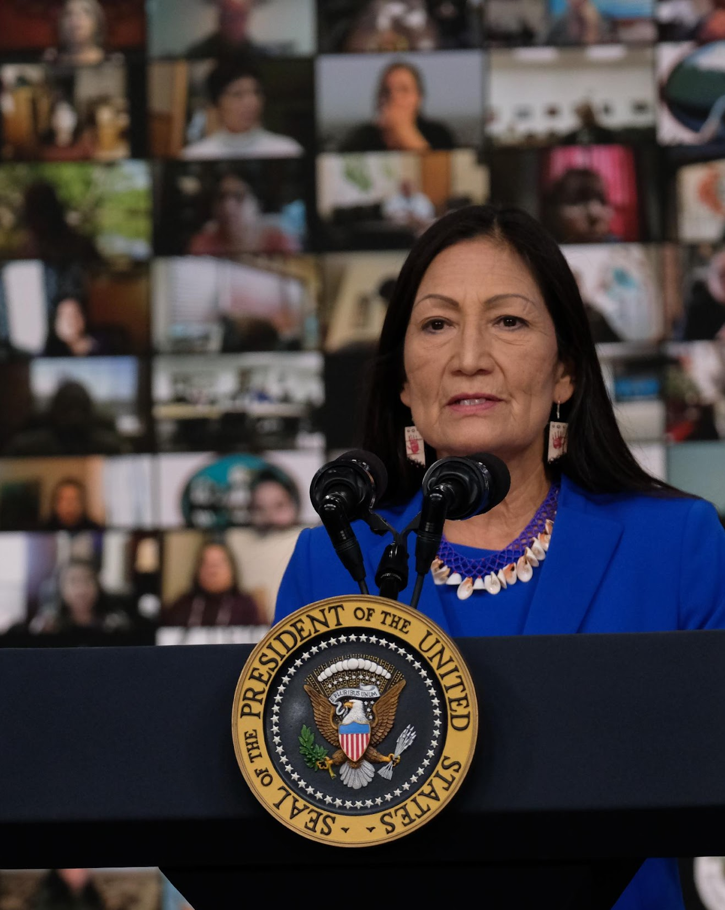
US FEDERAL REPORTS I & II
417 Federal Indian boarding schools
Operated from 1819-1969
Found in 37 states/territories
At least 74 burial sites at 65 schools
Up to 85% of Native children attended (over 19,000 children)
Over $23 billion in federal funds (in inflation-adjusted dollars)

Slide 6
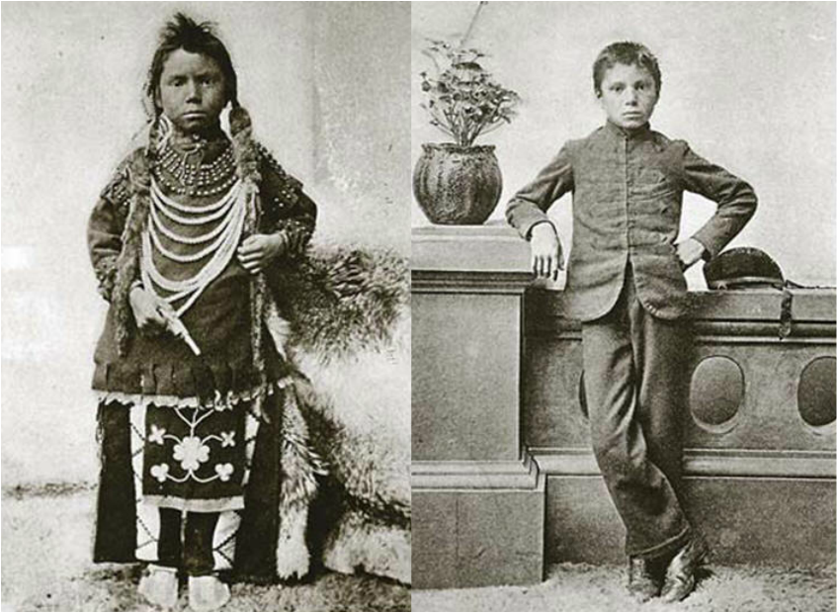
COMMON METHODS TO “CIVILIZE” THE INDIAN
Cut children’s hair
Gave Christian names
Forbade Native language, religion, and cultural practices
Manual labor
Harsh punishments and abuse

Slide 7
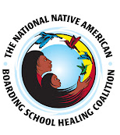
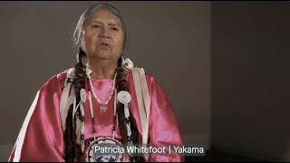
SURVIVOR VOICES
https://www.youtube.com/watch?v=zjUto-mQrfQ

Slide 8
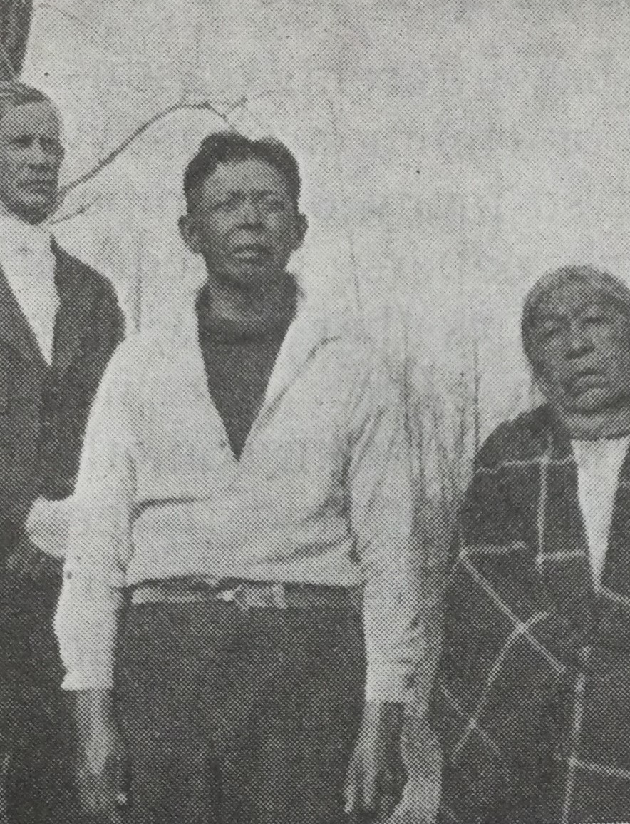
IMPACTS ON NATIVE AMERICANS THEN AND NOW
Physical health problems
Mental and emotional trauma
Addiction as way of coping
Loss of family / tribal connections
Loss of land and wealth
Death

Slide 9
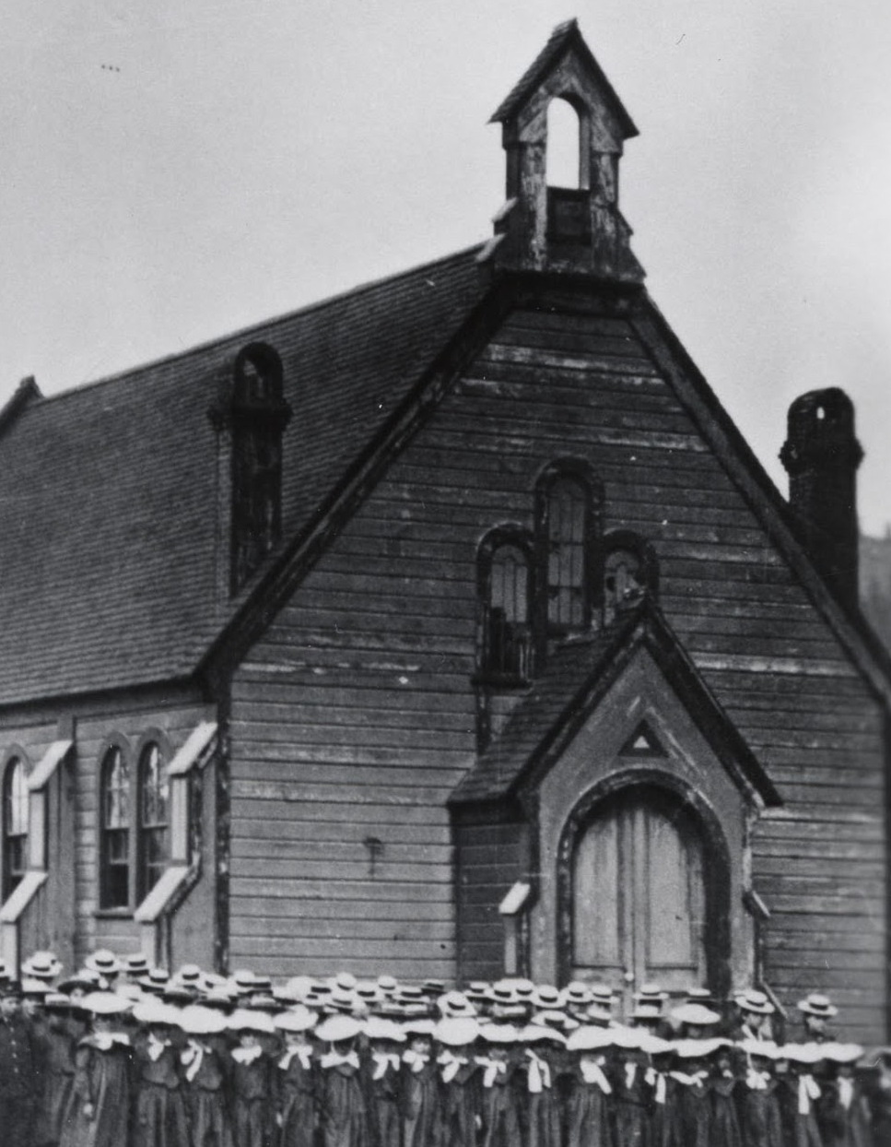
THE ROLE OF RELIGIOUS INSTITUTIONS
Sponsored or operated 50% of federally-funded Indian Boarding Schools
Received money and land from the US government for Indian children to attend
Protestant denominations operated134 of the schools

Slide 10
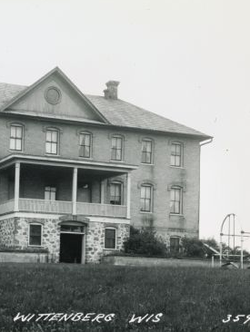
LUTHERAN INVOLVEMENT
Lutherans (ELCA predecessors) are identified in the Federal Report Vol. II as operating one federally-funded school
Bethany Indian Mission and School (Wittenberg, WI)
Investigating other Lutheran-operated schools not federally funded

Slide 11
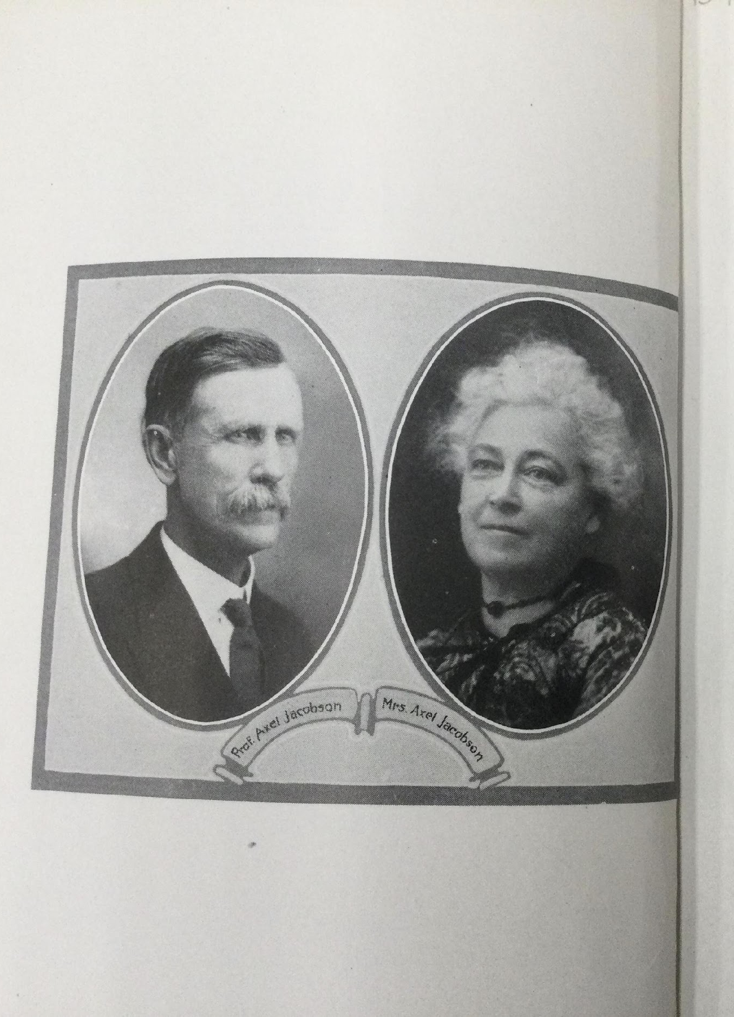
BETHANY INDIAN SCHOOL
Bethany Indian Mission Boarding School operated 1884-1933
The mission and school were founded by Norwegian-American Lutherans

Slide 12
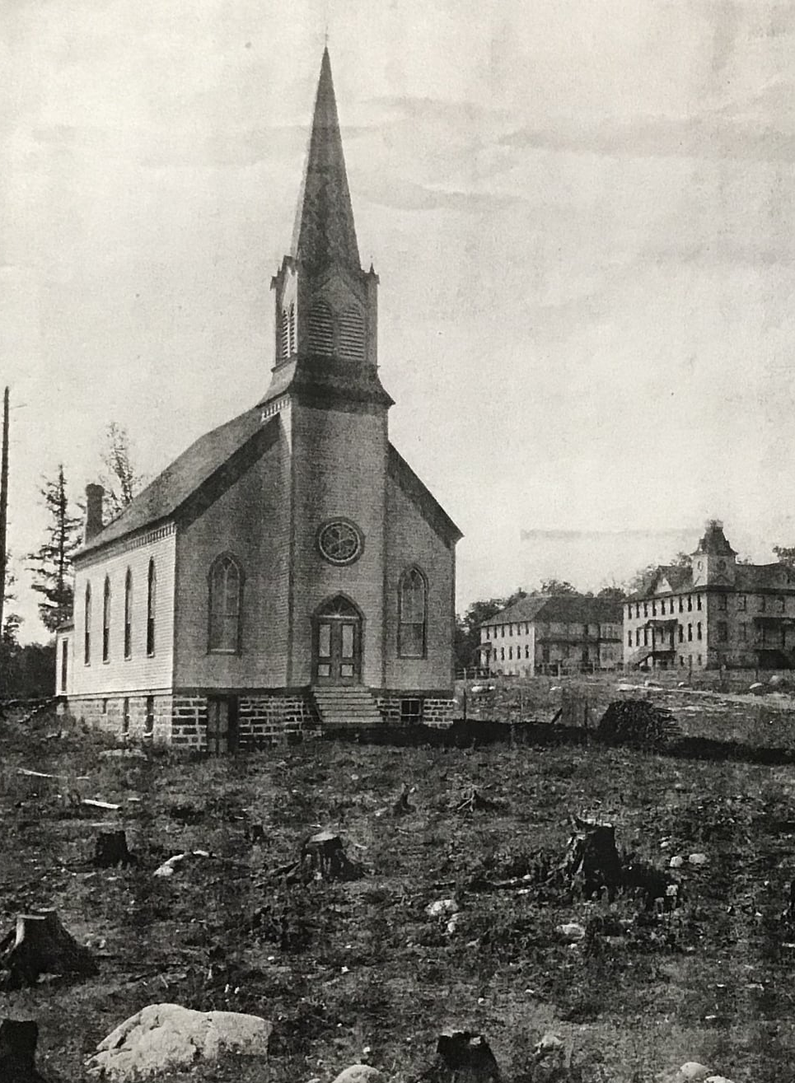
BETHANY INDIAN MISSION and BOARDING SCHOOL
Designed to “aid, educate, and Christianize the local Indigenous community”
Enrolled children from many tribes – Ho-Chunk, Oneida, Potawatomie, Ojibwe, Menominee, Stockbridge-Munsee, Stockbridge Mohican, Brothertown, Mamaceqtaw, and Sioux

Slide 13
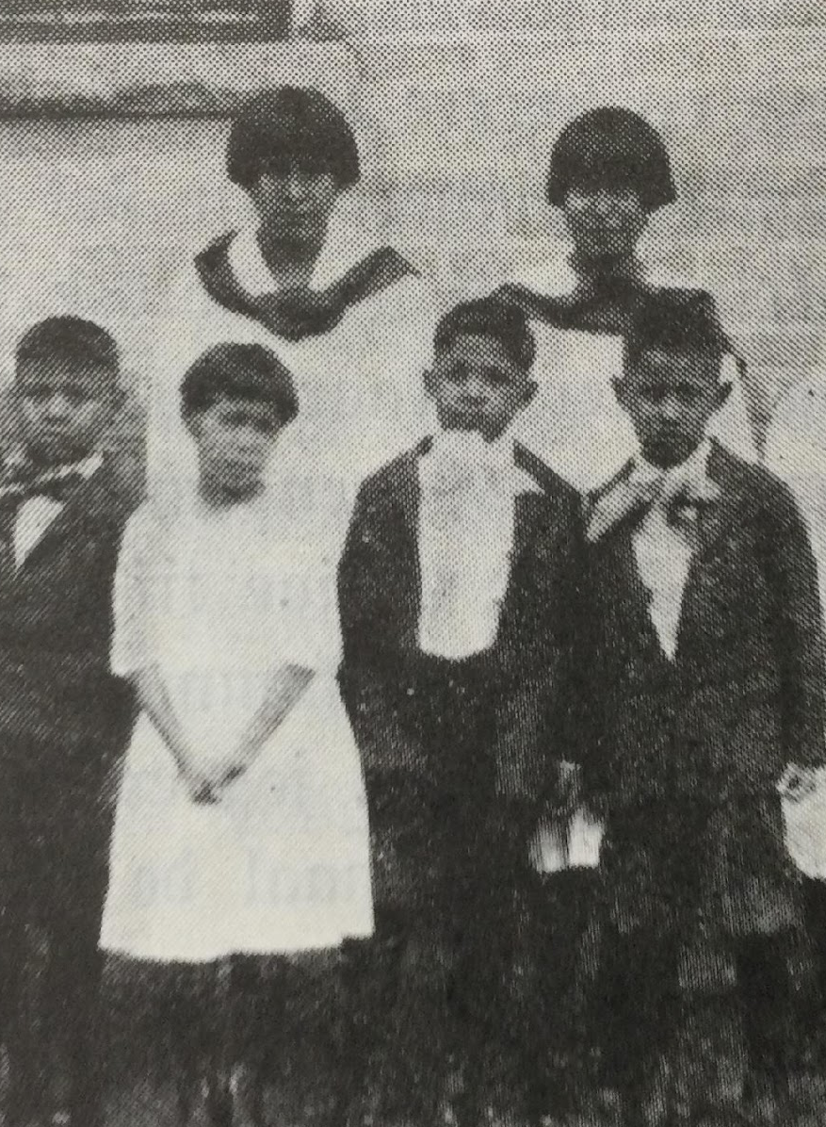
CHILDREN AT BETHANY
Enrolled children ages 6-19
Census of 25-140 students per year
Children stayed at the school October to May
Required to abandon all Native dress, customs, traditions, language, and ceremony

Slide 14
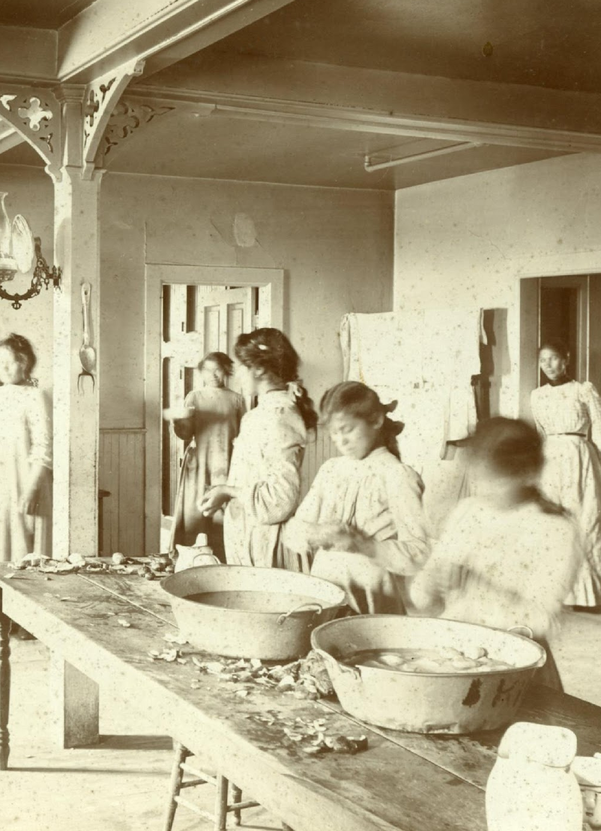
DAILY LIFE AT THE SCHOOL
Lessons in vocational and domestic skills, basic academics, and English language
Devotions and religious instruction
The children were responsible for keeping the mission running through their daily chores (unpaid labor)

Slide 15
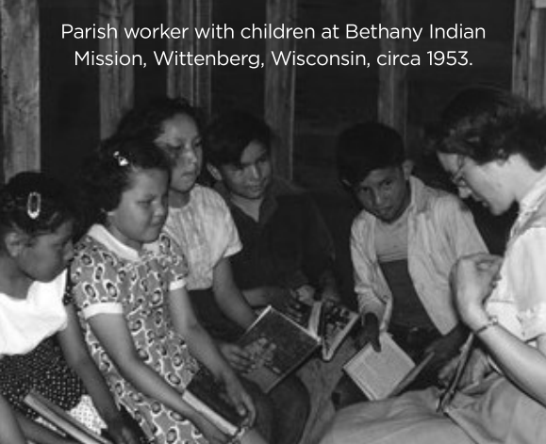
BETHANY INDIAN MISSION SCHOOL HISTORY
1884 – Mission and school opened
1933 - Boarding school closed
1955 - Mission closed, land sold
1962 - Buildings razed
2022 - Archives reviewed and organized
2026 – Digitizing and labeling all records
GOAL: Online access for survivors, descendants, and Tribal nations

Slide 16
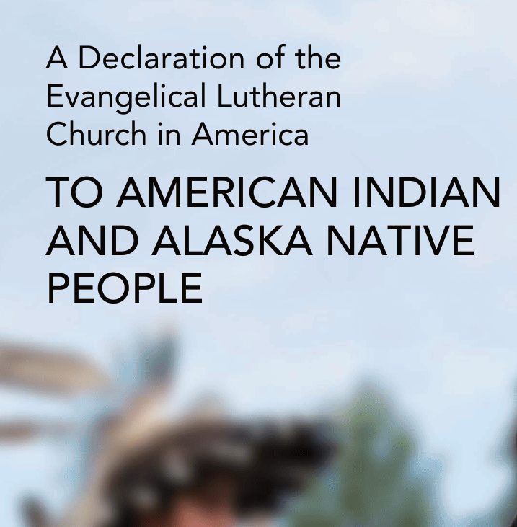
ELCA PATH TO HEALING
2016: ELCA passes resolution on Repudiation of the Doctrine of Discovery
2021: Issues Declaration of the ELCA to American Indian and Alaska Native People
2022: ELCA Truth Seeking & Truth Telling Initiative on Indian Boarding Schools begins
2023: Broader Truth & Healing Movement launches

Slide 17
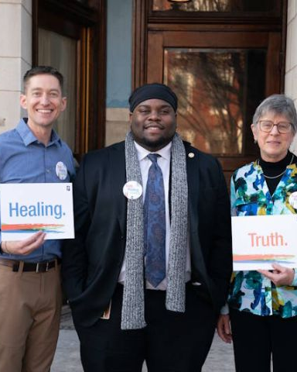
INITIATIVE’S SCOPE
100+ volunteers from 10 states, 27 synods
Expanding to all 65 synods in 2026
Lutheran clergy and lay volunteers
Conduct research, identify records, educate ourselves and others
Quarterly online gatherings, working groups, shared leadership
Numbers as of October 2025

Slide 18
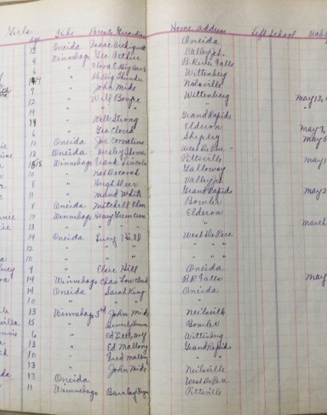
INITIATIVE’S GOALS
The purpose is healing.
The truth-seeking and truth-telling work we are doing is for the sake of the healing of and for Indigenous people.
The information we gather belongs to Indigenous peoples and Tribal nations.

Slide 19
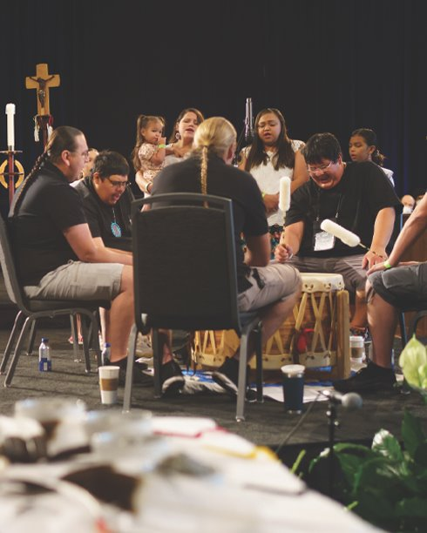
WHY TRUTH & HEALING MATTERS
“Knowing and embracing the truth is the first step toward healing for all of us.” - Bishop Elizabeth Eaton, 2023
Native people deserve to know and have their truth heard. They need healing.
White Lutherans participated in cultural genocide. We need healing.
The legacy of Indian boarding schools impacts Indigenous people across generations.

Slide 20
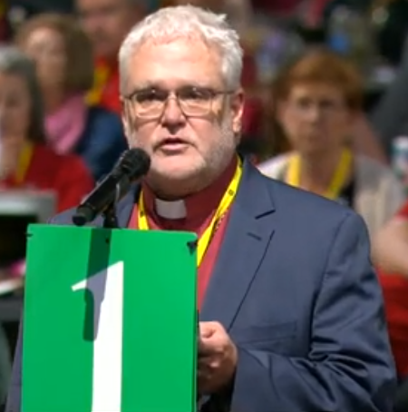
2025 Churchwide Memorial: Indian Boarding School Remembrance
22 synods passed memorials.
Church shall observe National Day of Remembrance (September 30)
Programs & materials will be created for children and adults.
Support and funding for work on locating all records (we expect to find more Lutheran schools).

Slide 21
REFLECTION

Slide 22
GUIDING QUESTIONS
How did the truths you heard today make you feel?
What was new or surprising to you?
Why is it so hard for people to know and believe this information?
What are you pondering? What are you compelled to talk about with others?

Slide 23
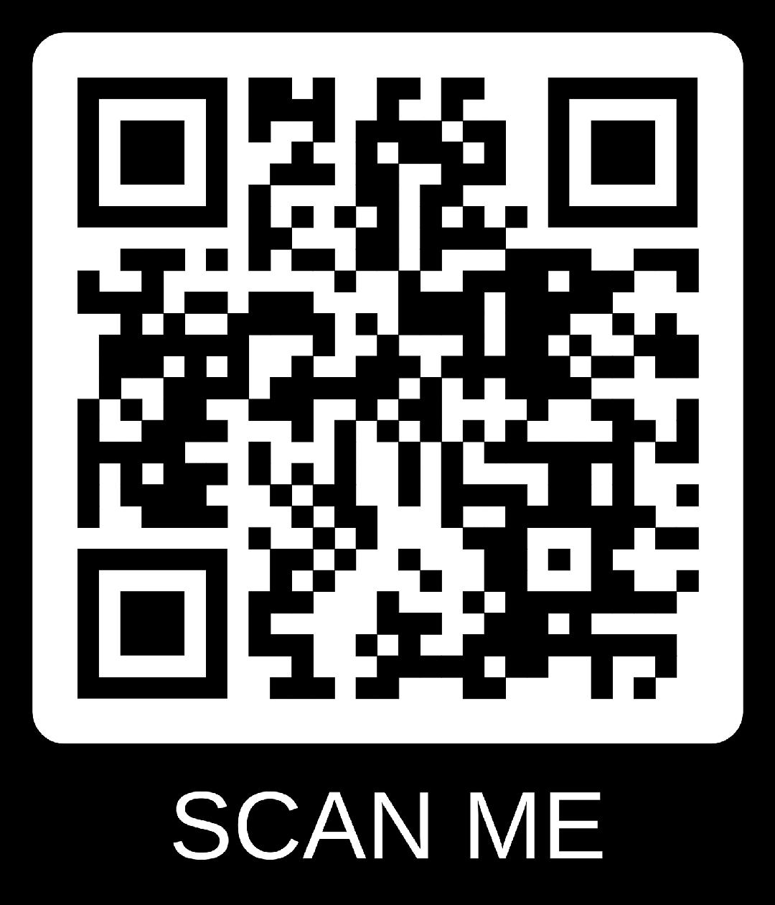
Invitation to Further Involvement
Observe the National Day of Remembrance – September 30
Ongoing education with youth and adults in your congregations
Advocate for national Truth & Healing Commission
Join the ELCA Truth-Seeking and Truth-Telling Initiative

Slide 24
Further Reflection
Where is God calling you in response to the truth that has been shared today?
How might you and your congregation engage in truth-seeking and truth-telling about Indian boarding schools?

Slide 25
Thank You
ELCA Truth-Seeking & Truth-Telling
Initiative on Indian Boarding Schools

