Slide 1
Welcome to the ELCA Candidacy Summit
Thank you for joining us!
The Keynote will Begin Soon
Called to Accompany & Called to Discern
September 14 and 19, 2023

Slide 2
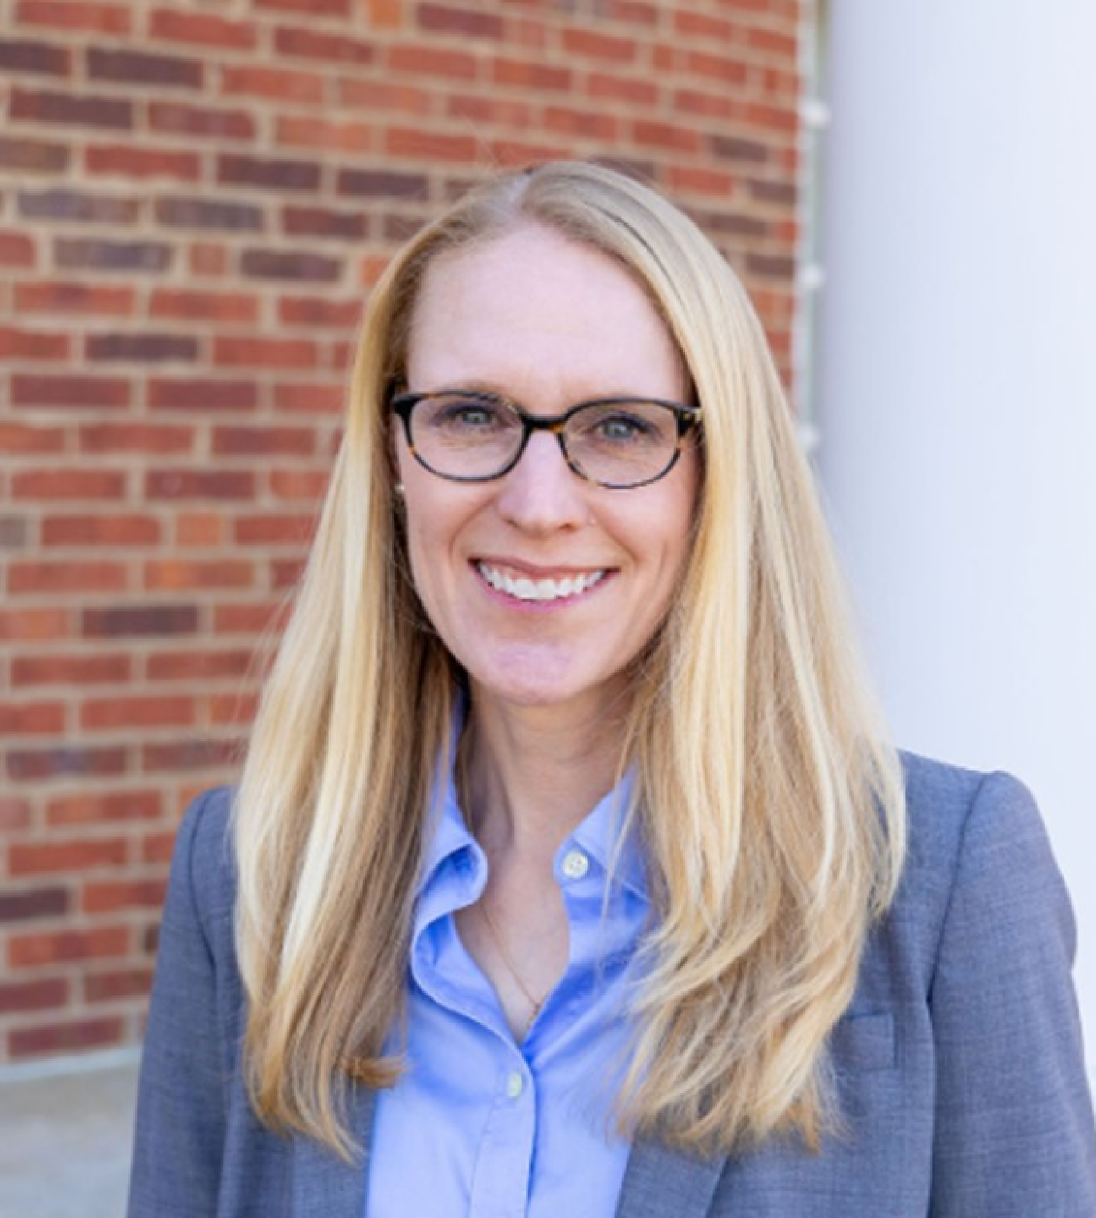
Today’s Keynote Speaker:
The Rev. Sara Cutter (she/her) serves as the Senior Director for Operations in the Christian Community and Leadership Home Area for the ELCA and as the facilitator for the Candidacy and Leadership Working Group (CLDWG). She will share key learnings from the CLDWG's work, and together we will wonder about the role of candidacy committees and maybe share a few dad jokes.

Slide 3
Today’s Schedule:
(all times in Central time)
Keynote: 1:00-2:30
Workshop One: 6:00-7:00
Workshop Two: 7:30-8:30
Thank you for joining us!
The Keynote will Begin Soon

Slide 4
While we gather, let’s learn more about ELCA Ministries
Thank you for joining us!
The Keynote will Begin Soon
Notes:
Ramie and Cherlyne

Slide 5
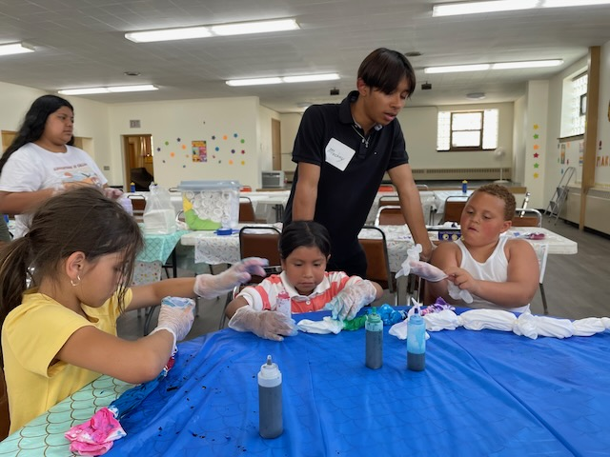
Horizon Apprenticeship Program
This program is designed to help young people of color or whose primary language is a language other than English acquire a missional imagination to help them discern their future and the role that Jesus and the church have in their life.
An ELCA congregation can nominate a young person (or persons) with growing leadership skills in their worshipping community to participate in the program. By nominating the young person, the congregation's leader agrees to oversee their apprentice's summer internship if accepted into the program

Slide 6
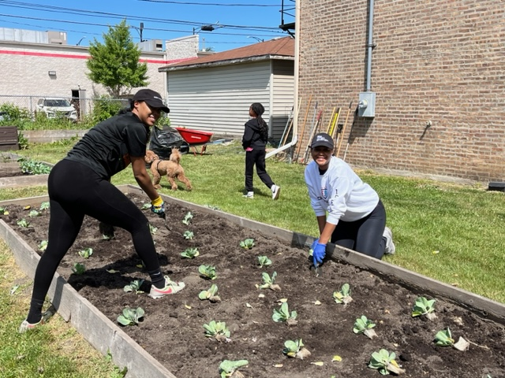
Horizon Apprenticeship Program
Nominees must be enrolled in high school or college and be between the ages of 16 and 20 for the entire program.
For questions or more information contact Cynthia Zamora, Program Director for Horizon Apprenticeship Program, at: Cynthia.Zamora@elca.org

Slide 7

Learn more at: www.elcaymnet.org

Slide 8


www.journi.faith

Slide 9
What is Journi?
… a free tool to help people discern their call to leadership and explore their call…
Podcasts
Videos
Quizzes
Ways to build your leadership toolbox
Spiritual personality quiz
Learn More at: www.journi.faith

Slide 10
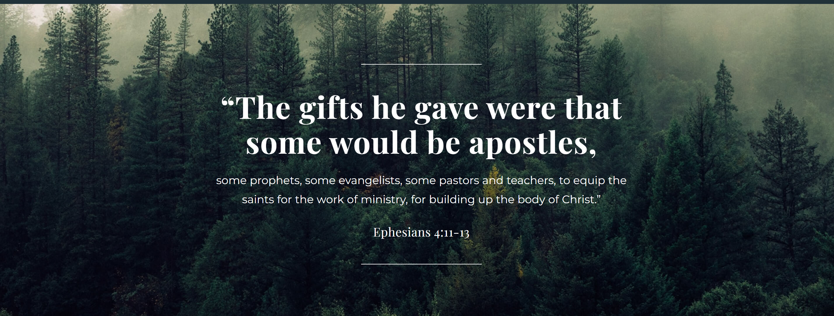
Learn More at:
www.journi.faith

Slide 11

fund for leaders
2022-2023 FFL Scholarships
141 Churchwide Scholarships: $2,328,625
217 Synod/Congregation Scholarships:
$759,833
*NEW* 80 TEEM Scholarships: $400,000
Total Students supported: 375
$3,488,458

Slide 12


Slide 13
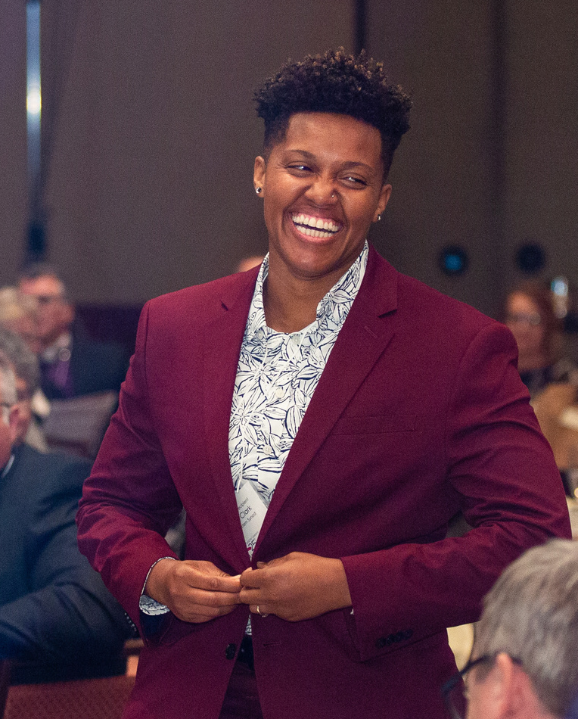
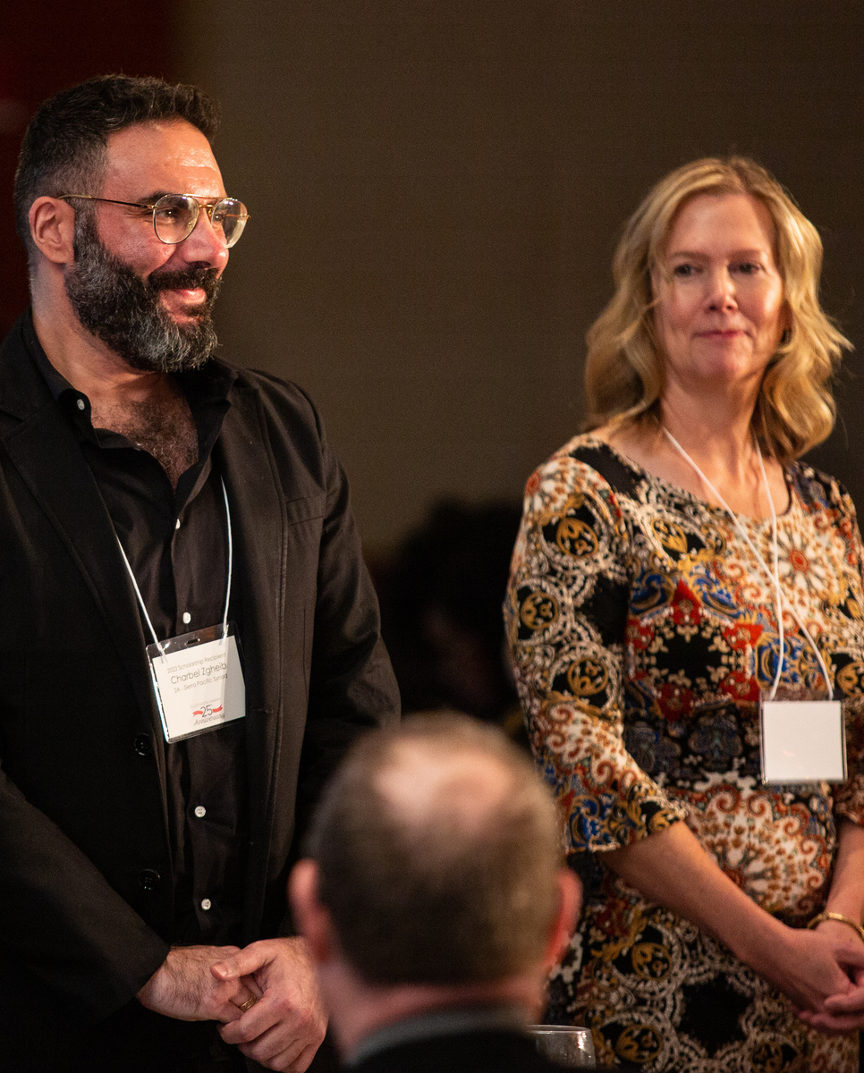
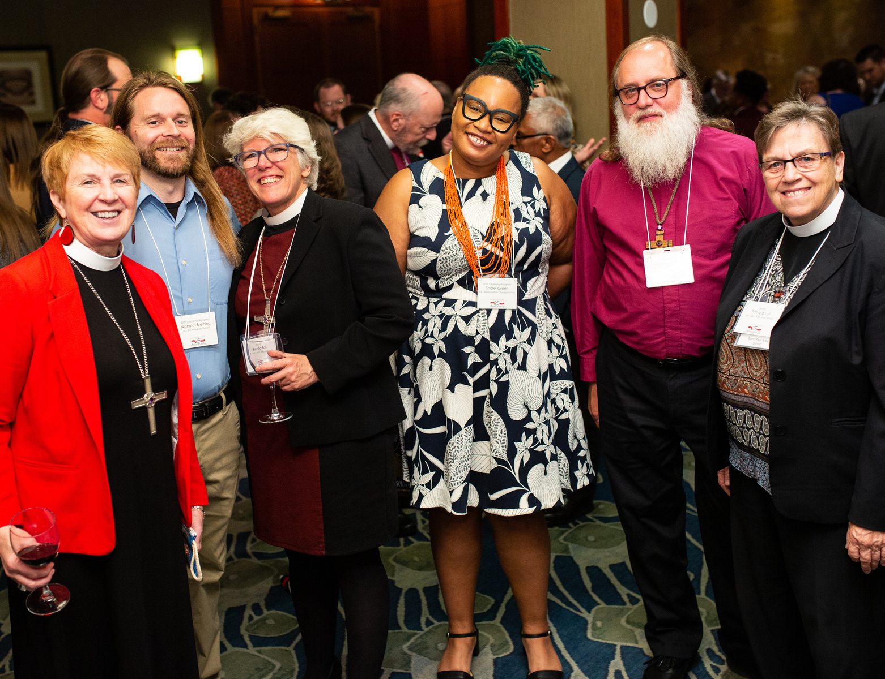

Slide 14
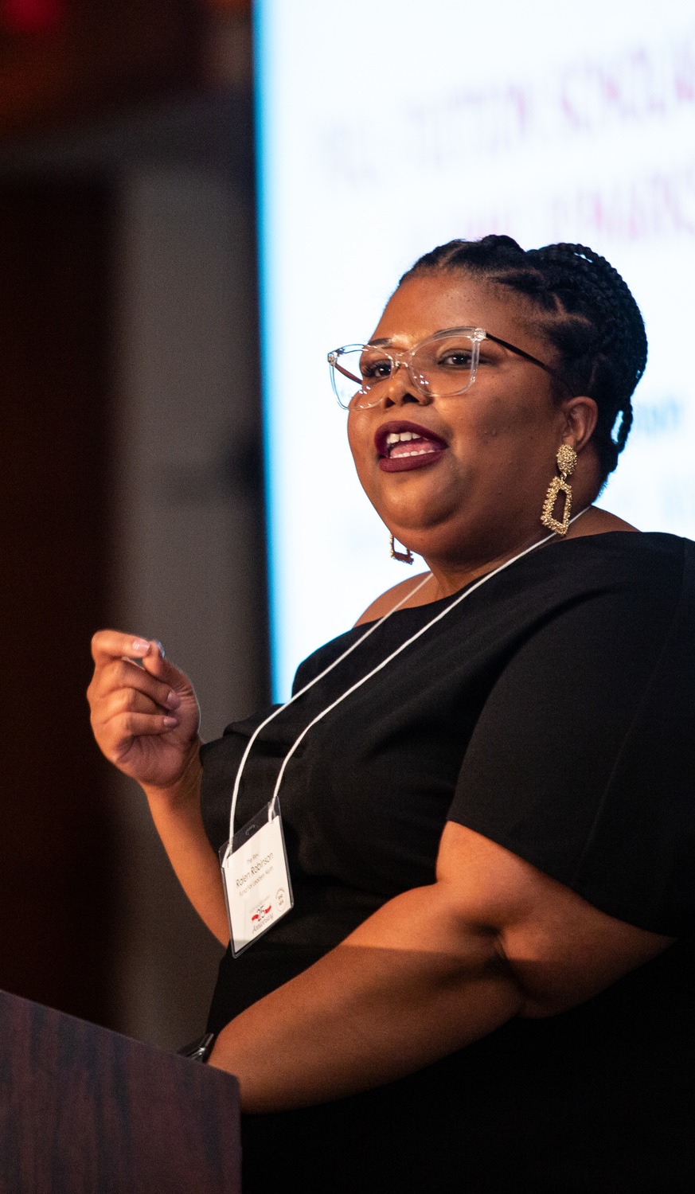
Be A part of
Fund for leaders
ONE WEEK OF TUITION FOR 1 COURSE
$150 gift
ONE MONTH OF TUITION FOR 1 COURSE
$600 gift
ONE SEMESTER OF TUITION FOR 1 COURSE
$2,500 gift

Slide 15
Welcome to the ELCA Candidacy Summit
Thank you for joining us!
The Keynote will Begin Soon
Called to Accompany & Called to Discern
September 14 and 19, 2023

Slide 16
Today’s Keynote Speaker:
The Rev. Sara Cutter (she/her) serves as the Senior Director for Operations in the Christian Community and Leadership Home Area for the ELCA and as the facilitator for the Candidacy and Leadership Working Group (CLDWG). She will share key learnings from the CLDWG's work, and together we will wonder about the role of candidacy committees and maybe share a few dad jokes.

Slide 17
Today’s Schedule:
(all times in Central time)
Keynote: 1:00-2:30
Workshop One: 6:00-7:00
Workshop Two: 7:30-8:30
Thank you for joining us!
The Keynote will Begin Soon

Slide 18
While we gather, let’s learn more about ELCA Ministries
Thank you for joining us!
The Keynote will Begin Soon
Notes:
Ramie and Cherlyne

Slide 19
Horizon Apprenticeship Program
This program is designed to help young people of color or whose primary language is a language other than English acquire a missional imagination to help them discern their future and the role that Jesus and the church have in their life.
An ELCA congregation can nominate a young person (or persons) with growing leadership skills in their worshipping community to participate in the program. By nominating the young person, the congregation's leader agrees to oversee their apprentice's summer internship if accepted into the program

Slide 20
Horizon Apprenticeship Program
Nominees must be enrolled in high school or college and be between the ages of 16 and 20 for the entire program.
For questions or more information contact Cynthia Zamora, Program Director for Horizon Apprenticeship Program, at: Cynthia.Zamora@elca.org

Slide 21


The ELCA’s Resourceful Servants initiative promotes the financial wellness of ELCA congregations, rostered ministers and seminarians.
Learn more by visiting resourcefulservants.org.

Slide 22


Slide 23

https://youtu.be/KhtuFCq7Lyg

Slide 24

Share the video and take the survey at: lovemadereal.elca.org

Slide 25


Holding in Prayer as the church Gathers…
Lutheran World Federation
African Descent Ministries, ELCA

Slide 26
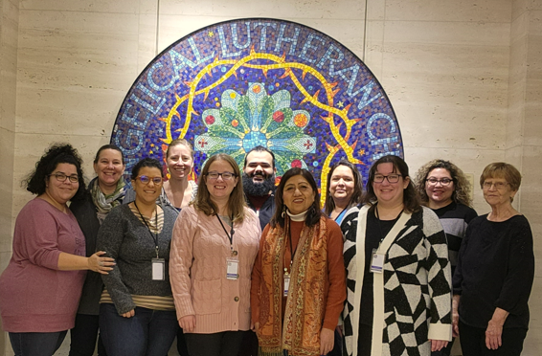
Meet the ELCA Candidacy Team
Chicago Team and Candidacy and Leadership Managers
Notes:
Matta and Maria

Slide 27
Welcome to the ELCA Candidacy Summit
Thank you for joining us!
The Keynote will Begin Soon
Called to Accompany & Called to Discern
September 14 and 19, 2023

