Slide 1
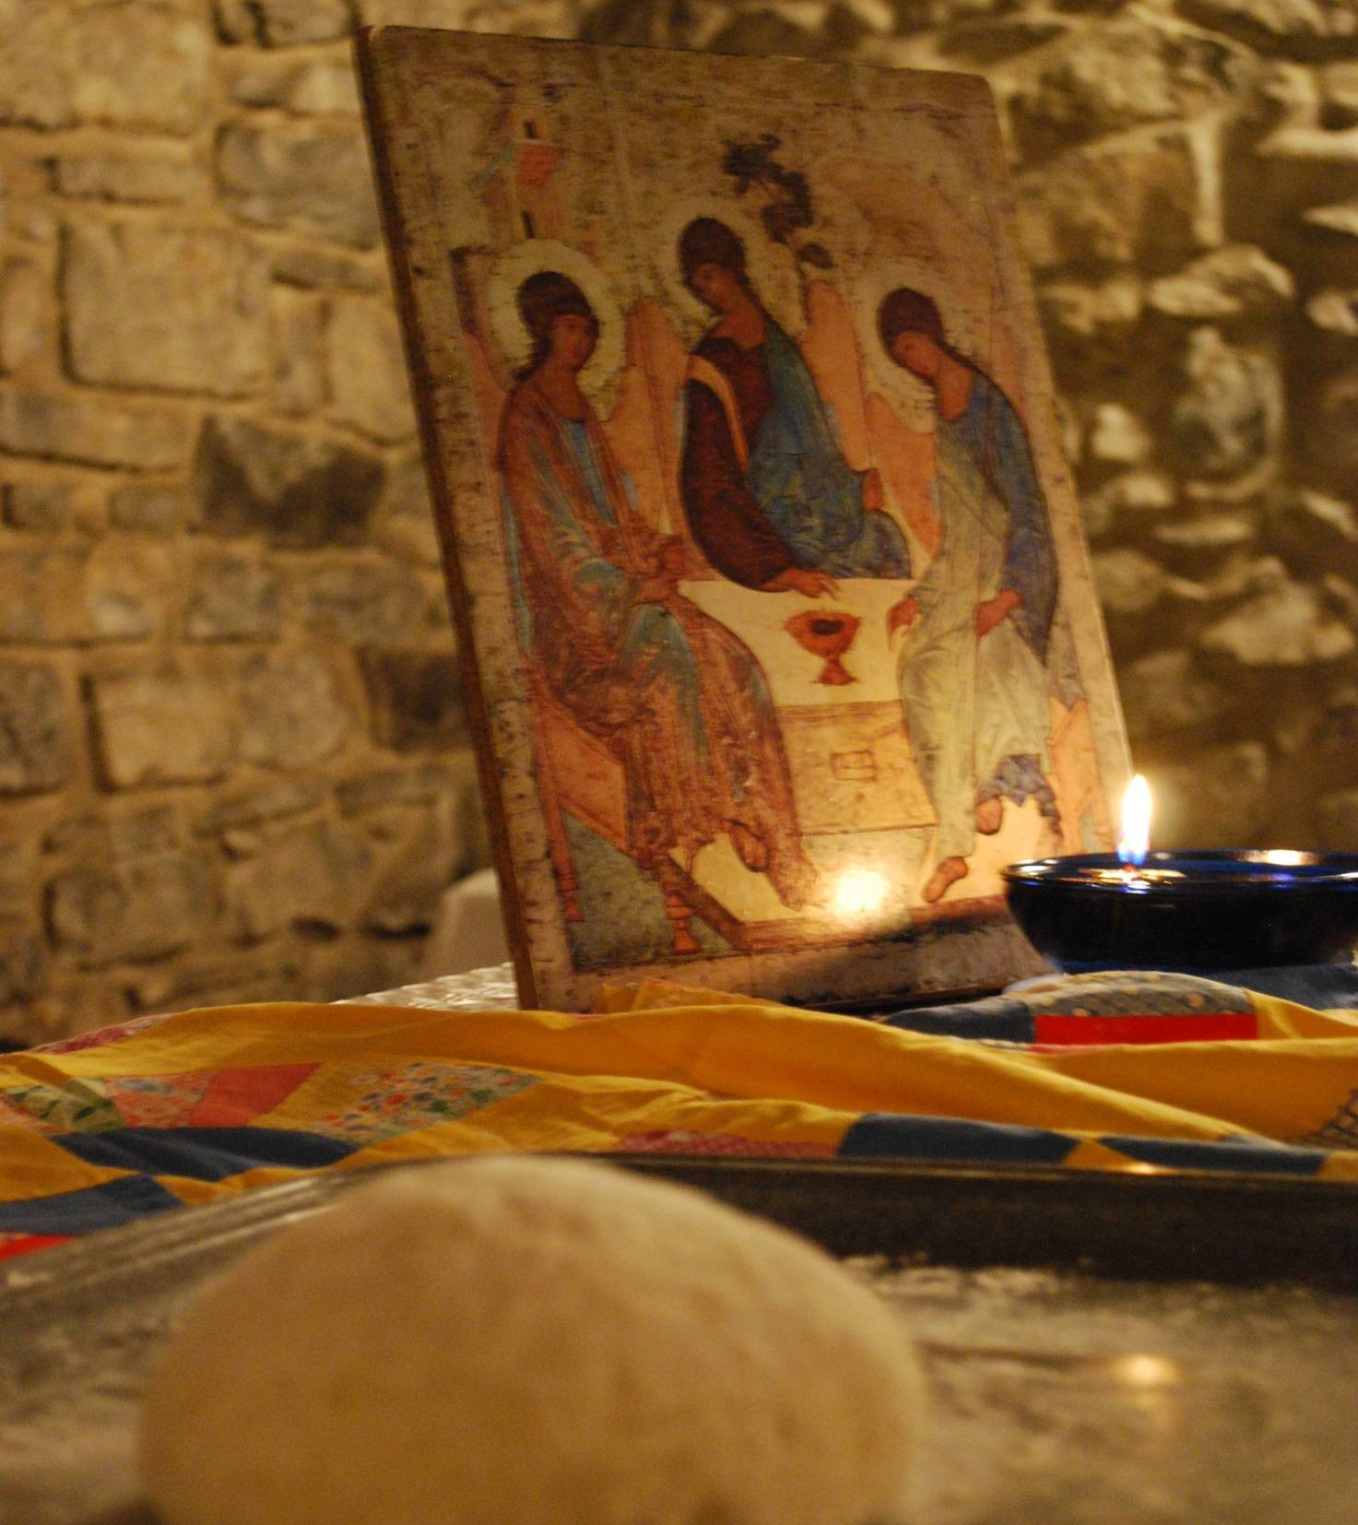
the lutheran world
federation
a communion
of churches
prepared by The LWF North America Regional Office

Slide 2
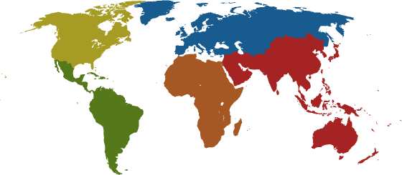
The Lutheran World Federation
A Communion of Churches
Over 70 million people
140 member churches
79 countries
Seven regions
Five continents
*as of 2009

Slide 3
Where Are We?
Africa: 31 churches in 23 countries
Asia: 47 churches in 18 countries
Europe: 43 churches in 25 countries
  Central West, Central East and Nordic Regions
Latin American and Caribbean: 16 churches in 14 countries
North America: 3 churches in 2 countries

Slide 4
In North America…
  The Member Churches in North America are
    Evangelical Lutheran Church in America
    Evangelical Lutheran Church in Canada
    Estonian Evangelical Lutheran Church Abroad
  North America holds five seats out of 48 in the LWF Church Council
  The North American Region has the largest number of non-LWF Lutherans, including Missouri Synod

Slide 5
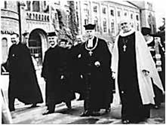
Our Shared History
Founded in 1947 in Lund, Sweden
  47 churches in 26 countries, 8% of the Delegates from the Global South
Originally focused on the aftermath of World War II
  Refugees in Europe
  Future of European missions in Africa and Asia
LWF Founding, Lund, Sweden, 1947

Slide 6
Becoming a Communion
1990: Assembly in Curitiba, Brazil: New Constitution and New Structure as a Communion of Churches
  110 Member churches
  Adequate representation from Asia, Africa, Latin America, and Eastern Europe
  43% Voting Delegates were women
  First time including Delegates from the then-Soviet Union

Slide 7
From Federation to Communion
From free association of churches to acceptance of koinonia (relationship as a gift of God)
From charity-based giving to interdependent sharing
From an agency to an instrument for shared vision and common tasks – giving and receiving
From paternalism (mission for) to mutual and holistic mission (mission with)

Slide 8
Communion is a Gift
A shared faith
A common history
Sense of belonging to the global Communion and growing Regional expressions
Diakonia (service) is at the heart of being a church
“The communio is God’s gift…We do not choose these relationships, nor may we determine to share with some and neglect others.” –Global Mission in the 21st Century, ELCA, 1999

Slide 9
Communion is a Task
The Lutheran World Federation acts on behalf of the member churches in areas of shared concern, such as
  Ecumenical and interfaith relations
  Promotion of peace, human rights, and care for God’s creation
  Humanitarian assistance and community development
  Theology
  Mission (United witness to the Gospel of Christ)

Slide 10
Accompaniment: Shared Model of Mission
Emmaus Road encounter (Lk 24:13-49)
Interaction between contexts, theology, and practice
Where do we discern our context?
  Globalization
  Economic inequity
  Technological change
  Threats to global health
  Violence (religious, cultural, and political)
  Ecological imbalance

Slide 11
Theology and Practice of Mission
The Trinity is a communion in mission, empowering and accompanying the One who is sent, the beloved, to impact the world with transformation, reconciliation, and empowerment.*
  God, the Creator, transforms
  Jesus, the Redeemer, reconciles
  The Holy Spirit, the Sustainer, empowers
* From Mission in Context, 2004

Slide 12
Our Holistic Mission
The Mission of The Lutheran World Federation is holistic – addressing the whole person, the whole Gospel, and the whole of humanity and creation
The holistic mission:
  Proclamation – sharing the Good News in Christ
  Diakonia – service to all in Christ
  Advocacy – working to change power structures and relationships

Slide 13
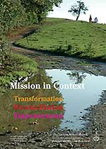
Mission in Context
Learn more about the mission of The LWF from Mission in Context, published in 2004
Forthcoming: Diakonia in Context, Spring 2010
Available online at www.lutheranworld.org

Slide 14
Instruments of Action
Coordination, Planning, and Communications
General Secretariat
Advocate for justice and peace, human rights
International Affairs and Human Rights
Lutheran Office for World Community
Mission together among member churches
Department for Mission and Development
140
LWF
Member
Churches
Upholding the right of the poor and the oppressed
Department for World Service
Deepening faith through engaging theology
Department for Theology and Study
Unity of the Church
Ecumenical Affairs

Slide 15
Common Work
Programs
  emanate from member churches
  are multi-church endeavors at a global and regional level
  facilitated by various LWF departments
Projects
  initiated, planned, implemented and coordinated by an individual member church
  coordination, assessment, and fundraising by The LWF

Slide 16
Department for Mission and Development
Coordinates work shared and guided by member churches
  More than 50 projects approved every year
  Up to 300 projects simultaneously
Global and regional programs on issues such as illegitimate debt, diakonia, sustainable development, capacity building, poverty, theological education
  Focus on inclusion of youth and women
Global campaign against HIV/AIDS

Slide 17
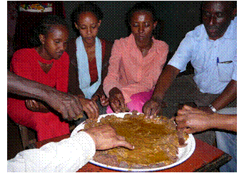
Department for Mission and Development
Manasibu Wareda Food Security
(The Ethiopian Evangelical Church Mekane Yesus)
  More than 6000 households benefit
  Soil and water conservation, distributing seeds
India, HIV-AIDS Awareness, Cure and Prevention
  Care and support programs for more than 4500 individuals.
  34 training programs covered 1209 leaders.
  Continued educational support and accompaniment for sex workers.

Slide 18
Department for World Service
36 Field programs
  Focus on leadership by local people
  40 International and 5,700 Local staff/HQ Coordinating Staff
  4 Regional, 20 Country-level, and 12 Associate Field Programs
112.3 Million dollars (2008)
Emergency relief and long term commitment for long term
development

Slide 19
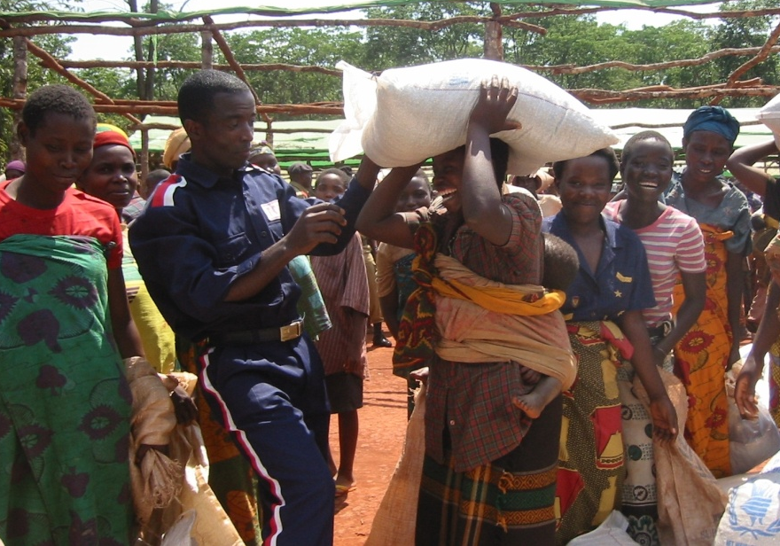
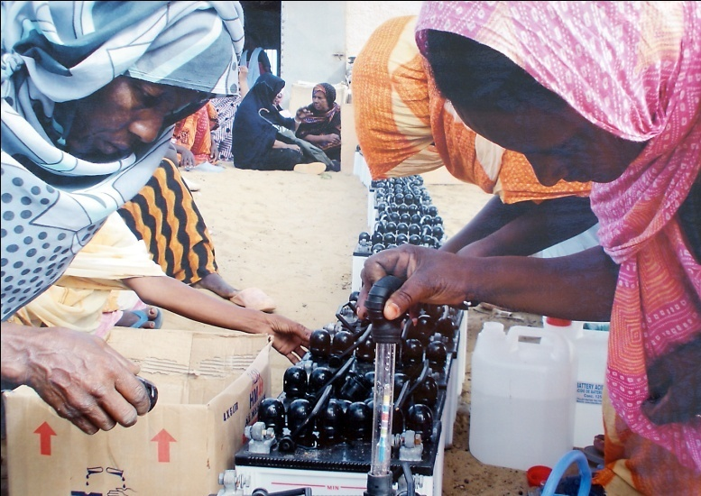
Department for World Service
Kenya and Tanzania: Long-term refugee camps in areas of persistent food shortages and violence
Mauritania: Train local women how to build simple solar generators for remote villages

Slide 20
Department for
Theology and Studies
Deepening faith through engaging theology
Facilitates regional and global conversations between theologians
Current focus on “Theology in the Life of the Church”
Publishes books, pamphlets and position papers on issues of concern to Lutherans around the world

Slide 21
International Advocacy
The LWF is a United Nations-recognized non-governmental organization through:
Office for International Affairs and Human Rights (IAHR)
  Located in Geneva, Switzerland
  Works with United Nations on refugee issues and human rights
Lutheran Office for World Community (LOWC)
  Located in New York City
  Works with United Nations Security Council and
  the UN Commission on the Status of Women

Slide 22
Office for Ecumenical Affairs
Joint Declaration on the Doctrine of Justification (1999) – a new doctrinal understanding with the Roman Catholic church
Final stages of formal apology to Anabaptist churches (Mennonites) for violence during Reformation
Developing relationships with the Independent Lutheran Council (Missouri Synod)
Ongoing dialogue with Roman Catholics, Baptists, Anglicans, Methodists, Orthodox, Reformed, and Seventh-Day Adventists

Slide 23
Governance:
Growing in Communion
Assembly held every six to seven years
Each Member Church sends Delegates
Between Assemblies, the Church Council makes executive decisions based on guidance of Assembly
Ongoing Renewal Process in The LWF continues to find ways to better serve God’s mission
Next Assembly: Stuttgart, Germany, July 2010

Slide 24
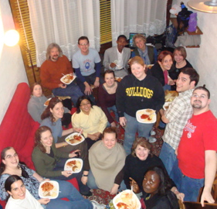
Inclusivity in Governance
Communion of equals
All Decision-making Bodies must include:
  50% women, 50% men
  50% from global South, 50% from global North
  Among these, 20% must be youth (18-30)

Slide 25

Be a part of…
Eleventh
LWF
Assembly
Stuttgart, Germany
July 2010

Slide 26
The Eleventh LWF Assembly in Your Community
Pray – for our leaders, delegates, staff, volunteers, and global community
Learn – with Assembly Bible Study on the Assembly theme
Sing – use the Assembly theme hymn in your worship
Eat - a meal together inspired by Food for Life: Recipes and Stories on the Right to Food (NA edition)
Listen - messages from five regional and two global Pre-Assemblies
Watch from home – live online from July 20-27
www.lwf-assembly.org and www.elca.org/lwf

Slide 27

Food for Life
All people have a right to food – The LWF works in many countries towards food security
A unique recipe and story book reflecting the work of The LWF in serving the hungry and dispossessed
Special North American edition available from Augsburg Fortress
Accompanying resources and reflections available from our website at elca.org/lwf

Slide 28
Share
The LWF Endowment Fund supplements financial support for the work of the Lutheran communion.
  In the ELCA, please send checks payable to
  The LWF Endowment Fund
  c/o ELCA Foundation
  8765 W Higgins Road
  Chicago, IL 60631
  In the ELCIC, please contact
  Trina Gallop, Director of Communications and Stewardship
  tgallop@elcic.ca
  204.984-9172

Slide 29
Share
To support LWF Projects and Programs, individuals or congregations can give a tax-deductible donation through
  ELCA www.elca.org
  ELCA World Hunger www.elca.org
  ELCIC www.elcic.ca
  Canadian Lutheran World Relief www.clwr.org
Please specify that your donation is intended for LWF
You may also specify which project or program you would like to support

Slide 30
Act
Celebrate LWF Sunday with the global Communion
  United States: first Sunday in October
  Canada: last Sunday in October
  Each year’s focus and worship resources are highlighted in Lutheran World Information (LWI) Special Edition for LWF Sunday
  Sermons, prayers, songs, studies…be creative!

Slide 31
Act
Pray for the Communion and its member churches
Celebrate belonging to the Communion
Subscribe or get the news from Lutheran World Information, online at lutheranworld.org under “news”
Practice holistic mission in your local context
Here in North America, when you act, The LWF acts – you are the face of The Lutheran World Federation

Slide 32
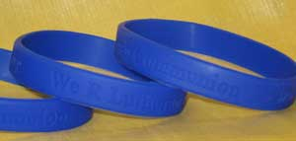
Be a Multiplier!
Share this resource
Tell your Communion story
Show your connection and support a program with an LWF Wristband – learn more at www.elca.org/lwf
Let people know you belong!

Slide 33
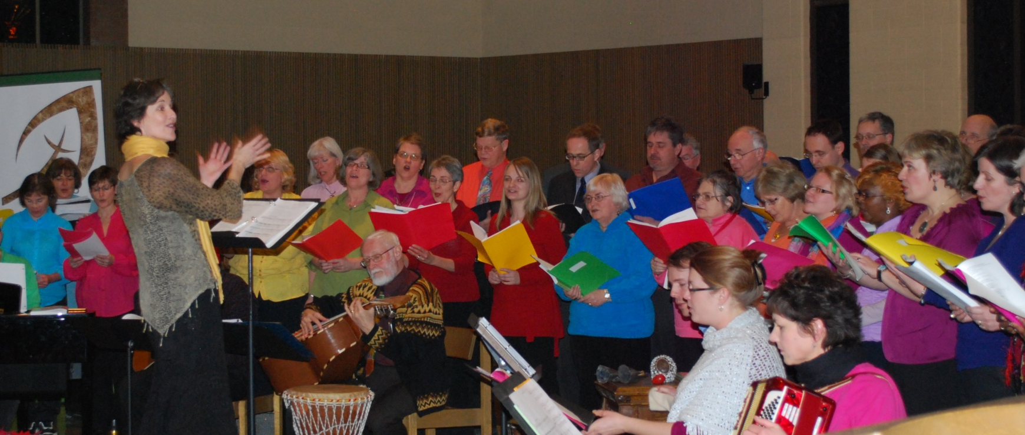
The Communion is Here…
making a difference with one another in living out God’s holistic mission – transforming, reconciling and empowering.

Slide 34
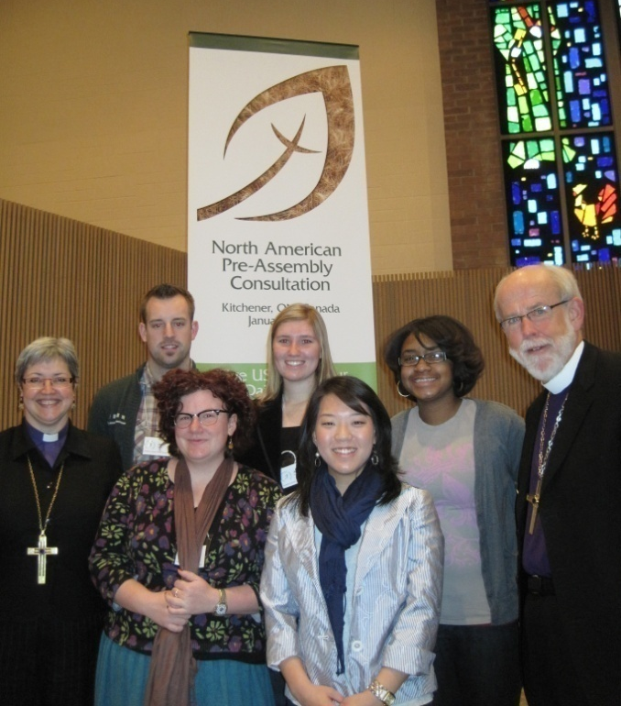
What would mission look like in North America... if our identity is understood and lived as part of a global Communion of Churches?

Slide 35
A Communion that gives and receives…
What do North Americans receive from The Lutheran World Federation as a member church?
Why is it important to belong to a communion?
Who do we (the member churches in North America) become as we mature and act in our communion relation, within our region and beyond?

Slide 36
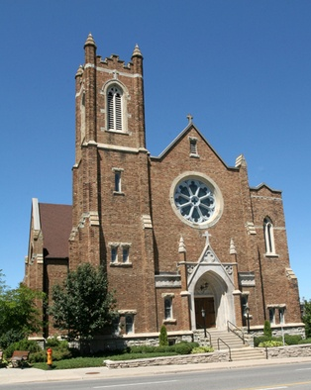
We Belong
Imagine your congregation…
St Matthew’s Lutheran Church,
A Congregation of the Evangelical Lutheran Church in Canada,
A Member Church of
The Lutheran World Federation - A Communion of Churches
St Matthew’s Lutheran Church, Kitchener, Ontario, Canada

Slide 37
Credits
Photographs:
  Cover: Rev. Teresita Valeriano, 2009
  5: Lund, Sweden, LWF Archives
  12: LWF Mission in Context cover
  16: LWF DMD Ethiopia, J. Schep
  18: LWS DWS, Tanzania, Mauritania
  23: LWF NA, Communion Formation 2009
  24: LWF General Assembly Logo 2010
  26: LWF, Food for Life cover, Ryan Spencer Reed
  30: LWF NA, wristbands
  31: LWF NA, Pre-Assembly, 2010
  32: LWF NA ,Pre-Assembly, 2010
  34, St Matthew’s Lutheran Church, Kitchener, ON, Canada
Concept and Content: Rev. Teresita Valeriano for LWF NA
Layout: Jennifer Snow

