Slide 1
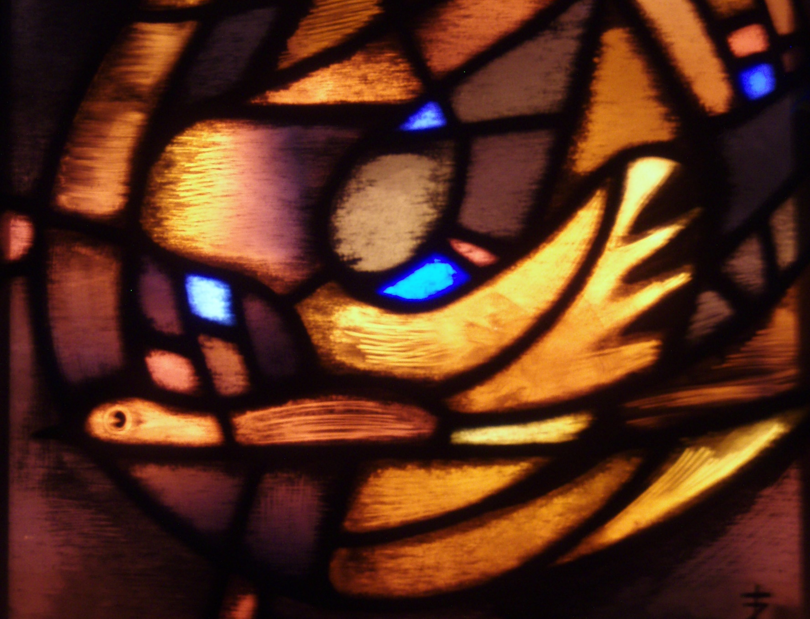
accompaniment: a shared model of mission
transforming
reconciling
empowering
the lutheran world federation: a communion of churches

Slide 2
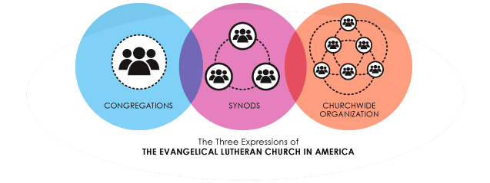
Our Relation: Expressions of the Church
The Lutheran World Federation, A Communion of Churches – a Fourth Expression?

Slide 3
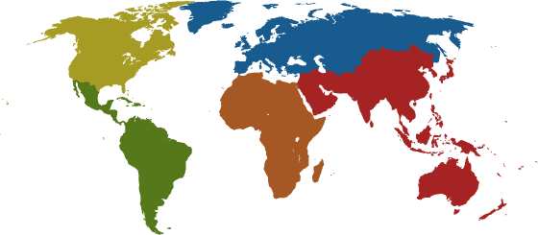
The Lutheran World Federation
A Communion of Churches
Over 70 million people
140 member churches
79 countries
Seven regions
Five continents
*as of 2009

Slide 4
Where Are We?
Africa: 31 churches in 23 countries
Asia: 47 churches in 18 countries
Europe: 43 churches in 25 countries
Central West, Central East and Nordic Regions
Latin American and Caribbean: 16 churches in 14 countries
North America: 3 churches in 2 countries

Slide 5
In North America…
The Member Churches in North America are
Evangelical Lutheran Church in America
Evangelical Lutheran Church in Canada
Estonian Evangelical Lutheran Church Abroad
The North American Region has the largest number of non-LWF Lutherans, including Missouri Synod
There are more Lutherans in Asia than in North America
ELCA now fourth largest Lutheran church; two African churches are larger
ELCA has 65 synods, with over 120 international companion relationships

Slide 6
Communion is a Gift
A shared faith
A common history
Sense of belonging to the global Communion and growing Regional expressions
Diakonia (service) is at the heart of being a church
“The communio is God’s gift…We do not choose these relationships, nor may we determine to share with some and neglect others.” –Global Mission in the 21st Century, ELCA, 1999

Slide 7
Communion is a Task
The Lutheran World Federation acts on behalf of the member churches in areas of shared concern, such as
Ecumenical and interfaith relations
Promotion of peace, human rights, and care for God’s creation
Humanitarian assistance and community development
Theology
Mission (United witness to the Gospel of Christ)

Slide 8
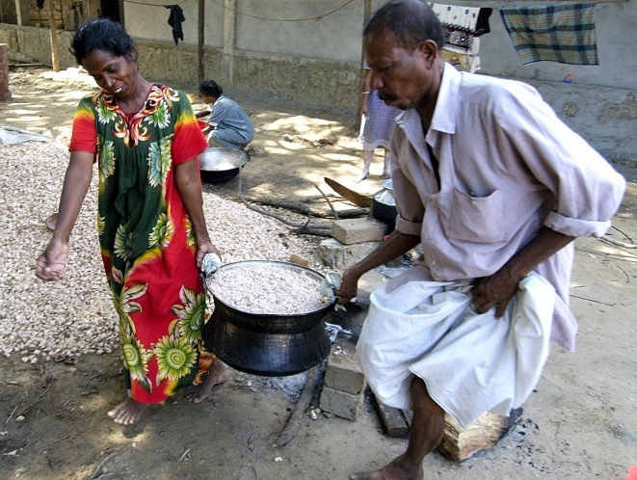
Accompaniment: Shared Model of Mission
Emmaus Road encounter (Lk 24:13-49)
Interaction between contexts, theology, and practice
What was the context of the story?
If Jesus asked us “what things?” what would we say about our present context?
* From Mission in Context, 2004

Slide 9
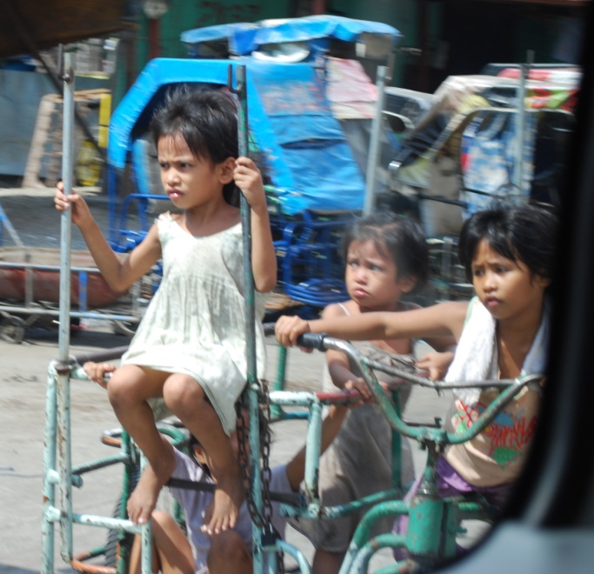
Discerning our Context*
Where do we discern our context?
Globalization
Economic inequity
Technological change
Threats to global health
Violence (religious, cultural, and political)
Ecological imbalance
* From Mission in Context, 2004

Slide 10
Theology and Practice of Mission
The Trinity is a communion in mission, empowering and accompanying the One who is sent, the beloved, to impact the world with transformation, reconciliation, and empowerment.*
God, the Creator, transforms
Jesus, the Redeemer, reconciles
The Holy Spirit, the Sustainer, empowers
* From Mission in Context, 2004

Slide 11
Our Holistic Mission
The Mission of The Lutheran World Federation is holistic – addressing the whole person, the whole Gospel, and the whole of humanity and creation
The holistic mission:
Proclamation – sharing the Good News in Christ
Diakonia – service to all in Christ
Advocacy – working to change power structures and relationships

Slide 12
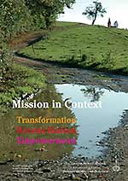
Mission in Context
Learn more about the mission of The LWF from Mission in Context, published in 2004
Forthcoming: Diakonia in Context, Spring 2010
Available online at www.lutheranworld.org

Slide 13
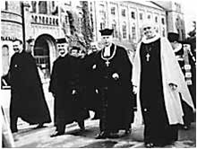
Becoming a Federation
Founded in 1947 in Lund, Sweden
47 churches in 26 countries, 8% of the Delegates from the Global South
Originally focused on the aftermath of World War II
Refugees in Europe
Future of European missions in Africa and Asia
LWF Founding, Lund, Sweden, 1947

Slide 14
Becoming a Communion
1990: Assembly in Curitiba, Brazil: New Constitution and New Structure as a Communion of Churches
110 Member churches
Adequate representation from Asia, Africa, Latin America, and Eastern Europe
43% Voting Delegates were women, 15.6% youth
First time including Delegates from the then-Soviet Union

Slide 15
From Federation To Communion
Independence and Interdependence
There is no stronger or weaker partner or isolation; none is complete without the others
Bilateralism and Multilateralism
Bilateral = two-sided: companion relationship
Multilateral = many-sided: communion relationship
The Companion Synod program is a concrete expression of the communion fellowship among the 140 member churches of the Lutheran World Federation.

Slide 16
From Federation to Communion
Mutuality
Formed in communion with God and others
Reciprocity: giving and receiving, claims and counterclaims, needs and responses
We keep both our independence and interdependence
Definition of mutual: felt by each: done, felt, or expressed by each toward or with regard to the other
* Encarta Dictionary, 2010

Slide 17
From Federation to Communion
Sustainability
God created all that is – an interdependent web of life
Our relationship is multilateral
To be sustainable means that our relationship and its expressions have to be holistic, inclusive, participatory, respectful of various cultures and spirituality, empowering, promoting and practicing justice and peace

Slide 18
From Federation to Communion
In our context as the church in North America, what are some challenges to practicing mutuality in our relationships with other member churches?
How do we practice mutuality in our local context?
Is mutuality different for our neighbor from a different culture or country? How?

Slide 19
From Paternalism to Equality
“When you advance the idea of a Communion of equals between North and South, there is a lot of paternalism to reverse. We are speaking about the work of the LWF for the next twenty years.” Gunnar Staalsett, General Secretary of LWF, at Curitiba Assembly, 1990.
“Us” and “Them”
Self-sufficiency and dependence
Donor/rich/able (here) and recipient/poor/vulnerable (out there)
Mission out there/mission in here
“We” Together
Strength and struggle of intentional Communion
Moving towards reconciled diversity

Slide 20
From Paternalism to Equality
Vulnerability
Our communion is not about we bring, but what God has brought about already.* All depend on and receive from God
Being in Communion is not based on our efforts or our ability to perform a task, but on God’s actions of grace and justification. In Christ, we are all transformed, reconciled, called to love.
How do we as North Americans name and share our vulnerability? To whom do we tell our stories?
*Karen Bloomquist

Slide 21
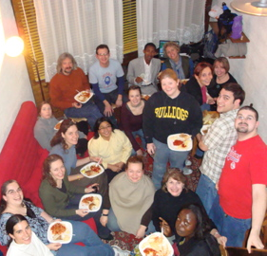
From Paternalism to Equality
Inclusivity
All programs and projects ask the question: Who is included, whose needs are met?
Communion of equals
All Decision-making Bodies must include:
50% women, 50% men
50% from global South, 50% from global North
Among these, 20% must be youth (18-30)

Slide 22
From Paternalism to Equality
What does ALL mean to you?
In your local community, who makes the decision on who is in or out, invited or not?
In your local community, who makes the decisions on whose needs are met? How are these decisions made?

Slide 23
From Naivete to Conscientization
Naivete is the state of being unaware of what is really happening – often, being unaware of power and how it is exerted
Conscientization is the complex process of awareness and liberation*
Becoming aware of power is the first step in Empowerment in finding our voices and moving towards freedom
*Paolo Freire

Slide 24
From Naivete to Conscientization
Empowerment
“The process of increasing the capacity of individuals or groups to make choices and to transform those choices into desired actions and outcomes.” (World Bank)
What might empowerment mean for those who are “powerful”? Should this definition include empowerment of those in power?

Slide 25
From Naivete to Conscientization
Empowerment
Through the LWF Department of Mission and Development, churches work together on a comprehensive capacity-building program including:
Management and leadership skills
Strategic planning, project planning, writing, monitoring, evaluation and reporting (PME)
Organizational and financial sustainability
Theological training and reflection
Inclusiveness (gender, generations, disabilities)
Diakonia and other social ministries
Conflict resolution and peace building

Slide 26
From Naivete to Conscientization
Emmaus Road Story
Where is Empowerment here, especially verse 35?
How are we empowered as disciples?
What do we think “power” is?
Where do we see “power”?
Are we aware of power? How can we become aware?
Is there a relationship between Empowerment and Vulnerability? How could we describe it?

Slide 27
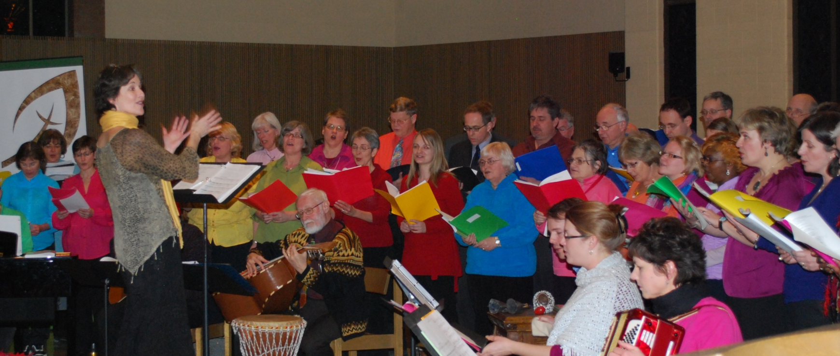
The Communion is Here…
making a difference with one another in living out God’s holistic mission – transforming, reconciling and empowering.

Slide 28
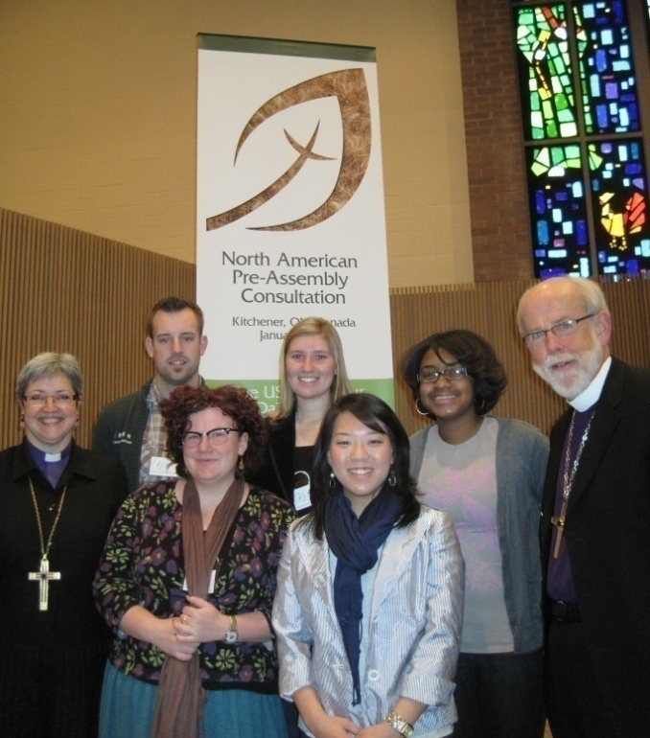
What would mission look like in North America... if our identity is understood and lived as part of a global Communion of Churches?

