Slide 1

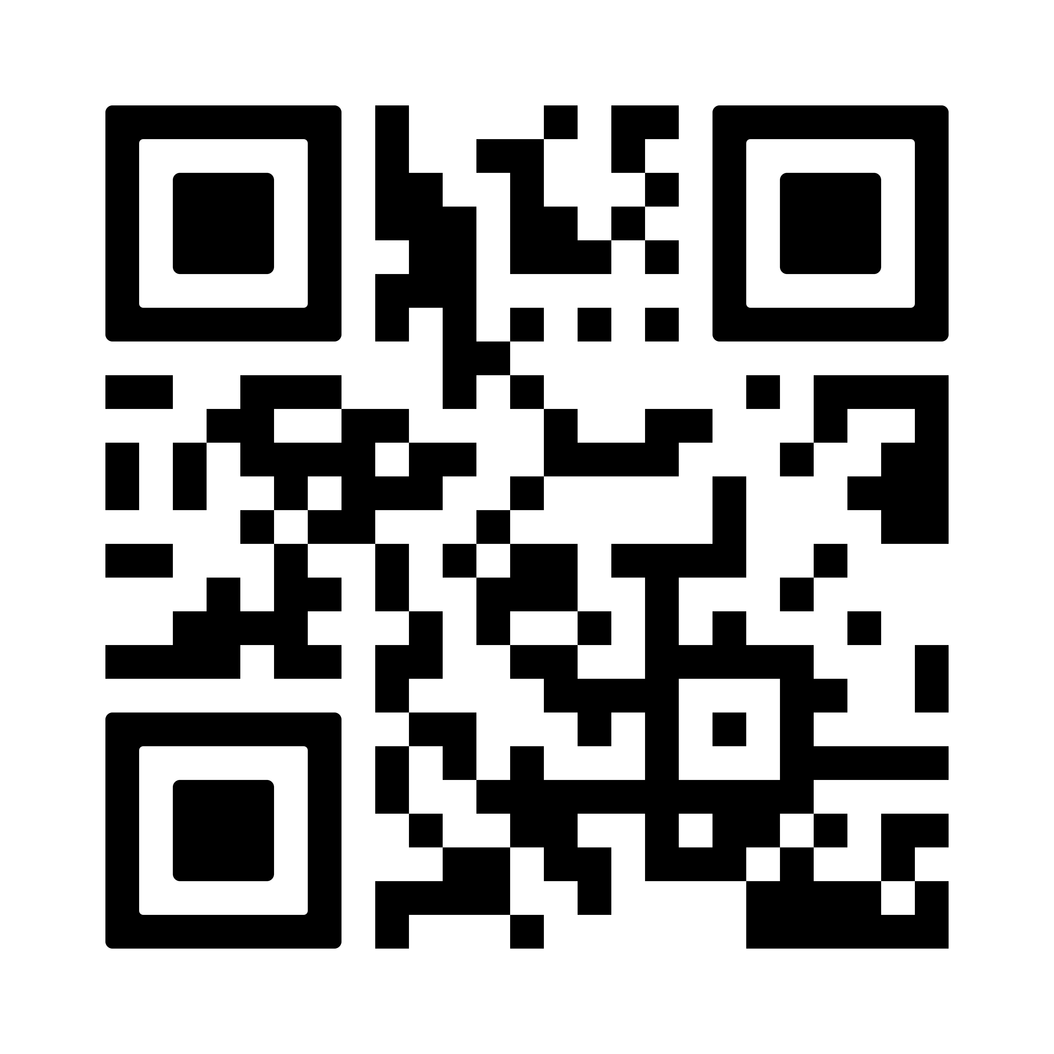
Middle East Crisis Response
Lutheran Disaster Response is working with our companions on the ground throughout the Middle East, to provide critical assistance for those affected by the conflict, including emergency food and water, shelter and essential supplies, trauma-informed care and long-term recovery efforts.
Scan the QR code to give today.
By giving to Lutheran Disaster Response, you make it possible for the ELCA to act quickly after disasters – including humanitarian crises – and remain for as long as the recovery takes.

