Slide 2

Ecumenical & Inter-Religious Relations
Ecumenical Journey 2010
Full Communion Relationships
Bilateral Dialogues, Discourse & Cooperation
Conciliar Relationships
Inter-Religious Relations
Building Blocks

Slide 3
Ecumenical Journey 2010
February 2-17, 2010
London
Istanbul
Rome
Geneva
Notes:
From February 3 through 17, Bishop Hanson and a delegation of 15 other ELCA members journeyed to important ecumenical centers in London, Istanbul, Rome, and Geneva. This was a meeting that had been planned and coordinated for well over a year. Those who attended did so at their own expense and represented the ELCA in a time for conversation, learning, and ministry.

Slide 4
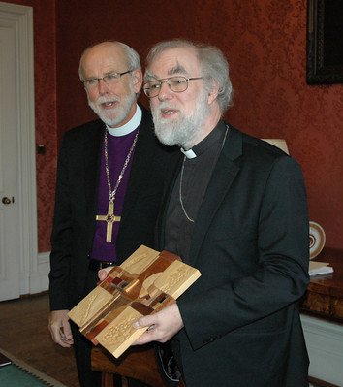
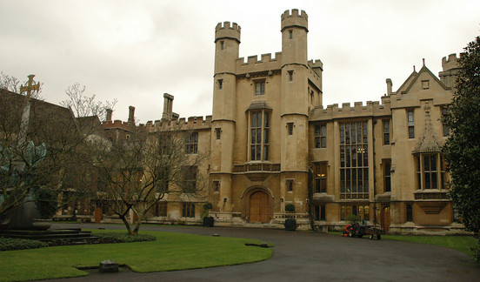
Ecumenical Journey 2010
ELCA Presiding Bishop and LWF President Mark Hanson presents a "Savior of the World" cross to the Archbishop of Canterbury, Dr. Rowan Williams, at Lambeth Palace in London.
Notes:
In London, meetings included: the Archbishop of Canterbury, the Anglican Consultative Council, the Church of England, and Lutherans in England.

Slide 5
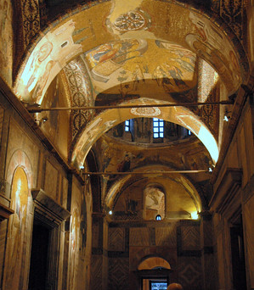
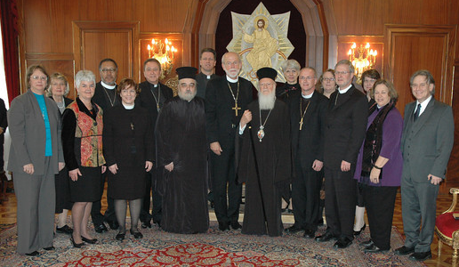
Ecumenical Journey 2010
The Ecumenical Patriarch Bartholomew I with the ELCA delegation in Istanbul. The group visited the Church of Chora, a Christian Church that became a mosque, and is being restored back to its original state.
Notes:
In Istanbul, our time included meeting with the Ecumenical Patriarch Bartholomew I and a conversation with the Orthodox theological commission.

Slide 6
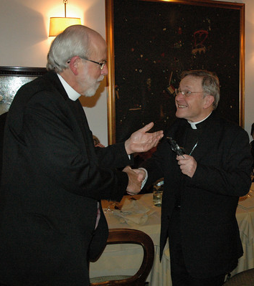
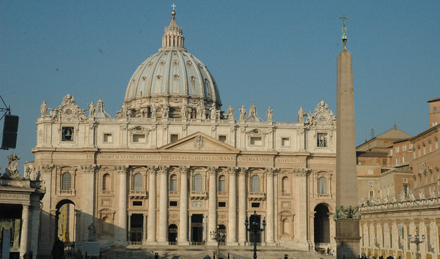
Ecumenical Journey 2010
In Rome, ELCA Bishop Mark Hanson, LWF President, met with Cardinal Walter Kasper, the Vatican’s chief ecumenical leader, and president, Pontifical Council for Promoting Christian Unity.
Notes:
In Rome, the visit included meeting the Pope, the Council for Promoting Christian Unity, the Congregation for the Doctrine of the Faith, and Inter-Religious Council. We also met leaders and members from the Lutheran Church in Italy.

Slide 7
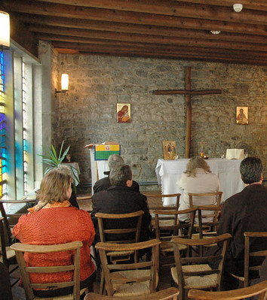
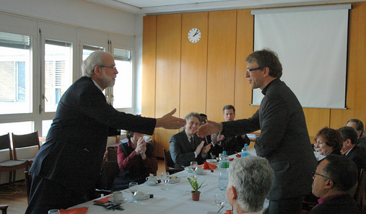
Ecumenical Journey 2010
The ELCA delegation met with Dr. Olav Fykse Tveit, general secretary, World Council of Churches, in Geneva. There, they toured the WCC's Ecumenical Institute at Bossey, including the chapel.
Notes:
In Geneva, the work of the Lutheran World Federation and the World Council of Churches highlighted our time of sharing.

Slide 8




Full Communion Relationships
ELCA-United Methodist Church
Lutheran-Moravian Coordinating Committee
Lutheran-Episcopal Coordinating Committee
Lutheran-Reformed Coordinating Committee
Notes:
Coordinating Committees: (1) Formula of Agreement: Presbyterian Church USA, Reformed Church in America, United Church of Christ; (2) Called to Common Mission: The Episcopal Church: The Coordinating Committees for our Reformed and Episcopal full communion agreements have three year plans that are focused on mission and ministry. Important connections between national staff and ministries were renewed at the FOA meeting this past September. The Lutheran-Episcopal Coordinating Committee meets at our churchwide office in April to consider a followed up to mission planning and theological and leadership training. Once again this will involve key staff persons for our churches.

Slide 9
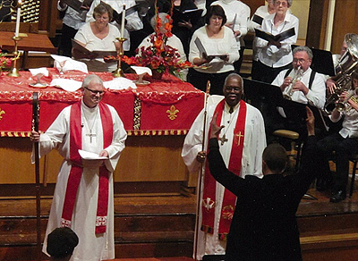
Full Communion Relationships
United Methodist Church
August 20, 2009
Notes:
United Methodist Full Communion Agreement: In January, the ecumenical staffs from the United Methodist Church and the ELCA met in Chicago. As with other agreements, there is a need for interim work before our coordinating committee meets. Interim worship guidelines have been developed with the leadership of Pr. Robert Schaefer and his UMC counter-part. These will be considered by the coordinating committee when it meets, along with the Interchangeability of ordained clergy. One of the unique parts of this consideration is our call process and the United Methodist appointment process. There have been a number of very good celebrations of the full communion agreement throughout the country.

Slide 10
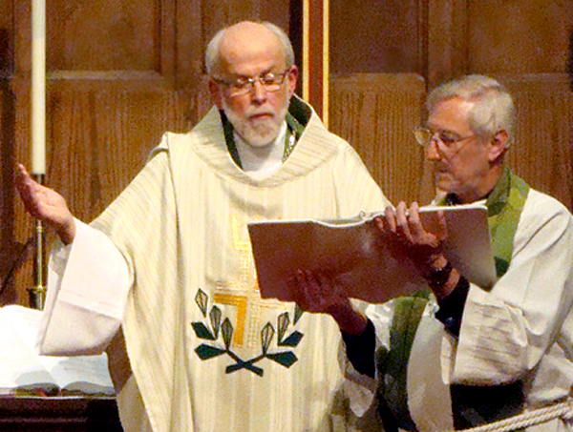
Full Communion Relationships
The Moravian Church
10th Anniversary Celebration
Notes:
The Moravian Church – Full Communion -- 10th Anniversary of Following Our Shepherd: The ELCA-Moravian full communion relationship celebrated 10 years on January 27th in Winston Salem, North Carolina. The coordinating committee hosted a morning workshop with heads of communion and twenty three additional participants. Topics ranged from new congregational starts to the strengths of the witness of full communion to ecumenical partners today. An afternoon presentation and reception to highlight the relationship was followed by a service of Word and Sacrament at Augsburg Lutheran Church in Winston Salem. The Lutheran-Moravian coordinating committee will provide a strategic trajectory assessment to heads of communion this spring.

Slide 11


Bilateral Dialogues, Discourses & Cooperation
Roman Catholic Dialogue
Lutheran Church-Missouri Synod (Cooperation)
Notes:
Roman Catholic Dialogue: The ninth meeting of the ELCA-Roman Catholic Round XI -- March 2010 continues to address challenging issues germane to the Joint Declaration on the Doctrine of Justification. Purgatory, indulgences, prayers for the dead, (of the saints) under the current theme: The Hope of Eternal Life. Significant papers are shared at each meeting and the development of a working draft for a final report, provide considerable dialogue and understanding. The International Lutheran-Catholic dialogue is addressing “Baptism and Growth in Communion. The dialogue is also working on a joint statement to assist the observance of the 500th Anniversary of the Reformation.
Lutheran Church-Missouri Synod (Cooperation): The next Committee on Lutheran Cooperation is scheduled to meet on April 12-13 in Chicago. The theme of our conversation will be “The way Lutheran churches such as the ELCA and LCMS can/ought to relate to one another given the nature of the ‘bound consciences’ positions of our respective churches.” Updates and contributions from LWR, LIRS, LSA, and LDR will be shared. The LCMS will have its’ (once every three year) Convention this summer in Texas.

Slide 12





Conciliar Relationships
Lutheran World Federation
Churches Uniting in Christ
National Council of Churches of Christ in the USA
Christian Churches Together
World Council of Churches
Notes:
Lutheran World Federation: The LWF pre-assembly meeting was held at the end of in January 2010 in Canada. Joining the ELCA delegates and advisors were delegates and advisors from the Evangelical Lutheran Church in Canada, the Estonian Lutheran Church Abroad, and representatives from the LWF in Geneva. Over forty persons were in attendance for preparation, orientation, discussion, and decisions by North American Lutherans. The LWF Assembly will take place in Stuttgart, Germany in July 2010. The theme of the Assembly is “Give Us Today Our Daily Bread.” In the pre-assembly, this theme took life through Bible studies, panel presentations, discussions, business items, and a message from our North American region.
Churches Uniting in Christ (CUIC): The office for CUIC has been closed and there is no longer a staff person. The objectives and priorities are being assessed. A meeting of heads of communion and ecumenical officers was held in February. Sherman Hicks represented the ELCA since Bishop Hanson and Donald McCoid were in Europe. Our commitment to racial justice is an important priority that we share with other Christian churches in CUIC. How this priority will be shared and realized in the future is the focus of ongoing conversations.
National Council of Churches of Christ in the USA (NCCC): In November, the ELCA delegates met in Minneapolis for the annual NCCC General Assembly. A significant highlight was the election of Kathryn Lohre, an active young adult ELCA member, as President-elect of the NCCC. “Rejoice always, Pray without ceasing, and Give thanks in all circumstances” was the theme that ran throughout bible studies, business sessions and presentations. The partnership with Church World Service (CWS) and shared presentations by CWS showed significant ministries that are supported and continue to touch many lives. Spiritual renewal and outreach to the needs of people through service and justice advocacy provided a faithful balance of Faith and Order and Life and Work.
Christian Churches Together: The annual meeting of CCT was held in Seattle from January 12-15. Bishop Claire Burkat a member of CCT’s Steering Committee and Bishop Chris Boerger attended the meeting. The priorities of witness (evangelism) and working to reduce domestic poverty by one-half were shared by the five Christian families who make up CCT.
World Council of Churches WCC: The Rev. Dr. Olav Fykse Tveit has begun his leadership as the new General Secretary of the WCC. The next general assembly of the WCC will be in Korea in 2013. The WCC continues to face financial downturns as it addresses growing ministry needs. The close of the WCC sponsored Decade to Overcome Violence (DOV) is expected to take place in the summer 2011; ER staff provide leadership on the WCC DOV committee in the United States.

Slide 13


Inter-Religious Relations
Lutheran Jewish Consultative Panel
Lutheran Muslim Consultative Panel
Notes:
ER staff continue their efforts in convening and participating in the National Christian-Muslim Initiative and the Christian-Jewish Dialogue Table, supported through the auspices of the NCCC. A new film on Christian-Jewish relations is being developed through the ELCA Consultative Panel on Lutheran-Jewish Relations, also for use by ecumenical partners. The ELCA Consultative Panel on Lutheran-Muslim Relations anticipates the conclusion of its contribution to the series of ‘Talking Points’ for use in ELCA and ecumenical partner congregations.
The NCCC Interfaith Commission is finishing its development of five thematic documents for use in congregations under the title “Interfaith and . . . . The five themes are Mission, Ecumenism, Morality, Identity and Theology. The Interfaith Commission meets in March in Los Angeles with national Christian and Muslim leadership.
In cooperation with other ELCA units (notably the ELCA Washington Office), staff have served on behalf of the ELCA Presiding Bishop on the White House Task Force for Interreligious Dialogue and Cooperation. The results of the task force are slated to be compiled in the spring of this year.

Slide 14
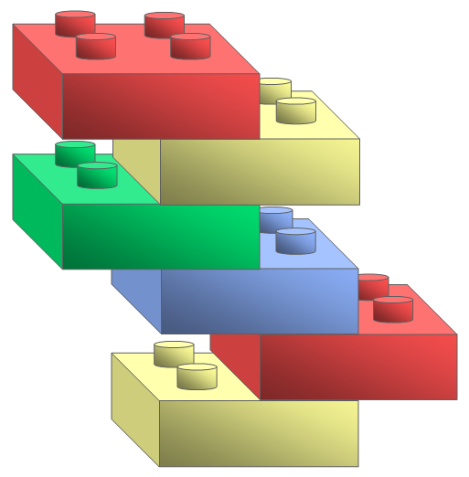
Ecumenical & Inter-Religious Building Blocks
International Disaster Response
Ecumenical Worship
Grass Roots Advocacy
Jewish-Christian Relations
Campus Ministry

Slide 15

Ecumenical & Inter-Religious Relations

