Slide 1
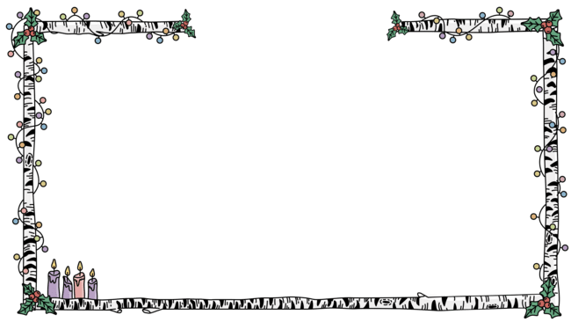


Slide 2

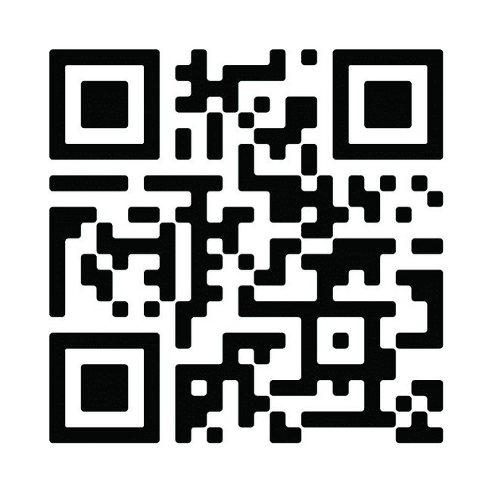

Visit ELCA.org/WHAdvent to download and order the ELCA World Hunger Advent calendar, study guide and other resources.

Slide 3



Visit ELCA.org/WHAdvent to download and order the ELCA World Hunger Advent calendar, study guide and other resources.

Slide 4


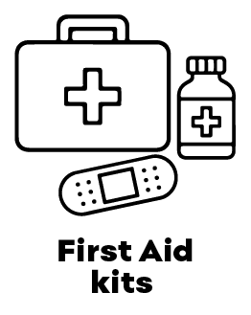











“Stocking the Streets” is an effort by ELCA World Hunger and your community to care for all our neighbors, some of whom lack a roof over their heads. A “Stocking the Streets” bag includes the items most frequently requested by individuals facing homelessness.
Starting on the 12th day of Advent, put one item per day in the “Stocking the Streets” bag. In the days following Christmas, you will be ready to pass out your bags when needed or bring them to a local social services organization that works with unhoused folks.
Find out more details about creating your "Stocking the STreets" bags at ELCA.org/WHAdvent

Slide 5



Visit ELCA.org/WHAdvent to find an Advent calendar, an Advent study guide and other resources
INTERACTIVE!

Slide 6

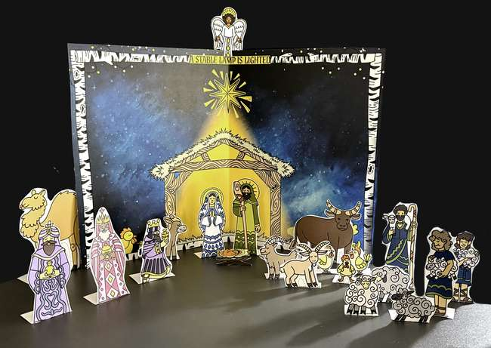


Snap a pic and share it with us!
Share photos of your completed and colored nativity scene from the Advent calendar by tagging @ELCAWorldHunger or posting them in the comments.
We can’t wait to see them all!

