Slide 1
Culture and Accompaniment
How where we come from affects what we think

Slide 2
“
Walking together in solidarity that practices interdependence and mutuality
“

Slide 3



God
My
Your

Slide 4
God
Engagement
Oppression
My
Your
Cultural Motive

Slide 5
What Is Culture?

Slide 6
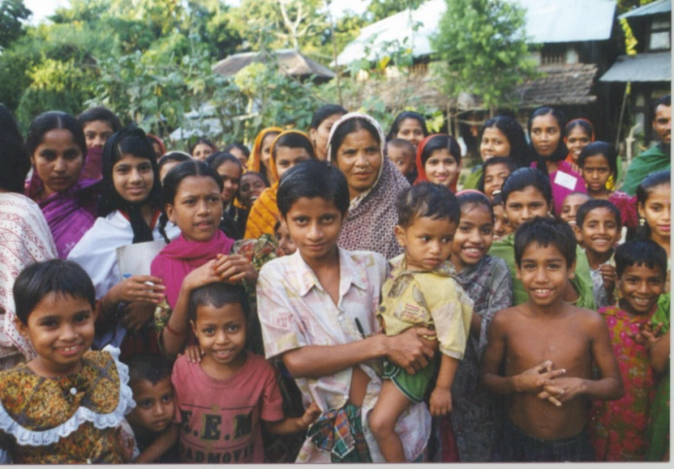

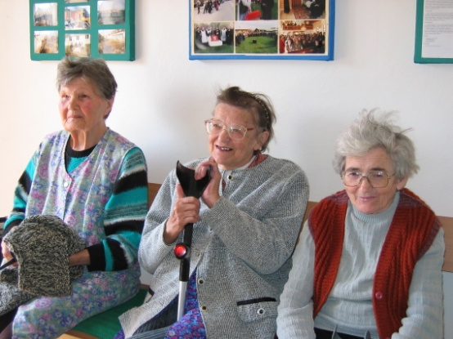
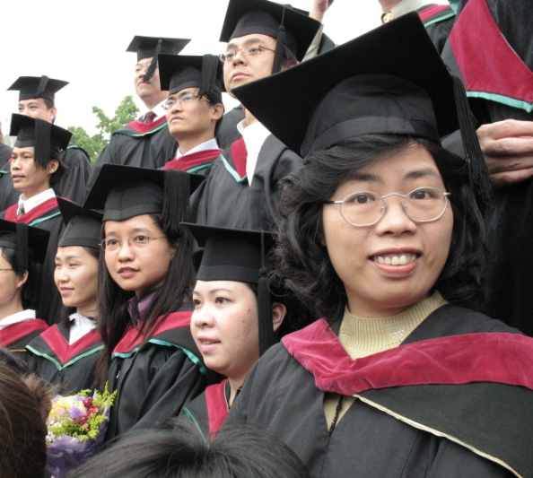
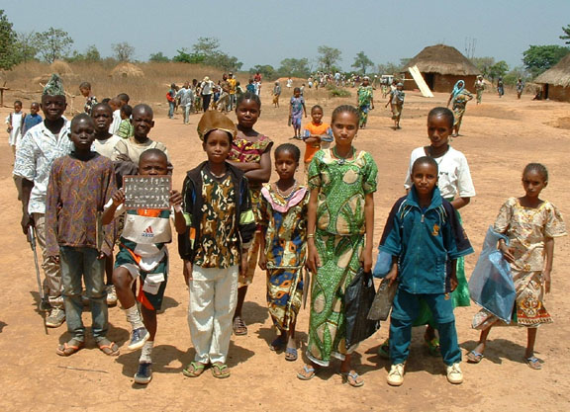

A shared, learned, symbolic system of values, beliefs and attitudes that shape and influence our perception and behavior
An abstract “mental blueprint” or “mental code”

Slide 7
Why is Culture Important?
Filter
How we perceive particular events and attribute value or meaning to them
Influence
Shapes our values, actions, expectations
Impact
Influences our viewpoint, how we view others, behaviors and relationships

Slide 8
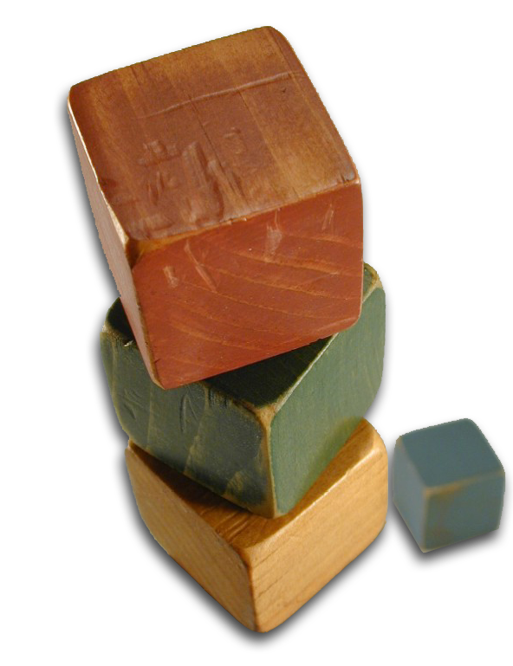
Characteristics of Culture
Learned
Process is called enculturation
Shared and Constructed by Society
No “culture of one”
Patterned
Repeated behavior
Symbolic
Internalized
Habitual, “natural”

Slide 9


External Culture
Dancing
Drama
Cooking
Dress
Literature
Games
Fine Arts
relationship to animals
notions of leadership
rules of descent
notions of modesty
perceptions of cleanliness
cosmology
status by kinship
status by sex
patterns of decision-making
concept of justice
definition of sin
arrangement of physical space
approaches to problem solving
theory of disease
concept of beauty
Concept of status mobility
incentives to work
courtship practices
ideals governing child raising
Internal Culture

Slide 11
Cultural Imperialism

Slide 12
Intercultural Competence
Universal language to help relate across differences
Know yourself
What is your external/internal culture?
How might this look to another?
Know the other
What is their external culture?
What internal culture could this be pointing to?
Create space
Allow space for learning and sharing

Slide 13
Circles of Understanding: Thinking
Language Proficiency
Learn
Review
Understand
Incorporate
Apply
Evaluate
Regional Expertise
Cross-Cultural Competence

Slide 14
Circles of Understanding: Doing
Language Proficiency
Receive
Arrange
React
Give Value
Accept Value
Regional Expertise
Cross-Cultural Competence

Slide 15

Christ and Culture
Christ against culture
Either/Or
Christ of Culture
Christ and culture are one
Christ above culture
Judging culture against God’s Word
Christ and culture in paradox
Two kingdoms
Christ the transformer of culture
Christ changes culture through us

Slide 16
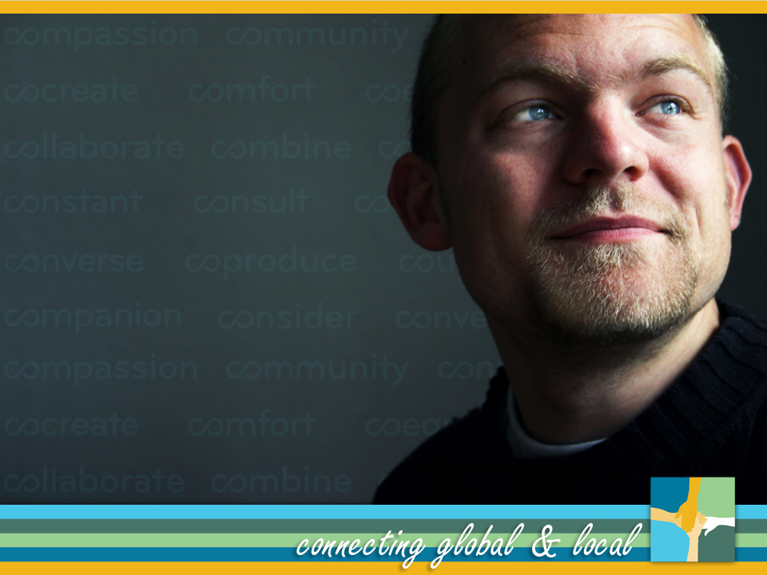
Praxis

