Slide 1
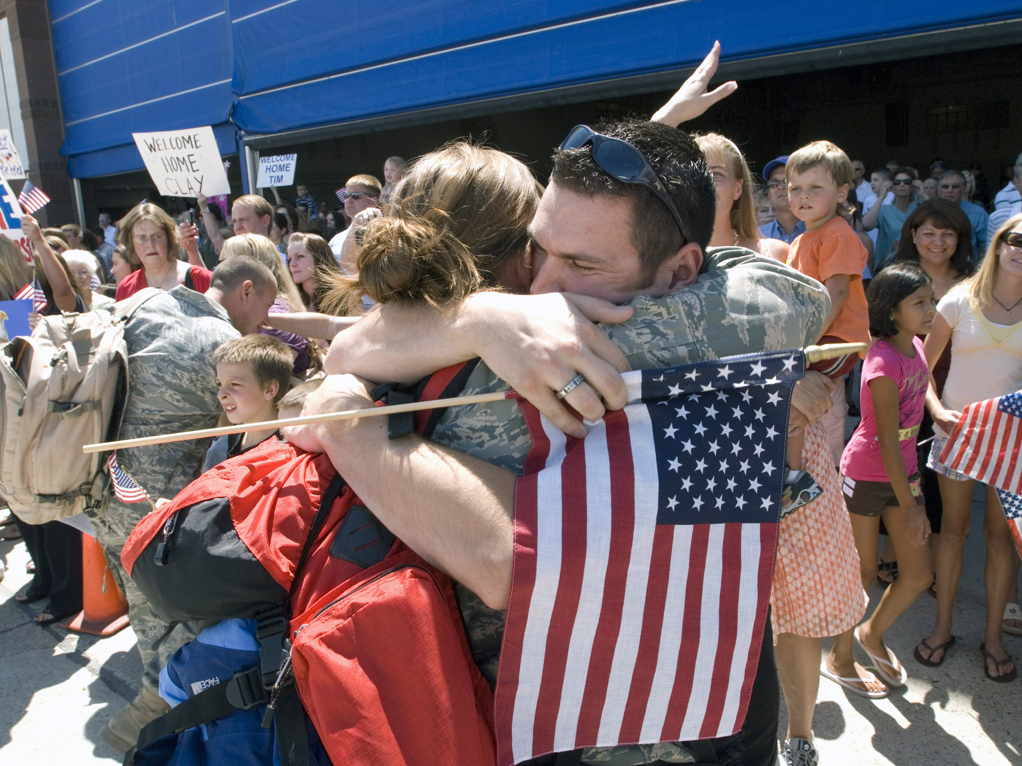
Care for Returning Veterans

Slide 2
Introduction and Ground Rules
Not a political forum
Questions are encouraged for group discussion
Be respectful of others
If the discussions, case studies, or videos at any time become too disturbing feel free to leave the room till you feel comfortable enough to return
Notes:
This presentation is not meant to a discussion of the war or politics, but how to care for those who have born the brunt of this conflict the soldiers, marines, airman, sailors, coast guardsmen, and other people who have served in Iraq (Operation Iraqi Freedom) and in the Global War on Terror (Operation Enduring Freedom) primarily in Afghanistan. The focus should be on how to care and support these veterans and their families in adjusting to the sights, sounds, and experiences of war and separation. Discussions should be respectful of all opinions. Additionally this program contains actual footage of combat and post combat activities that can be disturbing to veterans and their families because of the intense memories they can awaken. Allow those who are uneasy with these portions of the program to feel free to leave the room and to return when they are more comfortable.

Slide 3
Objectives
To Familiarize Ministers and Service Personnel with:
Military Culture & Veterans Issues
Psychological Impacts and Responses
Moral & Spiritual Issues and Responses
Military Family Issues and Responses
Suggest Ministries & Activities to Support Veteran’s and Their Families
Provide Understanding of the Resources Available
Notes:
This slide outlines the goals of the program. Service personal refers to all church workers and volunteers working to serve the veterans and their families.
Before going to the next slide, warn participants that the next slide involves actual footage of a mortar attack on a Marine FOB (Forward Operating Base). The language can be graphic, as different Marines respond to the incident in different ways. This slide also illustrates that there are no safe havens in Iraq and Afghanistan, and that even support personnel are exposed to life threatening events on an ongoing basis.

Slide 4

Mortar Attack

Slide 5
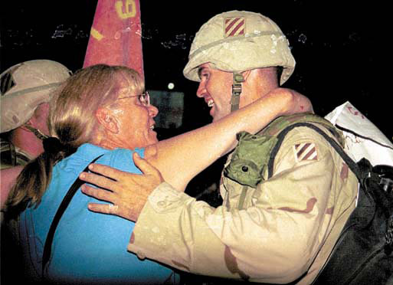
The Military Experience

Slide 6
Veteran Issues
Posttraumatic Stress
Transition
Reintegration
Employment
Health
Child Custody
Recurring Deployments
Grief & Loss
Rehabilitation
Suicide
Isolation
Substance Abuse
Sexual Assault
Infidelity
Notes:
This slide discusses the wide array of issues impacting veterans and their families.
POSTTRAUMATIC STRESS – Posttraumatic Stress or Posttraumatic Stress Disorder (PTSD) is the issue that has claimed the bulk of attention in the press and by government officials due its association with a number of tragic events. It needs to be acknowledge that posttraumatic stress is a normal reaction that normal people have to abnormal events that threaten their life or the life of those dear to them, and that most people recover on their own given time and social support. PTSD is the pathological variant of this condition where an individual becomes stuck in the event and cannot move on with their life. PTSD is an extremely complex diagnosis involving several symptoms occurring in different domains of behavior and can only be diagnosed by competent mental health professionals. Unfortunately, the label of PTSD is being attached to many veterans in the process of integrating their traumatic experience in to their lives and recovering from their exposure to combat. This misdiagnosis and labeling on the part of family members, co-workers, and even the military members themselves can adversely impact the military member in terms of how they see themselves and in necessary tasks, such as finding employment.
TRANSITION – By far the most common challenge facing veterans is transition back into the day to day world. It is not easy going from being on guard to danger at every corner to functioning and acting immediately and forcefully to stay alive to a low threat peaceful environment where measured and peaceful responses are the order of the day. Even simple everyday things like green grass and neon signs can seem overwhelming after months of brown deserts and blackouts. Combat driving kills are frowned upon by local law enforcement, but they have become reflexes that are hard to suppress when reminded by some sight or sound of roadside bombs or ambushes. Family life and work life can seem mundane and the routines, policies and procedure of the civilian world leave one longing for a adrenaline rush and the immediate action that was part of military life when deployed. Emergency services personnel can have a particularly difficult time transitioning back into civilian life as so many aspects of their civilian job resemble their jobs as military members, but the combat responses required to defeat and survive an enemy are very different from the skills necessary to deal with one’s fellow citizens in an orderly society.
REINTEGRATION – Reintegration is one aspect of transition that deals with returning home to family. The veteran has been changed by their exposure to combat and having seen terrible unspeakable things. They can feel rejected when family and friends speak of wanting to have the person who left, their son or daughter, their husband or wife, back. This communicates lack of acceptance for whom the veteran is in the here and now. But even the veteran often has expectations of returning home as it was when they left forget too that their spouse, children, family and friends have also grow and changed during their separation. Reintegration requires patience and understanding. Roles and responsibilities within the family have to be renegotiated In light changes and growth that have taken place. The roles and responsibilities include intimacy, parenting, financial management. Parents need to realized that the teenager that left hope is now an adult child wise in the ways of the world. The veteran may return to find themselves a parent and married to a spouse who is more self-sufficient than when they deployed. Reintegration is about creating a new normal in personal relationships and family roles.
EMPLOYMENT – Employment is a particularly important issue for Reserve and National Guard personnel returning from deployment. In 2007, approximately 12% of National Guard and Reserve personnel returned to find they had no employment. Though federal law guarantees return employment rights for most military members, those rights mean little if the job no longer exists. In one instance the Veterans Administration denied return rights to a chaplain who returned after being deployed as a member of the National Guard, on the basis that the law does not apply to clergy and religious professions. Even congregations within our own church body have asked their pastor/chaplain to either resign their commissions or to seek other calls. This is very much saying we have met the enemy as they is us.
HEALTH – Though PTSD garners most of the publicity, there are a number of other health issues for returning veterans. Mild Traumatic Brain Injury (MTBI) is chief among those issues for many veterans. MTBI refers to injuries suffered as the result of the concussive effects of modern munitions. These injuries are extremely hard to diagnose. One of the effects of MTBI is that lowers the ability self-regulate, meaning they lose inhibitions and often act out their thoughts without regard to consequences. Other health issues include adverse reactions to antimalarial drugs, dependence upon antidepressants to manage moods, and a variety unspecified health problems.
CHILD CUSTODY – Child custody is an often over looked issue. In a number of cases single parents have lost custody of their children as the result of their deployment. The typical scenarios looks like this: A single parent has sole or primary custody of a child after a divorce. Upon activation for military deployment, the custodial parent makes arrangement for the child to be cared for by the non-custodial parent during their deployment. Upon leaving the custodial parents leaving the country, the non-custodial parent petition the court for sole custody on the grounds of abandonment or the inability of the custodial parent to provide a stable environment for the child due to their military service and commitments. It needs to be remember that family courts are not bound to protect the rights of the parents, but to make decisions on the basis of what they see as the best interests of the child. The issue has become so serious that at least five states have amended their family court codes to specifically prohibit judges from make permanent custody ruling until the military member returns from deployment and can represent themselves in the hearing.
RECURRING DEPLOYMENTS – If these challenges were not enough, most military members face multiple deployments. Even Reserve and National Guard personnel, who comprise approximately 47% of the military forces in Iraq and Afghanistan, are in their second or third deployment. This means that health, transition, and family issues are further complicated by the cumulative effects of combat stress, family separation, and continuous transitions to and from the wartime and peacetime environments.
GRIEF & LOSS – Grief and loss are also recurring themes faces by veterans. It is not only the loss of comrades in battle, but it is also losses stemming from having missed important family events, such as the birth of a child, birthdays, anniversaries, graduations, first steps, etc… There is also the lose of innocence that comes from leaving the safe and peaceful environment of home and being thrust into the chaos and evil of war. Also one other significant loss is often over looked, which is the loss of the strong bonds and camaraderie that develops among close knit combat units, bonds that can be stronger than blood or marriage because they daily place their life in each others hands.
REHABILITATION – The good news among the many issues facing veterans is that casualties that would have bled to death on the battlefield even 10 years age are being saved as the result of advances in military medicine. But this also means that many more veterans are returning who have lost limbs and bear physical scars of battle. The veterans and their families need special assistance in reintegrating and transitioning back into civilian life. It is interesting to note that advances in the science of prosthetics have enabled some veterans actually to return to military service and finish out their careers.
SUICIDE – Suicide is an especially significant issue. The Army in particular has seen a sharp increase in suicides and the numbers could be underestimated as it is harder to track suicide among the reserve component (Reserve and National Guard). Inability to effectively to deal with any issues discussed can contribute to suicidal ideation or acts. The important thing to note concerning suicide is that asking the question is not going to put the idea into a person’s mind and may evening shock them in to seeking help. Ask the question in a straight forward manner,” Are you thinking about committing suicide?” If the answer is yes make immediate referral to a license mental health provider or encourage them to come with you to an emergency room. It is appropriate to ask if they have a plan and if they have the means to carrying out the plan. If the answer to these two questions is yes, it is advisable to physically had off the suicidal person to mental health or medical care givers.
ISOLATION – It is not uncommon for veterans to withdraw and isolate themselves because they feel misunderstood, have difficulty with transition, or are haunted by memories of their wartime experience. Though common this is not helpful. Research has shown that strong social support (family and friends), good self care (sleep, diet, exercise), and spiritual belief systems (belief in God or a higher power) are the most powerful factors in helping people recover from traumatic events. Isolating one self unfortunately is also one of the common reactions to trauma. It is important to allow the veteran adequate space and time to deal with their experience, but the greater the degree of isolation the more serious their problems can become.
SUBSTANCE ABUSE – Some argue that combat trauma is essentially a moral and spiritual wounding of the soul. This would can produce tremendous psychological and emotional pain. As common form of attempt to cope with this pain is self-medication, using alcohol or other substances to numb and avoid the pain. This can lead to serious problems of substance abuse and addiction. It is important to recognize that self-medication does not always involve substances, but can also involve behaviors such as engaging in high risk behaviors for the adrenaline rush, or sexual activities to produce dopamine for its pleasurable effects. Whether the substance is introduced externally or internally through specific behaviors it can serious life altering consequences.
SEXUAL ASSAULT – Sexual assault is another serious issue that tends to impact female military members. Approximately 20% of military personnel are female and serve in all branches, career fields, and ranks of the military. Though sexual discrimination, harassment, and assault are all crimes under the UCMJ (Uniformed Code of Military Justice) they do unfortunately occur. Sexual assault can be particularly devastating when the perpetrator is a fellow service member. Military members place their life and safety in each others hands on a daily basis, which adds an additional element of betrayal to this violation. The military has a unique sexual assault program that allows victims to choose either to report the offense or not to report the offense formally and still receive care and support. It is important that any victim of sexual assault talk with the specially trained sexual assault counselors that are available for each branch of services to be informed of their options and decide the course they would like to follow in responding to the assault. Some members choose to seek treatment outside of military channels, but this can result in mandatory reporting law enforcement depending on state statues governing sexual assault.
INFIDELITY – Long periods of separation and high amounts of stress can result in strong feelings of loneliness and longing for physical and emotional support. Unfortunately, this can lead to seeking that support in relationships outside of marriage and other exclusive relationship. When this occurs it is an additional stressor on the veteran and their significant other that needs to be addressed as part of the reintegration and transition process through counseling and other means.

Slide 7
Veterans Speak Marines of the 24th Marine Expeditionary Unit Between Iraq and A Hard Place R. J. Pratt & J. M. Pratt (Producers) San Diego, CA: Pratt Bros Entertainment (2006)
Notes:
This slide introduces an 18 minute vignette is which a group 0f Marines that participated in the actual war and then returned for a second tour in Iraq reflect upon their experience. Invite participants to note the different issues, relationships, and reactions to serving in combat for discussion after the film clip.

Slide 8
Notes:
Before going on to the next clip take time to discuss the observation of the participants as to the issues, relationship, and reactions spoken of by the Marines.

Slide 9
The Veteran Experience
Fear of Death
Killing
Survivor Guilt
Unreality
Strong Bonds
About Face
Unfinished Business
Seared Memory
Multiple Losses
Teamwork
Survival Mindset
Cautious of People
Soul Searching
Lack of Understanding
Notes:
These are some of the issues, relationship, and reactions discussed in the film clip. If there are particular items that were mot previously discussed, now is the time to point them out and allow discussion of those items as well.

Slide 10



Battlemind
Reintegration Issues
Withdrawal
Control
Inappropriate Aggression
Hypervigilance
Locked & Loaded at Home
Anger & Detachment
Combat Survival Skills
Buddies
Accountability
Targeted Aggression
Tactical Awareness
Lethally Armed
Emotional Control
Notes:
The Battlemind program was developed by the Army to focus on why some skills and mindsets are necessary to survive combat, but ineffective in dealing with peacetime and civilian worlds.
Additional information, flyers, and other Battlemind resources are included in the supplementary material, including a slide on the family side of the Battlemind program, if you choose to include that in your discussion.

Slide 11
Battlemind
Combat Survival Skills
Mission Opsec
Individual Responsibility
Non-Defensive (Combat) Driving
Discipline & Ordering
Reintegration Issues
Secretiveness
Guilt
Aggressive Driving
Conflict
Notes:
Battlemind continued.

Slide 12
Military Culture
Structured
Standardized
Authoritarian
Esprit de Corps
Focused on Mission
Disciplined
Service Before Self
Political
Mobile
Family Secondary
Technical
Education
Notes:
The military may defend our freedoms, but it is not a place to practice those freedoms. It is helpful in dealing with veterans and their families to understand the military culture that guides their life.
STRUCTURED – The military is extremely structure into different branches of service (Army, Navy, Marines, Air Force, and Coast Guard) each with different components (Active Duty, Reserve, and/or National Guard). Each services has its own history, traditions, rank, organization and acronyms. This is a maze that can daunting to even Active Duty family members and unfathomable to Reserve and National Guard families if they did not have prior military service. Each branch of service however does have a family support element even though they call it by different names. Generally by calling an installation and asking for the Family Support Center, you will be directed to the appropriate office for assistance. It is recommended that folks working with veterans learn the language associated with the veteran branch of service. Asking them to explain to you the language and organization of their particular branch of service is an excellent way to begin to develop rapport with a veteran.
STANDARDIZED – The military is also standardized in terms of procedures and processes, from the uniforms worn to the forms that need to be completed. Finding a source to help you understand these procedures can be essential.
AUTHORITARIAN – The military is also highly authoritarian with ranks and responsibilities clearly delineated. Generally the decision makers are the Commander (regardless of rank) and the Senior NCO (Non-Commissioned Officer) which can be called by any number of names from Top Sergeant, First Sergeant, Sergeant Major, to COB (Chief of the Boat). The services also have a strict class system that regulates professional and personal relationships between officers, non-commissioned, and enlisted personnel.
ESPRIT DE CORPS – Regardless of these distinction there exists what is know as Esprit de Corp, or a unique bond between service members. This bond is often forged and made stronger through the experience of combat. It is also reflected in the customs and traditions of the military and its branches. It is virtually liturgical. The pastor may say the “the Lord be with you” and the congregation response with “and also with you”. In the military, a lower ranking member salutes a higher ranking individual in greeting and respect and the higher ranking individual returns the salute in greeting and recognition. We might stand for the reading of the Gospel, where the military member rises and comes to attention for the raising and lowering of the flag. We may have an installation service, where the military has a Change of Command ceremony. It all contributes to establishing a common identity, standards of conduct, and marking rites of passage, which are a necessary part of establishing Esprit de Corps.
FOCUSED ON MISSION – The military is a missional organization, meaning it is sole purpose for existence is to accomplish its mission. Family and personnel concerns are always secondary to the mission. As such its responsiveness to family needs is in direct proportion to how the service see this as support the mission and the war fighter.
DISCIPLINED – Discipline is the watch word of the military and refers both for the needs for self-discipline, the discipline of the service, and above discipline in carrying out the commands of the civilian authorities. The is no more serious situation for the organization than a break down in discipline.
SERVICE BEFORE SELF – Sacrifice is a hallmark of the military life. Military members and their families sacrifice for the nation, and for each other sometimes forsaking freedoms and rights enjoyed by the civilian community such as the ability to campaign for political candidates and speak out for or against public policies while they serve.
POLITICAL – This does not mean that the services are apolitical. They compete with each other and other governmental agencies for budget dollars and promotions to the higher ranks are made by civilian politicians and appointees.
MOBILE – The military is an extremely mobile society often requiring military members and their families to move every three to four years sometimes to over seas locations. This creates tremendous disruption and pressure on military families, and often denies them the benefits of extended family support.
FAMILY SECONDARY - Despite of the great strides the services have made in the past 20 years in improving family support, the old adage of “If the military had wanted you to have a family they would have issued you one,” often still applies. Family needs are secondary to needs of the service. This is best illustrated by the need to shift medical to non-military sources when medical personnel are deployed to support military missions.
TECHNICAL – The military is increasingly a technical organization as the nation relies more on technology and less on manpower to wins its wars. This results it high levels of technical abilities and increased pressures on military families as fewer military members share and increasing duty load.
EDUCATION – It also should be understood that the military values education. Certain branches of the service will not take personnel who do not have a least a high school diploma, and promotion to the higher grades requires a minimum of a bachelor degree for the enlisted corps and a masters degree for the officer corps.

Slide 13
Deployment Cycle
Predeployment - Period of training and equipping prior to deployment (30-90 days).
Deployment - Combat and Humanitarian missions anywhere in the world (3-18 months).
Redeployment - Return from operations to home base (30 days). (For Reserve and National Guard components this includes demobilization and return to civilian life).
Notes:
It is also important to understand the deployment cycle and the role it plays in caring for military members and their families.
PREDEPLOYMENT – This phase begins at the time the service member is notified that he or she is going to be deployed and ends at the actual deployment of the service member. Typically, this time involves intense preparation for the deployment. “Fear of the unknown” often characterizes this stage as service members and families attempt to understand what they will face during their deployment or what life will be like with their loved ones gone.
DEPLOYMENT - This phase begins upon departure of the service member and ends about two weeks before the service member returns home. During the first month of deployment, the family often struggles to regain a sense of balance that has been lost by the service member’s departure. After the first month of deployment and until about a month before the service member returns home, most families settle into a new routine and adjust to life without the service member who has deployed. The service member initially has to adjust to being without his or her family and faces the new stress of being in a combat zone. Additionally, deployed service members often feel torn between the pressures of combat and their concerns for their loved ones at home.
REDEPLOYMENT - This phase begins about two weeks before the service member leaves the theater (defined as the geographic location where conflict is taking place) and lasts for the first several weeks of the service member’s return home. During the transition phase, families often experience many conflicting emotions. There is often great anticipation for the homecoming but there might also be anxiety for both the service member and the family, surrounding how life might be different when the service member returns because all have adjusted to a new routine. Redeployment ends with the successful reintegration of the service member in their community, the workforce, and the family unit. Most families are able to regain a sense of equilibrium despite challenges. This phase involves adjustments for both the service member and their family to new realities. This phase of the cycle can last for months or even years depending on the resilience of different family members.
A recent report from the Army surgeon general stated that “30 percent of U.S. troops returning from the Iraq war have developed stress-related mental health problems three to four months after coming home.” (Source: http://www.msnbc.msn.com/id/8743574/).

Slide 14
Connections
Connections need to created before deployment
Be maintained during deployment
And sustained after deployment
In concrete ways
Notes:
Perhaps the most important thing to remember in ministry to military families is connections. Connections need to be made prior to deployment, be maintained through the deployment, and sustained after the deployment if ministry is to have any lasting impact.
This is not a difficult task. Visiting with families prior to deployments to find ways to support them during the absence of the military members can be accomplished by the pastor of a ay leader. Rituals of sending and blessing can utilized within the worship service (with the families permission) to express support for the departing military member and their family. A program is currently being tested in Missouri (HEROES Care Program), where Stephen Ministers with specialized training and designated as Hometown Support Volunteers have access to a wide variety of support and referral services, and are helping to support military families throughout the deployment cycle.
During the deployment an occasional e-mail or letter reminding a troop that they are in your prayers and asking if there is anyway of being of assistance to them or their family can help maintain connection during the deployment. Do not be frustrated or concerned if you do not receive a reply, they have limited access to communications and prefer their allotted time in communicating with family members. But also be prepared to meet their requests where possible. Be sure that you are also checking in with the family from time-to-time and helping to support them during this difficult time.
Upon return be there to welcome them home with other members of the congregation. Special services or prayers of thanksgiving or even a welcome home potluck can show your support. Be sensitive however to the families needs for time together to being to reintegrate as a family. Also be alert to the challenges the family and veteran may face months after the their return.
Establishing connection early in the deployment cycle, caring and supporting their family during the deployment, and showing patience and understanding upon return are the best way of earning and having the veterans trust to help in more challenging times.

Slide 15
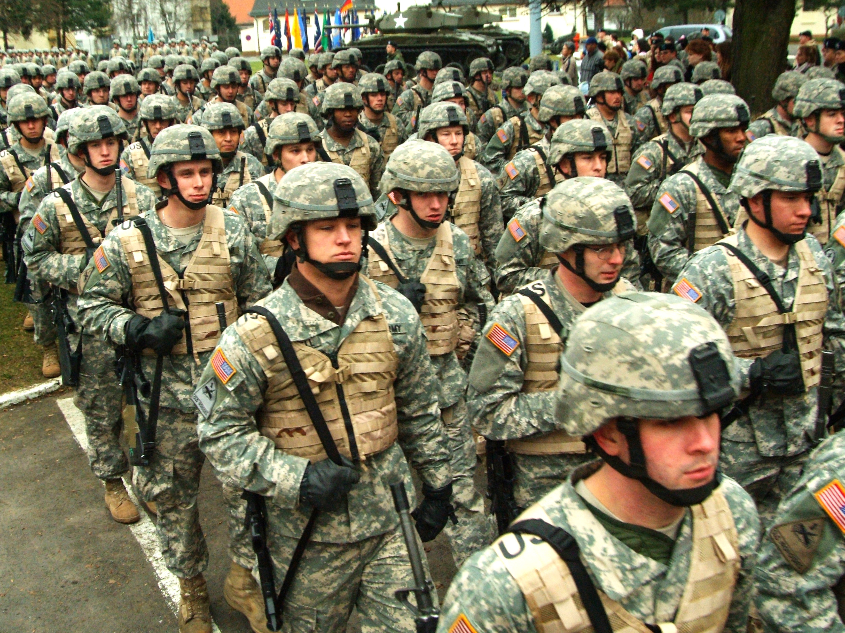
Psychological Impacts

Slide 16
Psychological Impacts
“Boys with a normal viewpoint were taken from the fields and offices and factories and classrooms and put into the ranks. They were remolded; they were made over; they were made to ‘about face,’to regard murder as the order of the day. They were put shoulder to shoulder, and through mass psychology they were entirely changed. We used them for a couple of years and trained them to think nothing of killing or being killed. Then suddenly, we discharged them and told them to make another ‘about face.’ This time they had to do their own readjusting without mass psychology, without officer’s aide and advice, without nation-wide propaganda. We didn’t need them anymore. Many, too many, of these fine young boys are eventually destroyed mentally, because they could not make that final ‘about face’ alone.”
Notes:
Have your group read this quote guess as to when it was made and by whom?
It was made in 1936 by Marine Corps Major General Smedley Butler.
The point to be made here is that the psychological and spiritual impacts of war are nothing new. One can see signs of PTSD in Achilles (The Illiad) and Aeneid (The Aeneas) in ancient literature. These reactions were described as Soldier’s Heart during the Civil War, shell shock in World War I, and battle fatigue in World War II. They have been a concern of military leaders throughout history, soon forgotten by society after the warfare ceased. It has only been since Viet Nam that the formal recognition of this condition as a psychological disorder has existed.

Slide 17
Posttraumatic stress
Normal Reaction to Abnormal Events
Intrusive Memories
Hypersensitivity
Avoidance/Dissociation
Stuck in the Trauma Response
Notes:
This slide is intended to reinforce the fact that posttraumatic stress is a normal reaction of normal people to extreme and life threatening events. It is part of the human survival response.
It is marked by differing symptoms that occur in three different domains: Intrusive memories, Hypersensitivity, and Dissociation and most people recover on their own. It is only when people become stuck that the condition we know as PTSD occurs
It should be noted that the symptoms described must exist for more than 30 days for a formal diagnosis to be made.
David Grossman, a world wide authority on combat stress refers to this reaction as Survival stress as it arises from activation of the survival response. This term is accurate and carries less social stigma than PTS or PTSD.

Slide 18
Human Stress response
The human stress response is a normal physiological reaction to stimuli that enables us to mobilize to meet life’s demands and to return to baseline behavior. When normal coping mechanisms are overwhelmed, or our lives are threatened, the brain automatically activates certain neurophysiological processes aimed at physical survival. These processes are not part of responding to day-to-day stress and are unfamiliar to us. They can be as frightening as the actual events that trigger them. They over ride all other processes even before we are consciously aware of them for the sake of our survival.
Notes:
This slide further emphasizes the normalcy of the reactions, but the fear they also elicit because we are unfamiliar with them. Those who experience these reactions often voice the feeling they are losing their mind, because of their intensity and inability to control their reactions.
Think back to the clip of the mortar attack shown earlier.
Now view the following clip of the reaction of a Marine patrol after encountering 9 IEDs (Improvised Explosive Devices). Pay attention to their behaviors and discuss what you observe.

Slide 19

Notes:
Discuss this clip before going on to the next slide.

Slide 20
Human Stress Response
20
Notes:
This slide to be narrated.
All of us have a base line of behavior that is normal for us. Click
We also high specific tolerances for how much stress we can tolerate both high Click and low Click.
Normally when we are stressed we gain increased energy and focus to accomplish the challenge that generates the stress then let down and relax for a period of time to recharge our batteries. In those instances our stress curve would look like this Click.
Traumatic (Survival stress) stress however looks very different. Imagine you are withdrawing money from an ATM and when you turn around there is a gunman with the gun pointed at you saying “Your money or your life.” Because of this life threatening situation you stress level immediately shoots through the roof. All you see is the gun, you don’t even think about handing over the money initially because you heart is pounding, and you are experiencing a variety other physical reactions that are new to you. You wisely hand over the money and the gunman departs. You feel an intense relief and your body almost physically crashed. Over the next few days you feel depressed fearful, but eventually you realize that you are safe and that this was an isolated incident. In this case your stress curve might look like this Click.
Now imagine you are a military member serving in Iraq or Afghanistan. You go out on patrol and encounter IEDs and have a buddy wounded, you return to base begin to come down from your combat stress but before you do you go out on another patrol only this time you are ambushed. You are lucky no one in patrol was hit but you see your first dead body. You return to base, again before you have dealt with your experience of the ambush you are sent out on patrol again. Nothing happens but you are on your toes to be ready to respond to any threat. You get a bit of a break in your next patrol and pass out candy to kids in the neighborhood. The next day you are called out to respond to a bombing of of a marketplace were you see the bodies of men, women, and children. Your heart is in your stomach as you recognized kids from the day before among the dead and wounded. You convince yourself that before you leave the country you will get the people responsible for this atrocity, and this is just your first month of a 12 month deployment. If this were the case your stress curve would look something like this Click.
This is why combat stress looks so different from other forms of traumatic stress, it is recurring, constant, and the individual never gets the opportunity to deal with one event before they are faced with another.
When one exceeds their upper stress limit, what I call breaking the trauma membrane, then the survival response is triggered in the brain.

Slide 21

The Neurophysiology of Traumatic Experience
Cerebral Cortex
X
Limbic System
X
X
X
Cerebellum &
Medula Oblogata
Notes:
The survival response is a normal neurophysiological response to situations where one perceives that their life or something very dear to them is threatened. The response takes place within the Limbic system of the brain.
The brain is composed of 3 different systems the cerebellum & medula oblongata Click, the limbic system Click, and the cerebral cortex or gray matter Click. For purposes of this discussion we will focus on the Limbic System and the Cerebral Cortex. The Cerebral Cortex is where our memories are stored and where many of the so called higher functions such as speech, mathematics, and decision making take place. The limbic system is comprised of a number of different organs such as the thalmus, hippocampus, amygdala and others that regulate different autonomic functions like respiration, and glandular functions. When the body is threaten these organ begin to dump massive amounts of chemicals such as adrenaline, serotonin, dopamine and a host of others that actually create a barrier and inhibit access to higher functions of the brain and our ability to access memories and prior learning Click. Two parts of the limbic system the hippocampus and the amygdala play a major role in this process.
The amygdala Click is essentially the trigger for this process. It feeds information directly to the limbic system without necessarily allowing it to be evaluated and processed by the cerebral cortex. In survival speed is of the essence. Continuous exposure to this type of trauma essentially creates a hair trigger that can lead to significant over reactions to minor events because the body has been condition to reacting to certain events without thinking to enhance its ability to survive. This contributes greatly to the hypersensitivity and exaggerated startle response often observed in trauma victims.
The hippocampus Click essentially serves as the bodies librarian and regulates memory. But because of the various chemicals being dumped into the brain it has difficulty access the library shelves where different memories are stored. This has two important effects. First it means that information and access to the higher functions of the brain cannot be readily accessed. Thus people experiencing trauma stress can have difficulty remembering where important documents, first aid kit, and other important things are stored. They can have difficulties with speech, reading, and making mathematical calculations to determine appropriate dosages of medication. Secondly, not having access to the library shelves means that memories of the event cannot be stored in a normal fashion. Thus people who experience trauma have difficulty recounting the event as it may be stored in bits and pieces in different parts of the brain where memory is not normally stored Click Click Click Click, where it cannot be recalled or is recalled involuntarily.
The point of this slide is not to provide a lesson in neurophysiology, but to emphasize that trauma reactions are not the result of weak character or a lack of faith, but the result of neurophysiological responses with which we were created. It is inappropriate to attach labels of deficient character and weak faith to trauma victims.
The next slide illustrates the down side of the stress/trauma reaction.

Slide 23
Behavioral Responses to Trauma
Impulsiveness
Sleep disturbance
Hypervigilance
Need to do certain things over and over
Doing strange or risky things
Self-medication
Eating problems
1000 yard stare
Keeping to yourself
Agitation
Always having to have things a certain way
Over working
Notes:
The following are common behavioral response to trauma.
IMPULSIVENESS – Acting without thinking or considering the consequences.
SLEEP DISTURBANCE – Either not sleeping or sleeping excessively.
HYPERVIGILANCE – On constant alert to possible threats.
NEED TO DO CERTAIN THINGS OVER AND OVER – This reaction is in response to create order out of the chaos of the traumatic experience and create a sense of being in control.
DOING STRANGE OR RISKY THINGS – This reaction is usually an attempt to create the rush and excitement that are part of the survival reaction.
SELF-MEDICATION – A common way of avoiding painful memories of the horrors of combat.
EATING PROBLEMS – Lose of appetite is often associated with the down side of the trauma curve, but sharp increases in appetite can also occur as the body seeks to replenish its energy reserves.
1000 YARD STARE – Reflective of the overwhelming power and shock of traumatic events.
KEEPING TO YOURSELF – Withdrawal is common as senses are overwhelmed and there may be fear and confusion associated with the traumatic stress reaction..
AGITATION – Trauma victims often exhibit nervousness, irritability, and can be prone to bouts of anger.
ALWAYS HAVING TO HAVE THINGS A CERTAIN WAY – Is another way to gain a sense of safety and control of one’s life after a traumatic experience.
OVER WORKING – Burying oneself in ones work is another way to avoid dealing with trauma by either creating a false sense of control or avoiding the effects of trauma through busyness.

Slide 24
Cognitive Responses to Trauma
Distortions of orientation
Presence of cause & effect thinking
Difficulty concentrating
Delusions (e.g., paranoia, grandeur)
Obsessions
Violent/ homicidal/ suicidal thoughts
Dissociation
Disabling guilt
Psychogenic amnesia
Helpless/ hopelessness
Notes:
Some common cognitive responses might be:
DISTORTIONS OF ORIENTATION – Trauma victims often experience distortions of time, narrowing fields of vision, and other spatial and temporal relationships. For example a small gun is remembered as being the size of a cannon.
PRESENCE OF CAUSE & EFFECT THINKING – Certain aspects of the trauma become universalized like all people with olive complexions are terrorists or believing all planes are weapons and panicking when one flies by.
DIFFICULTY CONCENTRATING – This is also accompanied by difficulty in making decisions.
DELUSIONS (e.g., paranoia, grandeur) – This could include phobic avoidance of the site where the trauma occurred or believing oneself to be bulletproof.
OBSESSIONS – This could be obsessing over safety or getting revenge upon the person or persons held responsible for the trauma.
VIOLENT/ HOMICIDAL/ SUICIDAL THOUGHTS – These thoughts are often associated with fantasies of revenge or seeking to avoid shame and guilt associated with a traumatic event.
DISSOCIATION – This could vary from isolating oneself from people and the world to gain a sense of safety to developing different personalities to avoid having to deal with the trauma.
DISABLING GUILT – This can be the result of complex grief associated with traumatic loss or blaming oneself for the trauma.
PSYCHOGENIC AMNESIA – Inability to remember the trauma.
HELPLESS/ HOPELESSNESS – These responses are associated with higher risks for suicide.

Slide 25
Emotional Responses to Trauma
Anxiety
Feeling depressed
Irritability or rage
Unusual fears, and phobic avoidance
Panic attacks
Feeling unsafe
Feeling disconnected from the world
Regressive emotions in adults
Feeling unlikable
Impatience
Unable to trust anyone
Notes:
Common emotional responses to traumatic events include the following:
ANXIETY – Feelings of anxiety can be generalized or tied to specific aspects of the trauma that serve as powerful reminders of the event.
FEELING DEPRESSED – This is normal as one goes through the traumatic stress cycle, but can become dangerous and increase the risk of suicide a person becomes stuck in this phase.
IRRITABILITY OR RAGE – Perhaps one of the most common emotions associated with trauma as victims feel violated or betrayed.
UNUSUAL FEARS, AND PHOBIC AVOIDANCE – Discussed in the previous slide.
PANIC ATTACKS – Related to cognitive distortions, particularly those associated with cause and effect thinking and delusions.
FEELING UNSAFE – Related to anxiety but without the restlessness and nervous energy.
FEELING DISCONNECTED FROM THE WORLD – An emotional example of of dissociation.
REGRESSIVE EMOTIONS IN ADULTS – A common reaction in the early stages of trauma when people are feeling overwhelmed and their normal coping methods are ineffectual.
FEELING UNLIKABLE – Feeling unlikable and unlovable are common in combat veterans especially if they have killed. Larry Dewey speaks of “Violations of the Geneva Convention of the Soul”, where a veteran has wounded or killed civilians, fellow soldiers, or executed battlefield justice. These types of events are particularly likely to produce such emotions, but similar emotions are also found in wounded soldiers who perceive that they have abandoned their comrades in the field and placed them at risk.
IMPATIENCE – This is also particularly pronounced in veterans who are conditioned to accomplish objectives on the basis of strict time tables and measure accomplishment in terms of black and white.
UNABLE TO TRUST ANYONE – Another very common attribute of returning veterans who have been living in an environment where people have been trying to kill them and it is very difficult to tell friend from foe. It is also common in any trauma victim who has personally experienced violence such as victims of physical and sexual assault.
Many of these emotions are tied to distorted beliefs and cognitions discussed in the previous slide.

Slide 26
Dumb Questions
How was it?
Why aren’t you still in Iraq?
Are you like those “crazy” Vietnam vets?
Did you kill anyone?
Did you read about what happened over there?
What do you think about Abu Ghraib?
Notes:
The responses are those heard from veteran’s when asked what kinds of questions were most irritating to you when you returned.
The three most significant were:
ARE YOU LIKE THOSE “CRAZY” VIETNAM VETS? – This question labels and stigmatizes veterans as a group and ignores the unique strengths and issues of the individual veteran.
DID YOU KILL ANYONE? – This can be a particularly painful question, especially for the veteran who has had to kill or witnessed killing of another human being.
WHAT DO YOU THINK ABOUT ABU GHRAIB? – This question reduces the entire war on terror to a single event that involved a relatively few number of soldiers and with which hundreds of thousands of soldiers had nothing to do. Much like My Lai in Vietnam it became a focal point of the media and press and therefore public perception. This question the minimizes and scandalizes the service of millions of veterans who served honorably and can produce anger and resentment at its very suggestion.

Slide 27
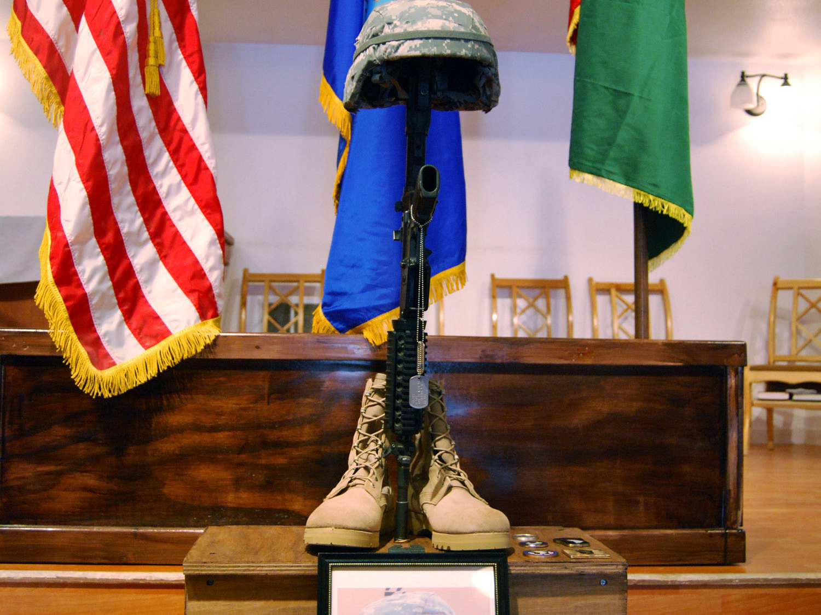
Moral & Spiritual Impacts

Slide 28
Moral & Spiritual Impacts
The Reality of Evil
Moral Violations
Moral Dilemmas
Theodic Diversity
Manifestations of Spiritual Injury
Profound Losses
Need to Find Meaning and Cleansing
Notes:
This slide provides an overview of the various issues addressed in this section of the presentation.
For the veteran good and evil are concrete realities not abstract concepts. On the one hand there is a need to see oneself and one’s cause as just. On the other hand the realities of war affirm the evil that is war and one cannot help but associated oneself with the destruction, suffering, death, and chaos of war. The end result is that the shining ideal becomes stained with the residue of war and there is no way to wash it off, except the blood of the cross. It is important to understand that many military veterans long to be cleansed and forgiven, but shun the church either out of fear of judgment or feelings of being unworthy because of their stains. It is important to listen non-judgmentally, and when you are tire of listening listen some more. Their experience is profound and cannot be explained away because it is deeply personal like faith itself. Living in Missouri, I have become increasingly familiar with the works of Mark Twain. He writes, “it is better to remain silent and be thought a fool, than to speak up and remove all doubts.” This is sage advice in working with veterans or any person that has been traumatized. My experience has taught me that the three most important things to do in working with veteran is to provide a safe environment where they are accepted for who they are, listen to their story and allow them to teach you about war as they know it, and when they are ready to speak God’s word of forgiveness. The worst things that you can do are become impatient, preach at them, and rush to forgiveness before they are ready.

Slide 29
Reality of Evil
Scope of Destruction
Intense Suffering
Killing and Death
Violations of Worldview
Chaos
Dehumanization
Notes:
SCOPE OF DESTRUCTION – Veterans have witnessed and inflicted tremendous destruction through the instruments of modern warfare and know that a single round from a rifle can bring death.
INTENSE SUFFERING – Many veterans have witnessed first hand the suffering of wounded comrades, grieving families, and the atrocities that people can inflict upon each other.
KILLING AND DEATH – Killing and death are part of the soldiers everyday. Remember the earlier quote from Maj Gen Butler, “They were put shoulder to shoulder, and through mass psychology they were entirely changed. We used them for a couple of years and trained them to think nothing of killing or being killed.”
VIOLATIONS OF WORLDVIEW – All of us have a worldview that presumes certain things about people, informs us of what is right and what is wrong, that allows us to feel safe and function in the world. We learned this view from our culture, our experiences, and from significant people in our lives. War often challenges and undermines these beliefs.
CHAOS – War is chaos and in the chaos mistakes are made. It is unrealistic to imagine war as an environment where friend and foe are clearly identifiable and civilians can be protected and there is no collateral damage, especially in an insurgency.
DEHUMANIZATION – Killing another human being is not a natural act. To make it easier it is often necessary to dehumanize the enemy, make them something less than human. In our own Civil War terms like Blue Belly and Johnny Reb were used for this purpose. In WW I it was the Hun, in WW II it was Kraut and Nip, in Korea it was Commies or Reds, and in Vietnam it was Gooks. In Iraq and Afghanistan it is Rag Heads or Hajis. Such efforts to dehumanize the enemy are only partially successful. They are generally ineffectual when the combatants are children of 12 years old or when personal pictures of family are found on bodies which brings home the reality of this is a human being.

Slide 30
Worldview
Just and Fair World
Value in Trusting Others
Self-Efficacy, Self-Esteem
Need for Safety
Order and Purpose to the Existence
(Everly, 2002)
Notes:
Some common elements of the typical American’s worldview.
The American worldview is largely shaped by Western beliefs regarding reason, human rights, self-determination, and generally positive notions regarding human beings. There are also common notions regarding the existence of some type of order and purpose to existence based on general religious beliefs. Even though less than 30% of the population worships on a regular basis, more than 90% of the population profess some type of belief in God.

Slide 31
Moral Violations
Killing of Innocents
Killing of Children
Ends Justify Means
Consensus Trance
Religious Justification
Blindness to Suffering
Community Violated and Desecrated
Notes:
Moral violations consist of breaches of fundamental beliefs regarding right and wrong, and certain ethical traps that can ensnare people into committing acts they would otherwise denounce or numb them to the pain and suffering of others.
KILLING OF INNOCENTS – War is not discrete, non-combatants are killed as well as combatants. When this happens the soldiers genuinely feels remorse, what Larry Dewey refers to as a violation of the “Geneva Convention of the Soul”. Though military members may accept this at a rational level, it can still leave lasting emotional scars and leave them with severe guilt and remorse.
KILLING OF CHILDREN – Any event involving children can cause a sense of moral outrage and violation, as children represent innocence and the promise of a future. Many soldiers are involved in the rebuilding of schools and engage in distributing candy, school supplies, and other humanitarian acts in the course of their service and suffer deeply when children are killed in the course of combat.
ENDS JUSTIFY MEANS – An ethical trap that essentially removes any ethical or moral limitations in favor of an objective.
CONSENSUS TRANCE – Another ethical trap that justifies behavior on the basis of another’s behavior or the groups behavior. It can rob one of their self-determination and be a source of severe guilt.
RELIGIOUS JUSTIFICATION – Religious justification is not a part of US policy, but is essential to the justification and motivation of the enemy. This religious polemic can raise questions in military personnel as to the nature and character of God.
BLINDNESS TO SUFFERING – Blindness to suffering is not an ethical trap as much as it is a survival mechanism and a way of keeping one’s sanity in the midst of the chaos and destruction of war.
COMMUNITY VIOLATED AND DESECRATED – The intense violence between various religious and political factions in Iraq and Afghanistan, the bombings of marketplaces, mosques, and even funeral processions further exacerbates a sense of desecration and violation of essential rules of existence.

Slide 32
Responses to Moral Violations
Loss of Trust
Lack of meaning & purpose in life
Difficulties with boundaries
No sense of righteousness
Feeling unlovable (shame, guilt, self-criticism)
Suffering is without meaning
No sense of thanksgiving
Notes:
The responses to moral violations are often long lasting as they impact the essential worldview and self-perception of the person who has experienced them.
LOSS OF TRUST – After months of facing road side bombs, being subject to ambush, and being targeted by non-uniformed personnel who could be your neighbors and friends, it can be difficult to trust friends and family back home and have any sense of safety.
LACK OF MEANING & PURPOSE IN LIFE – Meaning and purpose can seem abstract concepts after struggling to stay alive everyday. Also coming home to hear the media focus on the latest celebrity breakup or sports figures steroid scandal, with minimal if any reporting on the war and the sacrifices and suffering that they have witnessed first hand can often intensify this problem.
DIFFICULTIES WITH BOUNDARIES – There can be difficulties in maintaining boundaries or boundaries can become very rigid. After one has had to kill or violate some other boundary just to get through the day other boundaries can seem porous or there may be a need to over compensating by reinforcing one’s remaining boundaries no matter how minor.
NO SENSE OF RIGHTEOUSNESS – This describes a general sense of moral ambivalence in which there is no right or wrong, and such judgments no longer matter.
FEELING UNLOVABLE (shame, guilt, self-criticism) – This is the general stain of war that is very common though seldom spoken of that persists and can drive wedges into personal and community relationship. Such perceptions can often lead to withdrawal from worship and participation in religious activities.
SUFFERING IS WITHOUT MEANING – This response is directly connected to loosing one’s sense of meaning and purpose and experience intense futility in trying to make a difference or accomplish a mission.
NO SENSE OF THANKSGIVING – This is often reflected as survivor guilt and feeling no thankfulness for having survived and returned from the conflict. Their concern for their comrades and the people they have left behind outweighs any sense of thanksgiving for their own survival and safe return.

Slide 33
Moral Dilemmas
Protect the Innocent vs Provide Security
Do Not Commit Murder vs Seek Out and Destroy
Human Dignity vs Depersonalizing the Enemy
Justice vs Vengeance
Survival vs Self-Esteem
Culpability vs Loss of Control
Notes:
Veterans also are faced with tasks that create directly or indirectly moral dilemmas, with little assistance in resolving these dilemmas or coping with the outcomes.
PROTECT THE INNOCENT VS PROVIDE SECURITY - Though our everyday worldview would see the warrior as the defender of innocent civilians. But an important part of the mission is to provide force security, Procedures authorizing the use of deadly force for these purposes can lead to the inadvertent killing of civilians whom fail to follow commands or who get caught in cross-fires.
DO NOT COMMIT MURDER VS SEEK OUT AND DESTROY - Most individuals are aware of the commandment, Thou shall not commit murder, which can create internal conflicts when conducting operation designed to seek out and destroy the enemy.
HUMAN DIGNITY VS DEPERSONALIZING THE ENEMY - Society and the military itself stresses the importance of treating individuals with respect. Yet regard for human dignity can inhibit the ability to kill the enemy. The ability to vilify and dehumanize the enemy is common in every war. Even in our own Civil War each side vilified the other with terms such as Blue Belly or Johnny Reb. US soldiers used terms like Hun in the First World War, Kraut and Nip in the Second World War, Gook in Korea and Vietnam, and terms like Rag Head or Haji in the current conflict. When Gis recover personal effects and photos from fallen enemy, they can experience guilt and remorse as they see the enemy as more human.
JUSTICE VS VENGEANCE - This can be a subtle distinction in the midst of combat, but pursuing terrorist to bring them to justice is very different seeking vengeance for fallen comrades and citizens. Losing the ability to make this distinction can great significant moral dilemmas.
SURVIVAL VS SELF-ESTEEM - Another significant moral dilemmas is reconciling one’s wartimes behaviors with one’s self-image. The survival response routinely overcomes images of how we behave in the face of crisis. Behaviors arising from the survival response are not volitional and can leave one with a feeling of having committed a moral violation to the degree that they differ from our imagined responses.
CULPABILITY VS LOSS OF CONTROL - This dilemma is directly related to the previous dilemma in that intention what we set out to do is seldom reflected in what actually happens. Additionally the survival response overrides many of our personal controls. The question is, does one remain culpable for their actions when they are act from primal survival instincts even though there is know intent. Guilt is often an outcome regardless of how one answers this dilemma.

Slide 34
Theodic Diversity
God’s Sovereign Will (Fate)
Eternal Struggle Between Good and Evil (Control)
What Goes Around Comes Around (Balance)
Consequence or Judgement of Action (Justice)
Test of Faith (Character)
Opportunity to Serve (Compassion)
Evil as an Illusion (Relevance)
Notes:
Theodicy is the study of the relationship of God to pain suffering and evil. It is the classical question of, if God is so powerful and loving how can he allow such terrible things to happen? This question is one that is often avoided in theology because it is so difficult. Yet for veterans or anyone one who has experienced disasters or other traumatic events, it is a real question that cannot be avoided. For ministers this topic that is difficult to preach to because there are a variety of responses, none of which offers any comfort. Like Job’s friends, they were friends until they attempted to explain away or rationalized his suffering as something trivial in relation to God. Such explanations often only serve to anger the person suffering or create a greater sense of confusion as to how God could have allowed such a terrible thing to happen. The following examples illustrate the diversity in which people and religions attempt to answer the theodic question. Personal experience has taught me that individuals will grasp for what ever theodic explanation will help keep them afloat as they feel themselves drowning, and discard that explanation in favor for another when it fails to work. Theodicy is not a topic addressed in the normal course of religious education and individuals often draw from culture, media, and and other resources not a part of their own religious faith for theodic answers. This list is not exhaustive, but does encompass the general approaches to dealing with the question of theodicy.
GOD’S SOVEREIGN WILL (FATE) – This approach stress the sovereignty and power of God and that God’s plan for life has a purpose for suffering. It is often expressed in viewing the event as God’s will. This view is part of all of the world’s monotheistic religions. There is however a downside to this approach, in that it places the entire onus of evil and suffering on God and excludes or minimizes the culpability of the perpetrator. It can also allow the suffer to avoid dealing with their personal responses as some how inappropriate or irrelevant.
ETERNAL STRUGGLE BETWEEN GOOD AND EVIL (CONTROL) – This approach is more dualistic than the fate approach, seeing rather a war between the powers of good and evil in which people are caught in the crossfire or are actual participants. The difficulty that sometimes occurs for the veteran is that war time behaviors can result in their feeling as if they have crossed over to the other side and become evil themselves.
WHAT GOES AROUND COMES AROUND (BALANCE) - Sometimes characterized as karma, this theodic view asserts that there is a balance or inevitable equalization between good and evil, or appeals to an inevitable destiny that will ultimately be fulfilled as part of a grander universal plan. It is distinguished from fate in that it assumes an ordering and balancing of the universe rather than a specific plan.
CONSEQUENCE OR JUDGMENT OF ACTION (JUSTICE) - This can be the most problematic of the theodic views especially when it is personalized by an individual. This view sees the evil as the sentence for committing or failing to commit some act and the pain and suffering of evil as a punishment for such sins. Little of positive consequence arises from this approach which generally results in either blaming or severe guilt.
TEST OF FAITH (CHARACTER) - This approach see a test in the facing and enduring of evil, pain, or suffering. Though generally a positive way of dealing with the challenges of theodicy, it can become difficult and damaging if the individual sees themselves as having failed the test.
OPPORTUNITY TO SERVE (COMPASSION) - This view sees in the confronting of pain, suffering, and evil an opportunity to serve God and neighbor and finds comfort and meaning in service. It is driven by compassion for the suffering of others and minimizes or ignores the personal impacts of traumatic events. It could be argued that this is a type of denial, but it is essentially and externalization of the impacts of evil rather than an internalization of the impacts.
EVIL AS AN ILLUSION (RELEVANCE) - The point of view simply asserts that theodicy is an irrelevant question that is the result of human attributions to God that are artificial and have know meaning or that God does not exist therefore the question of God’s relationship to pain, suffering, and evil is irrelevant.

Slide 35
Theodic Views
Often Unexamined
Influences Level of Moral Violation
May Be a Protective Factor
May Be Risk Factor
Critical Component in Meaning Making
Notes:
It is often difficult to address theodic issues with veterans because we restrict ourselves to theological language that cannot be understood by the veteran or we have failed to examine our own theodic beliefs so as to enter into the dialogue with anything substantive to discuss. It is important that if one wishes to address issues of theodicy that they reflect upon their own beliefs and the complexity of this question lest they slip into offering platitudes that minimize the question. It is also important to recognize the role that theodicy plays in providing protection, creating risks, and making meaning of the veterans war time experiences.

Slide 36
Signs of Spiritual Impact
Anger with God
Questioning Core Beliefs
Doubting Purpose to Life
Moral Ambivalence
No Sense of Thanksgiving
Excessive Guilt and Shame
Notes:
These are some commons examples of how moral issues impact a person’s relationship with God.
ANGER WITH GOD - This is probably the most common spiritual impact. Attempting to defend God in the face of such anger often only serves to intensify the anger.
QUESTIONING CORE BELIEFS - Self-doubt is also a very common spiritual impact.
DOUBTING PURPOSE TO LIFE - This is another form of self-doubt.
MORAL AMBIVALENCE - The various moral and ethical dilemmas associated with combat can serve to create a moral ambivalence, a sense that actions are without purpose or meaning.
NO SENSE OF THANKSGIVING - Constant exposure to pain and suffering and the horrors of combat can result in a sense of futility or guilt that can rob a veteran of any sense of thanksgiving for having survived or returned safely from the combat zone. Family members who are thankful for their loved ones return can have a difficult understanding this behavior.
EXCESSIVE GUILT AND SHAME - One does not have to be guilty of any offense to feel a sense of guilt. Many veterans return with a sense of guilt for what they have done and for what they have left undone. This guilt can be for having survived when comrades did not, for leaving comrades behind, and for not having finished the mission. It is important to not rush towards forgiveness before the veteran is ready.

Slide 37
Relationship With God Crisis of Faith
Reconciling a Loving God With the Horrors of war
Rebuilding Trust in God
Abandoned and Betrayed by God
Anger Towards God
Breach in Core Beliefs
Finding No Comfort in Faith Practices
Notes:
As mentioned earlier anger with God is a common spiritual wounding as the result of war, which in turn can lead to a crisis of faith. Aspects and signs of such a crisis of faith are described in this slide.
RECONCILING A LOVING GOD WITH THE HORRORS OF WAR
REBUILDING TRUST IN GOD
ABANDONED AND BETRAYED BY GOD
ANGER TOWARDS GOD
BREACH IN CORE BELIEFS
FINDING NO COMFORT IN FAITH PRACTICES

Slide 38
Relationship With Others Learning to Trust
Where’s the Threat?
No One Understands
Exceptional Bonds
Willingness to Risk
Reacquaintance
Community Reintegration
Notes:
How one relates to their neighbor is also a significant spiritual disruption. The ability to trust is deeply impacted by combat. Also the bonds created between combat veterans can become particularly strong as the folks who fought along side of you are the only ones you can truly trust in a hostile world. Friends, family, and neighbors often have a difficult time understanding these reactions.
WHERE’S THE THREAT? - To survive in combat one needs to be alert to all possible threats. This can make the veteran appear to be paranoid to civilians.
NO ONE UNDERSTANDS - Veterans often believe that know one can understand their experience because it so intense and unique.
EXCEPTIONAL BONDS - Veterans develop exceptional bonds with other units members that are stronger and more intimate than family.
WILLINGNESS TO RISK - Because of a sense of constant danger veterans often are adverse to taking risks, especially emotional risks. They may however participate in other high risk pursuits to regain a type of adrenaline high reminiscent of combat.
REACQUAINTANCE - It takes time to get reacquainted and to feel comfortable with friends and family, as well as groups of people.
COMMUNITY REINTEGRATION - Community reintegration also takes time. Rushing back to work to soon before recognizing and addressing some of these issues can also present challenges.

Slide 39
Relationship With Self Self-Perceptions
Distorted Thinking
Sense of Belonging
Grief and Survivor Guilt
Unfinished Business
Reconciliation of War Zone Behaviors and Attitudes
Forgiveness
Notes:
Even the veterans relationship with their self can be deeply impacted by their experience. We have already discussed many examples of this disruption have already been mentioned.
DISTORTED THINKING
SENSE OF BELONGING
GRIEF AND SURVIVOR GUILT
UNFINISHED BUSINESS
RECONCILIATION OF WAR ZONE BEHAVIORS AND ATTITUDES
FORGIVENESS

Slide 40
Relationship With Environment Interacting with Society
Living in the past rather than the present
Battlemind
Sensory Overload
Employment Issues
Societal Perceptions
Value Incongruence
Notes:
Another often overlooked spiritual concern is the disruption of the veterans relationship with their larger environment. The following are a few examples of such disruptions.
LIVING IN THE PAST RATHER THAN THE PRESENT - Some vets have trouble transitioning back into a peace time environment. The intensity, fear, and survival responses experience can result in changed worldviews that make returning to peacetime society difficult.
BATTLEMIND - The Battlemind program recognizes that the skills and mindsets necessary for success and survival in warfare can cause significant problems in functioning within a peacetime society. It is not easy to transition back and forth between the two, but due to numerous deployments we ask are veterans to do just that.
SENSORY OVERLOAD - Even as war overloads the senses, so return to life in the United States can also overload the senses. Vets living in blackout conditions and in the desert for a year sometimes talk about how green lawns and neon lights actually hurt their eyes for a short period of time when they return.
EMPLOYMENT ISSUES - Nearly half of the troops serving in Iraq and Afghanistan are members of the Reserves and National Guard. In 2007 12% of National Guard and Reserves personnel returned home having lost their jobs. In many cases local municipalities have faced Federal Government action for withholding promotions and reducing seniority of Reserve and National Guard personal who have been activated. Even in ELCA congregations have requested that pastors who are reserve component chaplains resign their commissions or have considered service as a reserve chaplain as a disqualifying factor in calling a pastor. The possibility of additional recall also effects the willingness of other employers to hire reserve personnel.
SOCIETAL PERCEPTIONS - Veterans sometimes struggle with perceptions of others that they are broken and suffer from PTSD or other maladies. Recognition as heroes can also be problematic as many veterans may not have participated in combat or may feel guilty regarding their participation in combat operations.
VALUE INCONGRUENCE - Value incongruence refers to the difference between societal views which focus on celebrity and sports news rather than war news. Given the large part of the veterans life invested in their military service, they often see such an emphasis as minimalizing those things they hold to be of importance.

Slide 41
Relationship With Evil Have I Become What I Hate
Distorted Thinking
No Sense of Belonging
Grief and Survivor Guilt
Unfinished Business Need for Vengence
Reconciliation of War Zone Behaviors and Attitudes
Feeling Unforgivable
Notes:
The involvement in combat can raise a variation of the theodic question in terms of the relationship of the veteran to evil itself. Having participated in war the veteran may question whether or not they have become the very thing they hate, in terms of their having killed and caused large scale destruction. This type of self questioning can can contribute and lead some of the following reactions.
DISTORTED THINKING
NO SENSE OF BELONGING
GRIEF AND SURVIVOR GUILT
UNFINISHED BUSINESS NEED FOR VENGEANCE
RECONCILIATION OF WAR ZONE BEHAVIORS AND ATTITUDES
FEELING UNFORGIVABLE

Slide 42
Profound Losses
Loss of Comrades
Loss of Safety
Loss of Innocence
Loss of Worldview
Loss of Trust
Loss of Connection
Notes:
War produces significant losses not all of which are obvious. One of the most overlooked sources of loss is the loss of camaraderie of other veterans upon their return to civilian life. Other losses include:
LOSS OF COMRADES
LOSS OF SAFETY
LOSS OF INNOCENCE
LOSS OF WORLDVIEW
LOSS OF TRUST
LOSS OF CONNECTION

Slide 43
RESOURCES FOR MEANING MAKING
Courage to Face and Talk About the Evil
Staying Connected with God and Others
Utilization of Spiritual Resources
Serve causes larger than the self
Exercise Compassion and Purpose
Meaning Essentially Intrinsic Rather Then Extrinsic
Notes:
Certain things can be done to help make meaning from the veterans wartime experience and allow the veteran to move forward to create a new normal. Encouraging veterans in any of the following pursuits can be of assistance in helping veterans proceed with their lives.
COURAGE TO FACE AND TALK ABOUT THE EVIL
STAYING CONNECTED WITH GOD AND OTHERS
UTILIZATION OF SPIRITUAL RESOURCES
SERVE CAUSES LARGER THAN THE SELF
EXERCISE COMPASSION AND PURPOSE
MEANING ESSENTIALLY INTRINSIC RATHER THEN EXTRINSIC

Slide 44
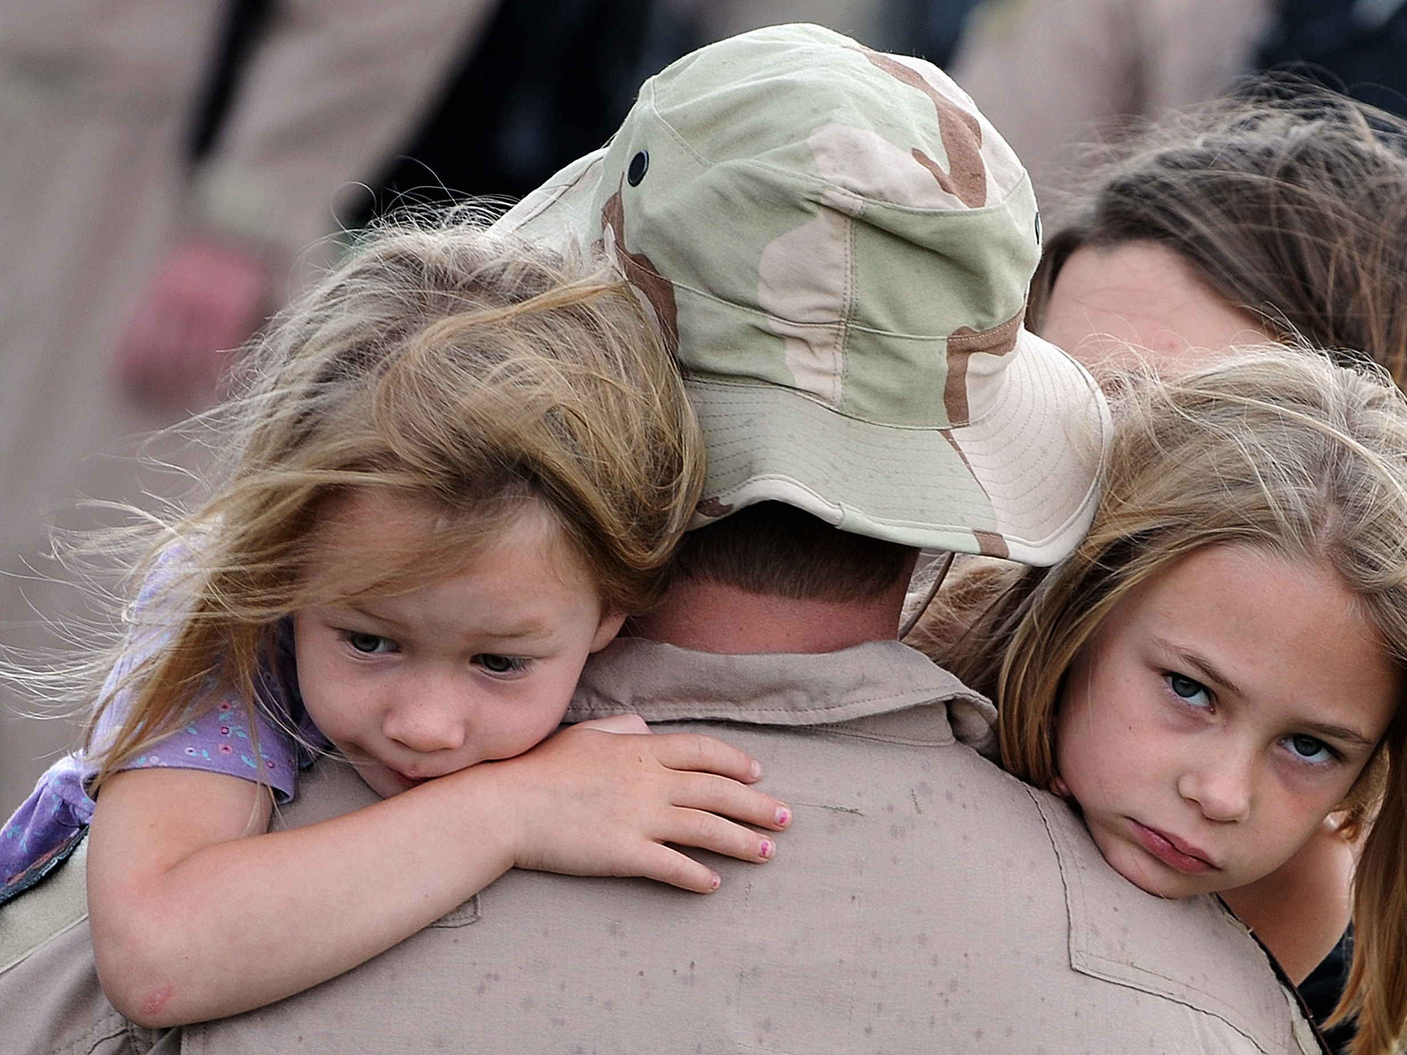
Family Impacts

Slide 45
Questions, Questions, Questions
Will Life Ever Be the Same Again?
Will My Parent/Spouse/Son or Daughter Come Back?
Will We Be Safe While One Parent Is Away?
Can I Survive Alone
Notes:
These are some common questions with which families wrestle during deployment.
WILL LIFE EVER BE THE SAME AGAIN?
WILL MY PARENT/SPOUSE/SON OR DAUGHTER COME BACK?
WILL WE BE SAFE WHILE ONE PARENT IS AWAY?
CAN I SURVIVE ALONE

Slide 46
Family Impacts
Reverberations of Trauma Throughout the Family System
Deployments Alter Family Structure and Roles
There Is the Need to Create a New Normal
Marriages Face Unique Challenges
Children Have Unique Needs and Reactions
Trauma Is Indeed Contagious
Notes:
The families face many of the same issues as the veteran by virtue of their care and concern for the veteran. They also have their own unique concerns and challenges. Some of the challenges that are faced include:
REVERBERATIONS OF TRAUMA THROUGHOUT THE FAMILY SYSTEM
DEPLOYMENTS ALTER FAMILY STRUCTURE AND ROLES
THERE IS THE NEED TO CREATE A NEW NORMAL
MARRIAGES FACE UNIQUE CHALLENGES
CHILDREN HAVE UNIQUE NEEDS AND REACTIONS
TRAUMA IS INDEED CONTAGIOUS

Slide 47
Family Deployment Tasks
Pre-Deployment
Departure Grows Closer
Departure
Deployment
Transition
Reintegration
Brief intense emotions
Possible detachment
Intense period of sadness
Adjustment to new routines
Tension continues
Adjustment to new routines
Notes:
The emotions and tasks facing families vary greatly depending on the phase of the deployment.
PRE-DEPLOYMENT - The announcement of deployment can create anxiety especially the first time it occurs. Concerns for safety are often accompanied uncertainty as to how the family will cope with the absence of the military member.
DEPARTURE GROWS CLOSER - As the deployment draws near family members begin to emotionally detach from one another. Sometimes family members actually initiate conflict to make saying good-bye easier.
DEPARTURE - The actual departure however still produces feelings of sadness and the family may struggle to find ways to adapt to the absence of the military members.
DEPLOYMENT - During the deployment the family settles into new routines and begins to function more comfortably together.
TRANSITION - About two weeks before the military members return formal briefings begin to take place to prepare them to transition back to their families and civilian life. Family members often do not receive the same preparation but begin to anticipate the reunion with mixed emotions.
REINTEGRATION - Reintegration begins when the military member returns and they and their family members begin to create new routines that account for individual growth within the family and allows them to move forward together.

Slide 48
Life Cycle Issues
Launching
New Couples
Young Children
Adolescents
Divorce
Migration
Chronic Illness and Disability
Notes:
The family life cycle stage also effects the tasks and challenges faced by families in terms of deployment and reintegration.
LAUNCHING - Many young military members are in the launching phase, the initial separation from family and going out for the first time as adults. Family impacts effect primarily parents and siblings of veterans in this stage.
NEW COUPLES - Newly married couples have unique challenges as they may not have had a great amount of time together before being impacted deployment and will have limited personal experience to draw upon. Additionally, the remaining spouse maybe geographically separated from extended family support systems for the first time.
YOUNG CHILDREN - Young children present unique issues. They often feel they are some how responsible for the military members leaving. They need to be reassured and told that the departure was not their fault.
ADOLESCENTS - Adolescent have two developmental tasks that can cause conflict during deployments, the need to differentiate themselves as adults and the need to assume more responsibility in the family because of the absence of a parent.
DIVORCE - If the family was experiencing difficulty and considering divorce, deployment only exacerbates these problems.
MIGRATION - Military families experience frequent moves which are disruptive to family members, when these moves follow on the heals of a deployment the difficulties are magnified.
CHRONIC ILLNESS AND DISABILITY - Families with chronically ill or disabled members face addition stress as care for these members must be assumed without the assistance of the family member that deployed.

Slide 49
Soldier & Spouse From Battlemind Training Vignettes
Notes:
Note the different issues that are present in this vignette.
Think of what resources are available to help the couple deal with these issues.

Slide 50
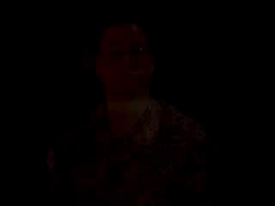

Slide 51
Marriage Impacts
Decreased Personal Expressiveness
Greater Interpersonal Conflict
Role Conflicts
Reduced Problem Solving Skills
Reduced Family Cohesion
Intimacy Issues
Notes:
Deployment and combat trauma also creates unique challenges for marriage and family. Many of the following problems can occur in families as the result of deployments.
DECREASED PERSONAL EXPRESSIVENESS
GREATER INTERPERSONAL CONFLICT
ROLE CONFLICTS
REDUCED PROBLEM SOLVING SKILLS
REDUCED FAMILY COHESION
INTIMACY ISSUES

Slide 52
Family Reintegration Tasks
Get Reacquainted
Reestablish Intimacy
Negotiate New Boundaries
Renegotiate Roles
Adjust for Current Family Realities
Seek Family Oriented Social Support Networks
Adapting to Community Change
Notes:
The following tasks are common ones that need to be accomplished to help families successfully reintegrate following deployments. They take time, commitment, and support to be accomplished.
GET REACQUAINTED
REESTABLISH INTIMACY
NEGOTIATE NEW BOUNDARIES
RENEGOTIATE ROLES
ADJUST FOR CURRENT FAMILY REALITIES
SEEK FAMILY ORIENTED SOCIAL SUPPORT NETWORKS
ADAPTING TO COMMUNITY CHANGE

Slide 53
Helpful Responses
Have Realistic Expectations
Listen and Allow Telling of Each Other’s Stories
Be Supportive and Encouraging
Allow Necessary Time for Transition
Focus on Strengths Rather Than Deficits
Do Not Force Interpersonal Relationships
Work Together to Create a New Normal
Notes:
HAVE REALISTIC EXPECTATIONS – The most common desire expressed by the folks I have talked to is that they want their son/daughter, husband/wife, mother/father back. Thinking back to what the veterans said earlier in this presentation, this is not going to happen. They have been changed. Realistic expectations begin with starting in the moment to build a new normal and trying to return to an idealized past. People change and grow everyday, veterans and their families. Life moves forward even as we remember the past.
LISTEN AND ALLOW TELLING OF EACH OTHER’S STORIES – Much has happened during the deployment for the veteran as well as for the family members, listen to each others stories. When I returned from my Afghanistan deployment I experienced the famous “Why you were away on vacation, I had to…” conversation. Every family members sacrifices something through a deployment and that sacrifice needs to be recognized and not minimized. Also for the veteran realize that many experiences will be held back, because they do not wish to scare or traumatize other family members with graphic accounts of combat or other experiences.
Be Supportive and Encouraging - One of the three factors consider essential in helping individuals overcome the effects of trauma, including combat trauma, is the presence of supportive relationships. This is not always easy as one of the common responses is to withdraw. It is important not to take such trauma reactions personally and maintain supportive relationships despite distance in a partner.
ALLOW NECESSARY TIME FOR TRANSITION – Allow time for transition. Think back to the Battlemind Program, it takes time to change combat survival habits to more acceptable civilian responses. I remember returning from one deployment and walking down the hall to use the guest bath for a week rather than using the master bath off the bedroom, simply because I had gotten use to walking five blocks to use the common latrine and showers during the deployment.
FOCUS ON STRENGTHS RATHER THAN DEFICITS – Focus on what is going well and find strength and encouragement in those things to help deal with the more difficult transitions. Think of this way, you can improve your rabbit hunting skills or your skunk hunting skills. If you choose to improve your skunk hunting skills you will have one big stink. If you choose to improve your rabbit hunting skills you will have a lot more warm fuzzies. A silly analogy, but one that illustrates the truth of finding what you hunt for, and the importance of focusing on strengths.
DO NOT FORCE INTERPERSONAL RELATIONSHIPS - Interpersonal relationships cannot be forced, they only exist in an atmosphere of mutual respect. Attempts to force one partner to accede to one’s own will only results in conflict.
WORK TOGETHER TO CREATE A NEW NORMAL - This is the basic rule of successful reintegration.

Slide 54
Father & Son From Battlemind Training Vignettes
Notes:
Note the different issues that are present in this vignette.
Think of what resources are available to help the couple deal with these issues.

Slide 55


Slide 56
Impacts on Children
Disruption of Routines
Boundary Issues & Parental Roles
Fear for Safety of Military Parent
Mimicry of Parental Responses
Sleep Disturbances and Phobias
Increase in Number of Physical Ailments
Secondary and Vicarious Traumatization
Notes:
DISRUPTION OF ROUTINES – Routines are very important to children providing a safe and predictable world in which to grow and explore. Deployments disrupt routines either through the removal of a parent, or a physical move to a new location. The sooner that a family can return to old routines or establish a new routine the better it is for children. If the family relocates to a new community with school age children as the result of a deployment, it is advisable to consult with school officials regarding previous routines and other issues related to the deployment.
BOUNDARY ISSUES & PARENTAL ROLES – For older children there may be boundary issues such as expecting children to accept increased responsibility, or an older child may attempt to take over the role of the missing parent or challenge the authority of the remaining parent. It needs to be remembered that deployment is a temporary situation and that changes made in these areas can be very challenging in reintegrating the family after the military member returns.
FEAR FOR SAFETY OF MILITARY PARENT – As children get older they become more aware of the dangers faced by the deployed parent and exhibit greater fear for their safety. Children need to be allowed to voice these concerns and be assured that steps are being taken for the soldiers safety.
MIMICRY OF PARENTAL RESPONSES – Younger children tend to mimic the emotional and behavioral responses of parents. Parents can reduce this impact by having a personal confidant or support system, and maintaining strong and nurturing presence with children.
SLEEP DISTURBANCES AND PHOBIAS – These reactions are common in younger children and need not cause alarm unless they lead illness or other dysfunctions.
INCREASE IN NUMBER OF PHYSICAL AILMENTS – This reaction is also common in young children. Take these complaints seriously as they are often stress related but not necessarily a source of alarm.
SECONDARY AND VICARIOUS TRAUMATIZATION – Secondary and vicarious traumatization is a post-deployment issue. In those members who return with severe PTS issues, their behaviors can reverberate and impact family members in much the same way that addictions and abuse effect family systems. If you feel that this is a concern, talk with your pastor and seek care from a mental health professional.

Slide 57
Developmental Issues
Toddlers (3-5) - Separation Anxiety, Self-Comforting Behavior, Regression, Refusal to Eating and Sleep
Elementary (5-10) - Anxiety, Withdrawal, Regression, Fear, Uncontrolled Acting Out, Behavioral Contagion
Middle School (10-13) + Fighting, Isolation Behavior, Emotional Contagion, Difficulties with Concentration
Teenagers (13-18) + Rule Testing, Substance Use, Assaults, Use of External Systems for Support
Notes:
Childhood is a very dynamic period with numerous and rapid changes taking place in the child’s physical, cognitive, and emotional development. Their reactions need to be kept in the context of where they are in that development.
TODDLERS (3-5) – Toddlers have very limited expressive skills and tend to exhibit their problems through behaviors and somatic difficulties.
ELEMENTARY (5-10) – Elementary aged children are beginning to develop greater skill but still have significant limitations. The family is still the primary center identity and the disruptions to the family as the result of deployment can reverberate in the child’s life through regression and acting out in school.
MIDDLE SCHOOL (10-13) – At this age physical changes associated with puberty, greater sense of social identity, and related emotional changes add to the difficulty of dealing with deployment.
TEENAGERS (13-18) – Teenagers are more likely to test their ability to function as adults or to take on more responsibility as the result of a deployment. This age group also is far more likely to turn to peers rather than parents for social and emotional support. All this is in addition to the normal challenges of raising a teenager.

Slide 58
Remember with Children
Children have individual reactions
Children take their emotional and behavioral cues from parents
Children are generally egocentric and see themselves as responsible for everything
Children may need an invitation to talk
Children need people to listen to them and their stories
Notes:
CHILDREN HAVE INDIVIDUAL REACTIONS – Children have individual reactions based on their stage of development, family environment, and individual personalities which are in the process of formation.
CHILDREN TAKE THEIR EMOTIONAL AND BEHAVIORAL CUES FROM PARENTS – Younger children often take their cues for how to respond to the unfamiliar from their parents. This is true of deployments and crisis situations. Parents need to keep this in mind and seek support to help them manage and cope effectively with deployment. In doing so they will also be of greater help to their children.
CHILDREN ARE GENERALLY EGOCENTRIC AND SEE THEMSELVES AS RESPONSIBLE FOR EVERYTHING – Children up to about the age of 10 tend to be egocentric and omnipotent seeing everything that is happening around them as being because of them. This means if Mommy or Daddy leave, it is because of something they have done. Children need to be reassured repeatedly that the deployed military member has left because of their military commitment and not because of anything that the child has done.
CHILDREN MAY NEED AN INVITATION TO TALK – Children can be easily intimidated by adults, even parents. It is appropriate to ask children about their concerns and provide avenues for safe expression. For younger children this may be through play or art, because of their limited vocabulary and expressive skills. The important thing is to provide a safe environment where they are free to express themselves and can feel listened to.
CHILDREN NEED PEOPLE TO LISTEN TO THEM AND THEIR STORIES – Having given permission and opportunity for children to express themselves LISTEN. Their concerns maybe different from your own or not make a lot of sense, but they are theirs and need to be addressed.

Slide 59
Reserve and National Guard Family Concerns
Families not as experienced with deployment and extended absences
Family members less familiar with military support agencies
Live in local communities with less access to military support systems
Face integration back into civilian job or may need job assistance.
Notes:
Where churches can perhaps have the greatest impact is with members and families of the Reserve and National Guard components of the military. These folks often live many miles from a military installation and from other military families making access to support services and other military families who share their experience and can encourage them difficult. Likewise certain veteran issues such as adverse economic impacts and unemployment are far more common among these families. For example a reservist who is self-employed or owns their own business runs the risk of facing of losing their business, but without the employment protections offered by law to regular employees. Additionally, the military pay of the reservist or guardsman can be significantly less than that of their civilian job impacting the life-style of the family. Families of these components maybe less experienced with the military bureaucracy and have greater difficulty in knowing where to turn and seek assistance when needed. The fact that your congregation is not near a military installation does not mean you do not have members who are members of the reserve components or their families that are not directly impacted by the war. In some cases, particularly the Army where the deployments are longer, you spouse will return to their families and hometown communities for support during the deployment.

Slide 60
Available Resources
Review of Resources
Bibliography
Program Reviews
Notes:
This DVD contains a bibliography of many web sites, books, scholarly articles, and video resources related to returning veterans and their families. But you are the expert as to what is available in your own community to assist these families as they struggle with their worries and concerns. Your compassion and creativity are perhaps your greatest resource in helping veterans and their families across the entire deployment spectrum. In the course of developing this presentation, I have found that the issue is not one of not having programs available to assist veterans and their families, but that the vast variety of programs are unknown outside of local communities and specific clientele. Some programs are also proprietary as they are part of businesses or research efforts. The principles of NVOAD (National Voluntary Organizations Active in Disaster) seem to me to be of paramount importance here as in disaster response, COOPERATE, COMMUNICATE, COLABORATE, and COORDINATE. Networking with other organizations and drawing on each others expertise, experience, and resources is the best way to serve our veterans and their families.

