Slide 1

A Biblical Conversation
with
2 Corinthians 7:16-8:7

Slide 2
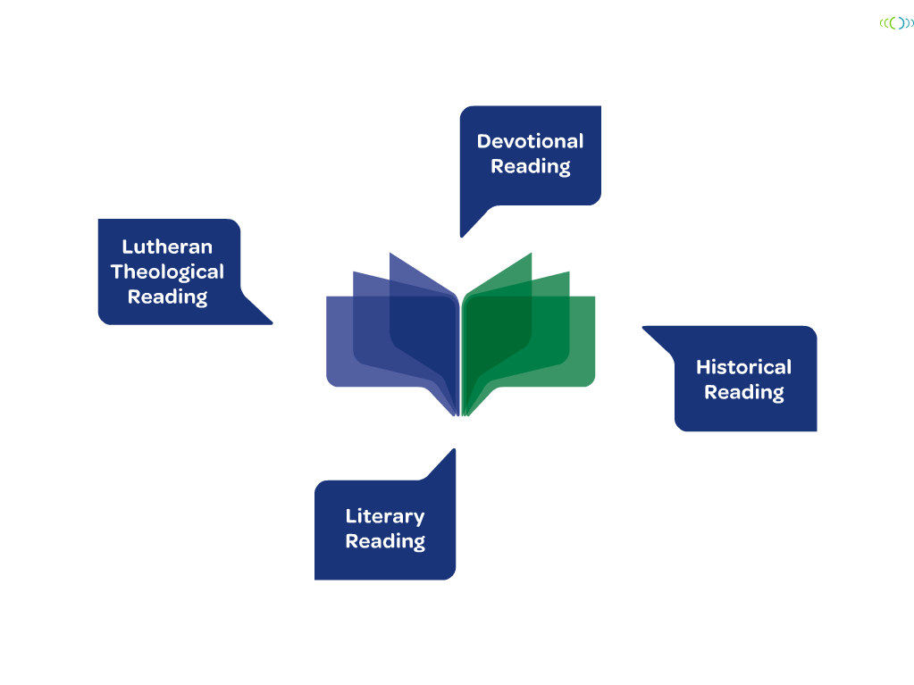

Notes:
2
Jacobson focuses on four ways to approach the Bible in study. These approaches are not the only ways to study the Bible, but they encompass key categories of study that, when used together, help us experience the Bible in a multi-dimensional way. Three of the four approaches we share with other Christians, while the fourth approach (Lutheran Theological Reading) is the unique and helpful “spin” we bring to reading and interpreting Scripture.
These four approaches are used in each of the four Bible studies in the final section of the book, and they will be used as an integrated approach to Bible study in other Book of Faith Bible studies yet to come.

Slide 3

Devotional Reading
Lectio Divina
T.R.I.P. - Thanks, Regret, Intercession,
and Purpose
Catechemenate Bible Study Methods
Kaleidoscope Institute –
Eric Law --Building Inclusive
Community Around Holy Scriptures

Slide 4
Devotional Reading Principles
Listen slowly and carefully.
Attend to the text.
Develop a habit
Don’t need expert in the room. Experts can get in the way.
No right answers.
  Worst Question:
What do you think?

Slide 5
Devotional Questions
What word or phrase strikes you ?
What images, stories or memories
come to mind?
When were you asked to be generous?
What reasons were given?
What confuses or challenges you?
  Who are the most generous,
  those who have more
  or those who have less?
What is God calling us to be, do, tell?

Slide 6
2 Corinthians 7:16-8:7
^{7:16} I rejoice, because I have complete confidence in you.
8:1 We want you to know, brothers and sisters, about the grace of God that has been granted to the churches of Macedonia; ² for during a severe ordeal of affliction, their abundant joy and their extreme poverty have overflowed in a wealth of generosity on their part.³ For, as I can testify, they voluntarily gave according to their means, and even beyond their means,⁴ begging us earnestly for the privilege of sharing in this ministry to the saints--⁵ and this, not merely as we expected; they gave themselves first to the Lord and, by the will of God, to us, ⁶ so that we might urge Titus that, as he had already made a beginning, so he should also complete this generous undertaking among you. ⁷ Now as you excel in everything-- in faith, in speech, in knowledge, in utmost eagerness, and in our love for you-- so we want you to excel also in this generous undertaking.

Slide 7
Devotional Questions
What word or phrase strikes you ?
What images, stories or memories
come to mind?
When were you asked to be generous?
What reasons were given?
What confuses or challenges you?
  Who are the most generous,
  those who have more
  or those who have less?
What is God calling us to be, do, tell?

Slide 8
Historical Questions
What insights from history would be helpful to know in order to hear, read, study or understand this passage more accurately?
Websites: textweek.com; workingpreacher.org; enterthebible.org
Do we know anything about the author? Who wrote this letter?
Do we know when this letter was written, where it was written from, and where it was written to?

Slide 9
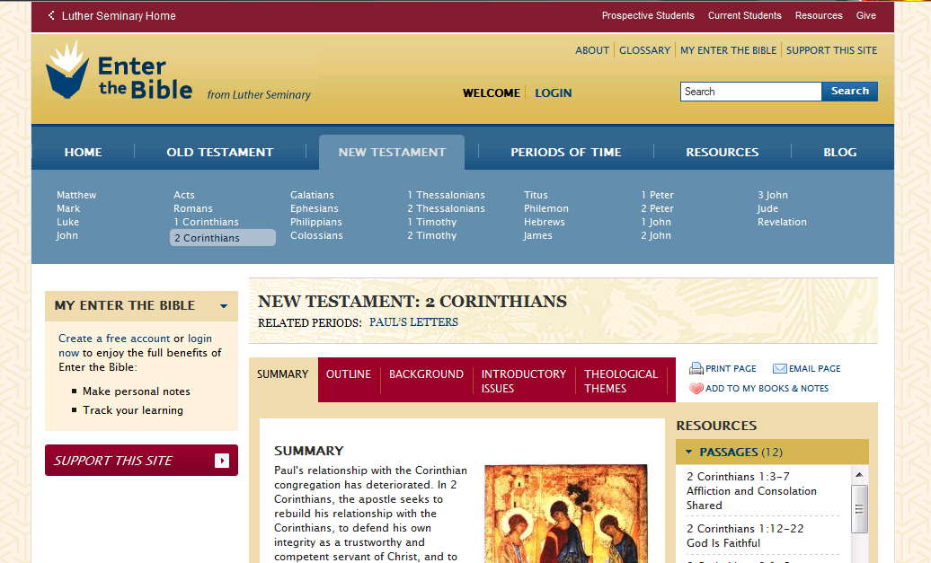
http://www.enterthebible.org

Slide 10

When Was It Written?
After Paul had left Corinth and was living and working in Ephesus (see 1 Corinthians 16:8), he had a letter exchange with the Corinthians. First Corinthians is left from that exchange. At the end of 1 Corinthians, Paul writes that he expects to visit Corinth. At the beginning of 2 Corinthians, Paul speaks of being reluctant to make "another painful visit" (2 Corinthians 2:1). It seems likely, then, that 2 Corinthians was written within several months of 1 Corinthians, after the visit alluded to in 1 Corinthians 16:5-7. All of this probably took place in the early 50s.

Slide 11
Historical Reading Exercise
What about the original context would you like to know?
If you were writing the notes for a Study Bible for this passage, at which points would you put a note?
Example: Ruth 1:1 In the days when the judges* ruled, there was a famine in the land, and a certain man of Bethlehem in Judah went to live in the country of Moab**, he and his wife and two sons…
* when judges ruled -- prior to kings, Israel was ruled by Judges. In the Book of Judges which precedes Ruth, things go badly
** Moab -- a bitter enemy of Israel,
see Deuteronomy 23:3-6
.

Slide 12
2 Corinthians 7:16-8:7
^{7:16} I rejoice, because I have complete confidence in you.
8:1 We want you to know, brothers and sisters, about the grace of God that has been granted to the churches of Macedonia; ² for during a severe ordeal of affliction, their abundant joy and their extreme poverty have overflowed in a wealth of generosity on their part.³ For, as I can testify, they voluntarily gave according to their means, and even beyond their means,⁴ begging us earnestly for the privilege of sharing in this ministry to the saints--⁵ and this, not merely as we expected; they gave themselves first to the Lord and, by the will of God, to us, ⁶ so that we might urge Titus that, as he had already made a beginning, so he should also complete this generous undertaking among you. ⁷ Now as you excel in everything-- in faith, in speech, in knowledge, in utmost eagerness, and in our love for you-- so we want you to excel also in this generous undertaking.

Slide 13
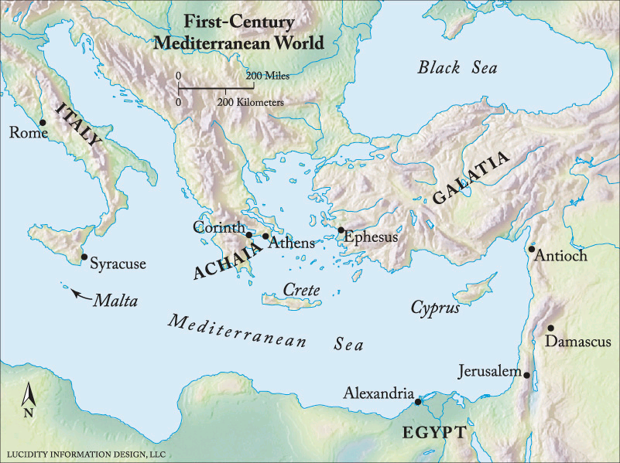
Corinth, in the Region of Achaia
Map from enterthebible.com

Slide 14
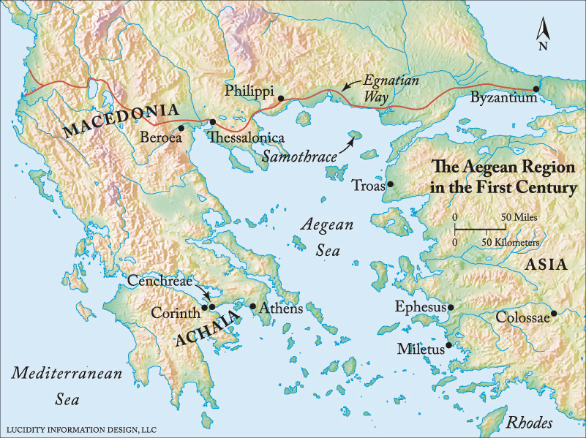
Macedonia, including Philippi and Thessalonica
What is the relationship of churches in Macedonia and the church of Corinth?

Slide 15
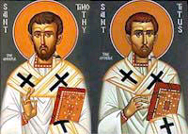
Who is Titus?

Slide 16
The Collection
Acts 11:27-30 ²⁷ At that time prophets came down from Jerusalem to Antioch. ²⁸ One of them named Agabus stood up and predicted by the Spirit that there would be a severe famine over all the world; and this took place during the reign of Claudius. ²⁹ The disciples determined that according to their ability, each would send relief to the believers living in Judea; ³⁰ this they did, sending it to the elders by Barnabas and Saul.

Slide 17
The Collection
Galatians 2:6-10 ⁶ And from those who were supposed to be acknowledged leaders (what they actually were makes no difference to me; God shows no partiality)-- those leaders contributed nothing to me. ⁷ On the contrary, when they saw that I had been entrusted with the gospel for the uncircumcised, just as Peter had been entrusted with the gospel for the circumcised ⁸ (for he who worked through Peter making him an apostle to the circumcised also worked through me in sending me to the Gentiles), ⁹ and when James and Cephas and John, who were acknowledged pillars, recognized the grace that had been given to me, they gave to Barnabas and me the right hand of fellowship, agreeing that we should go to the Gentiles and they to the circumcised. ¹⁰ They asked only one thing, that we remember the poor, which was actually what I was eager to do.

Slide 18
The Collection
Romans 15:25-28 ²⁵ At present, however, I am going to Jerusalem in a ministry to the saints; ²⁶ for Macedonia and Achaia have been pleased to share their resources with the poor among the saints at Jerusalem. ²⁷ They were pleased to do this, and indeed they owe it to them; for if the Gentiles have come to share in their spiritual blessings, they ought also to be of service to them in material things. ²⁸ So, when I have completed this, and have delivered to them what has been collected, I will set out by way of you to Spain…

Slide 19
Literary Reading
First Steps on Type
  What is a letter? What kind of letter is this one?
Literary Context: What comes before and after our passage?
Literary Use of Language: What themes are important?
  Exercise: Underline the repeated or important words or phrases. What do you notice?

Slide 20
Key Words and Repetitions
Charis – grace, privilege
8:1 We want you to know, brothers and sisters, about the grace (charis) of God
that has been granted to the churches of Macedonia…
8:4 begging us earnestly for the privilege (charis) of sharing in this ministry to the saints…

Slide 21
Key Words and Repetitions
Charis – grace, generous undertaking
8:6 -7 so that we might urge Titus that,
as he had already made a beginning, so
he should also complete this generous undertaking (charis) among you.
Now as you excel in everything-- in faith, in speech, in knowledge, in utmost eagerness, and in our love for you-- so
we want you to excel also in this
generous undertaking (charis).

Slide 22
Key Words and Repetitions
Perisseia/Perisseuo
8:2 for during a severe ordeal of affliction, their abundant joy (perisseia literally, “the abundance of their joy”) and their extreme poverty have overflowed (perisseuo) in a wealth of generosity on their part.
8:7 Now as you excel (perisseuo) in everything-- in faith, in speech, in knowledge, in utmost eagerness, and in our love for you-- so we want you to excel (perisseuo) also in this generous undertaking.

Slide 23
Key Words and Repetitions
**begging us earnestly (paraklesis) for the privilege (charis) of sharing (koinonia) in this ministry(diakonia) to the saints—
Paraklesis – earnestly,
with strong appeal,
lift another’s spirits,
comfort, console.

Slide 24
Key Words and Repetitions
Paraklesis –
2 Cor 1: ³ Blessed be the God and Father of our Lord Jesus Christ, the Father of mercies and the God of all consolation,⁴ who consoles us in all our affliction, so that we may be able to console those who are in any affliction with the consolation with which we ourselves are consoled by God. ⁵ For just as the sufferings of Christ are abundant for us, so also our consolation is abundant through Christ. ⁶ If we are being afflicted, it is for your consolation and salvation; if we are being consoled, it is for your consolation, which you experience when you patiently endure the same sufferings that we are also suffering. ⁷ Our hope for you is unshaken; for we know that as you share in our sufferings, so also you share in our consolation.

Slide 25
Key Words and Repetitions
**begging us earnestly (paraklesis) for the privilege (charis) of sharing (koinonia) in this ministry(diakonia) to the saints—
Koinonia – sharing,
generosity, contribution,
fellowship, communion

Slide 26
Key Words and Repetitions
**begging us earnestly (paraklesis) for the privilege (charis) of sharing (koinonia) in this ministry(diakonia) to the saints—
Diakonia –
ministry,
service

Slide 27
Key Words and Repetitions
begging us earnestly (paraklesis) for the privilege (charis) of sharing (koinonia) in this ministry(diakonia) to the saints—
they urgently pleaded with us for the privilege of sharing in this service to the saints. New International Version
Praying us with much intreaty that we would receive the gift, and take upon us the fellowship of the ministering to the saints. King James
begging us with much entreaty for the favor of participation in the support of the saints, New American Standard
They gave offerings of whatever they could—far more than they could afford!—pleading for the privilege of helping out in the relief of poor Christians. The Message

Slide 28
Literary Shape
Exercise:
Summarize Paul’s argument in this passage. How is he trying to persuade the ones reading the letter to be generous? How does Paul’s argument work on us today?

Slide 29
2 Corinthians 7:16-8:7
^{7:16} I rejoice, because I have complete confidence in you.
8:1 We want you to know, brothers and sisters, about the grace of God that has been granted to the churches of Macedonia; ² for during a severe ordeal of affliction, their abundant joy and their extreme poverty have overflowed in a wealth of generosity on their part.³ For, as I can testify, they voluntarily gave according to their means, and even beyond their means,⁴ begging us earnestly for the privilege of sharing in this ministry to the saints--⁵ and this, not merely as we expected; they gave themselves first to the Lord and, by the will of God, to us, ⁶ so that we might urge Titus that, as he had already made a beginning, so he should also complete this generous undertaking among you. ⁷ Now as you excel in everything-- in faith, in speech, in knowledge, in utmost eagerness, and in our love for you-- so we want you to excel also in this generous undertaking.

Slide 30
    Lutheran Theological Questions
        In what ways do we hear
        this passage as law?
        In what ways do we hear
        this passage as Gospel?
        How does this passage show forth Christ?
        How do others hear this text, especially folks
        from cultures different from my own?
        How does this passage move us from God’s salvation to our vocation?

Slide 31
    Lutheran Theological Questions
        In what ways do we hear this passage as law?
        In what ways do we hear
        this passage as Gospel?
        How does this passage
        show forth Christ?
        How do others hear this text, especially folks
        from cultures different from my own?
        How does this passage move us from God’s salvation to our vocation?

Slide 32
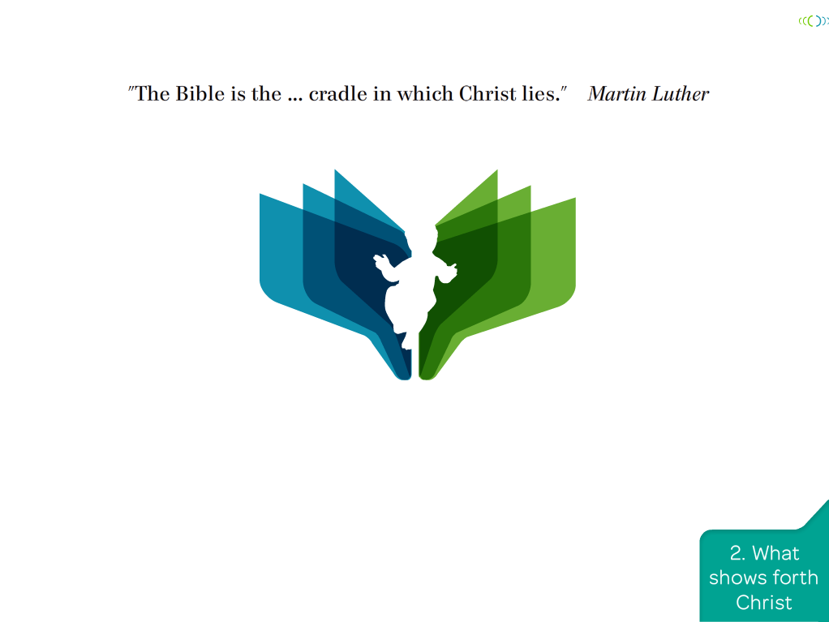
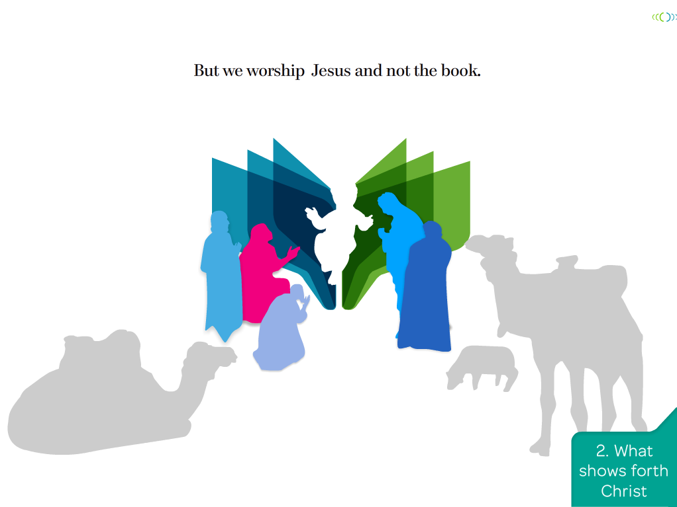
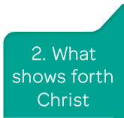
Notes:
When we Lutherans say the Bible is the Word of God we mean, above all, that the Bible is the book that reveals Jesus Christ to us. And by that we mean the whole Bible - not just the Gospels or the New Testament.
The Jesus we know and love is the Messiah of Israel, so the Scriptures of Israel - the Old Testament - also reveal him to us. . . . Everything in the Bible points us toward Christ and helps us to know Christ and to love Christ and to have a relationship with Christ, who is risen from the dead.
Martin Luther used to say the Bible is like the manger that held the Christ child. In many Christmas scenes, we see people kneeling before the manger to worship, but they are not worshiping the manger. They are worshiping the Christ child who is in the manger. So, also, we do not worship the Bible. We worship the Christ who is found in the Bible.
Mark Powell puts it this way: “Lutherans are Jesus people, and they understand the Bible to be a Jesus book.” [Powell, pp. 31-32]

Slide 33
    Lutheran Theological Questions
        In what ways do we hear this passage as law?
        In what ways do we hear
        this passage as Gospel?
        How does this passage show forth Christ?
        How do others hear this text,
        especially folks from cultures
        different from my own?
        How does this passage move us from God’s salvation to our vocation?

Slide 34
    Lutheran Theological Questions
        In what ways do we hear this passage as law?
        In what ways do we hear
        this passage as Gospel?
        How does this passage show forth Christ?
        How do others hear this text, especially folks
        from cultures different from my own?
        How does this passage move us from God’s salvation to our vocation?

Slide 35






Notes:
35
No matter what approaches we use when we read and study the Bible, we bring some overarching and guide values. Echoing thoughts from chapter 1 and from Martin Luther’s own approach, Diane Jacobson lists some of these values:
We come prayerfully asking that the Holy Spirit might guide our study and that Christ might be among us.
We come to the Bible humbly, asking for the gift of faith and ever mindful of our own capacity for sin and self-deceit.
We come mindfully, bringing to our study the gifts of reason, the tools of scholarship, and the insights of others.
We come attentively, reading Scripture carefully and closely.
We come in the context of a faithful community, letting our stories interact with the stories of the Bible.
And we come expectantly, listening for the voice of God working through the text and in the mutual study to inspire, shape, and enliven us individually and as a community of faith.

