Slide 1

50th Anniversary of the Church’s Decision to Ordain Women
Survey Report
August 2021
Updated March 2022
Rebecca Sims, Ph.D.
Deborah Coe, Ph.D.
John Hessian, MA
Kendra Rosencrans, Ph.D.
Research, Analysis and Data

Slide 2
Table of contents
03
Executive Summary
25
Wait Time for Most Recent Call
05
Introduction: Research Questions
30
Attributes and Experiences
49
09
Compensation
Analyses of Open-ended Questions
54
15
Vocational Roles
Recommendations
20
59
Composition of the Word and Sacrament Roster
Appendices

Slide 3
Executive Summary
Findings from a 2020 survey of rostered ministers for the 50th anniversary of the church’s decision to ordain women, conducted by ELCA churchwide staff members
  Key Findings
  When it comes to equity in pay and other compensation, the gender gap persists.
      Among rostered ministers, men still tend to receive the calls that come with more compensation and more prestige.
      The overall number of rostered ministers is decreasing, and increasingly more new rostered ministers are women.
      Wait times for calls have been increasing for both women and men. Women from racialized communities experience the longest wait times.
      There are some gender, racial and ethnic differences in how rostered ministers perceive themselves and their roles.
      Rostered ministers who are women (white and from racialized communities) and all ministers from racialized communities continue to experience higher rates of discrimination and sexual harassment compared with white men.
      Both men and women increasingly advocate for the use of inclusive language in congregational settings.
      Educational debt for rostered ministers continues to rise, and women still have significantly more debt than do men.
  Recommendations
      The churchwide organization, seminaries and Portico: Continue to study educational debt and disparities of debt among seminary students and seek debt forgiveness measures.
      Synods: Develop and implement diversity, equity, and inclusion strategies that include training for congregations and candidacy committees and support congregations to call candidates who are women, especially women from minoritized communities.
      The churchwide organization, synods and Portico: Create systems of support for rostered ministers who are women, such as continuing education in theology and administration, pastoral care, affinity networks, access to specialized mental health and wellness resources, etc.
      Synods: Continue to advocate for all women and all persons of color to be compensated at or above synod guidelines.
      The churchwide organization, seminaries and synods: Regularly conduct sexual harassment education for all three expressions of the church and have policies and practices in place that provide accountability measures and safe avenues for reporting offenses.

Slide 4
Notes on this report
Due to a variety of factors, this report is available much later than anticipated. For this, we who worked on it apologize.
A report on ministers of Word and Service is forthcoming.
Language matters, and it matters particularly for this report because the survey asked questions about sex, gender, sexuality, and race and ethnicity. Language for these topics is changing and will continue to change. The staff members who worked on this report acknowledge this and hope that the mix of terms employed here reflects justice and integrity, even while we are confident that better and different language will be used in the future.

Slide 5
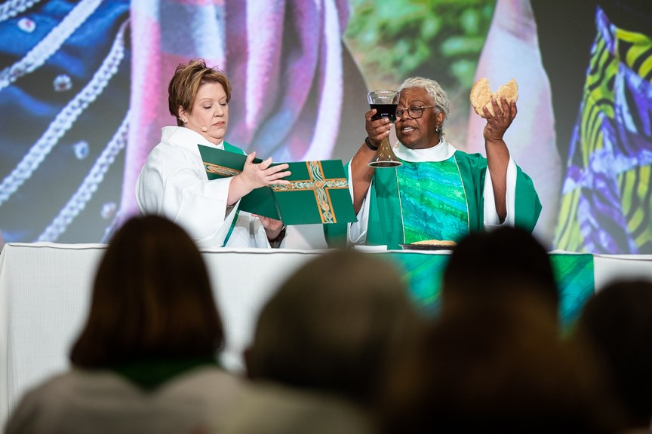
Overview of the section
  Purpose of the Study
  Research Questions
  How the Study Was Conducted
Introduction:
Research Questions

Slide 6
Purpose of the Study
Introduction
The year 2020 was the 50th anniversary of two Lutheran church bodies in North America deciding to ordain women in ministry. In 1970 the American Lutheran Church (ALC) and the Lutheran Church in America (LCA) reformed the church with those historic votes. They later joined the Association of Evangelical Lutheran Churches to become the ELCA in 1988. As with previous anniversaries, ELCA Research, Data and Analysis conducted an extensive survey to explore the differences and similarities in ministerial experiences based on gender and race.
We (ELCA Research, Data and Analysis) patterned this survey on those conducted in 1995, 2005 and 2015, which were fielded in support of the 25th, 35th and 45th anniversaries. Using data from these previous surveys for comparison, we examined trends in ministerial experiences.
We conducted this study to:
Explore differences and similarities in the ministerial experiences of women and men.
Learn how race, ethnicity and gender interact to affect ministerial experiences.
Track any trends over time.
Provide data to help the ELCA in all its expressions make informed decisions to positively affect the ministerial experiences of people of all genders.

Slide 7
Introduction
Research Questions
1. Are there currently gender,
racial and ethnic differences:
  In compensation levels?
  In vocational roles?
  In retention rates?
  In wait time for calls?
  In attributes and experiences?
2. What are the trends over the
past five to ten years?
    The survey was designed to explore how rostered ministers were experiencing ministry.
    We anticipated that the responses would differ based on gender, race and ethnicity, as well as at their intersections.
    We compared the responses to the 2020 survey with those of 2015 and 2005 to consider how responses may have changed.
    All reported differences are significant at the .05 level. This means that there is a less than 5% chance that we incorrectly detected a difference between groups when they were, indeed, equivalent.*
* For information about significance testing, see appendix

Slide 8
How the Study Was Conducted
Introduction
    The 50th Anniversary Questionnaire was emailed to a sample of 2,707 ELCA Word and Sacrament ministers in November 2019.* Women, younger ministers and ministers from racialized communities were oversampled. We conducted weighted analyses to statistically correct for the oversampling of these three groups. Participants completed the survey between November 2019 and February 2020.
    This sample consisted of:
    1,075 white women.
    1,100 white men.
    181 women from racialized communities.
    351 men from racialized communities.
    Response rates:
    46% (499) of the white women responded.
    31% (340) of the white men responded.
    31% of the women from racialized communities (57) responded.
    14% of the men from racialized communities (49) responded.
    We recognize that the term “rostered ministers” refers to ministers of Word and Service as well as ministers of Word and Sacrament. For brevity, we use “rostered ministers” or “pastors” throughout the report to refer to ministers of Word and Sacrament.
We invited a sample of 2,707 ELCA Word and Sacrament ministers to complete the survey online.
A total of 945 people completed the survey, for a combined response rate of 35%.

Slide 9
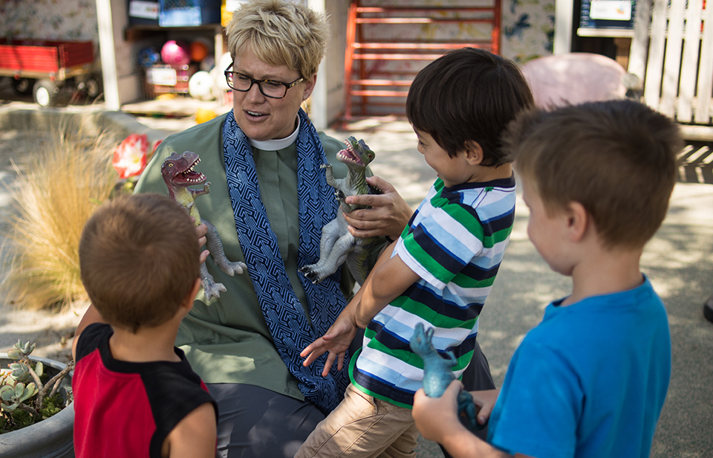
Overview of the section
  Compensation Levels
  Synod Guidelines
  Differences by Year of Graduation
Compensation

Slide 10
Median and Mean Defined Compensation Levels for Full-time Pastors Serving Congregations in 2015* and 2020
Compensation
Year | 1st call women | 1st call men | Percentage difference | All Women | All Men | Percentage difference
2015 Median | $59,552 | $62,150 | 4% | $61,302 | $67,412 | 9%
2015 Mean | -- | -- | -- | $60,758 | $70,354 | 15%
2020 Median | $58,441 | $60,354 | 3% | $65,365 | $72,000 | 10%
2020 Mean | $60,029 | $64,611 | 7% | $68,245 | $74,880 | 9%
When a call is issued for a first-call pastor, the synod bishop and staff members often treat the base-salary guidelines as a requirement for approving the call. For subsequent calls, however, pastors are more likely to have to negotiate an appropriate level of compensation on their own with less direct intervention from the synod.
Defined compensation includes a base salary, a housing allocation (typically 30% of the base salary) and a Social Security offset (7.65%).
In the 2020 survey, compensation information was not available from Portico, so participants were asked to self-report their compensation.
For all ministers, men have been earning more than women, and this has not changed in the past five years.
For first-call pastors, the median compensation gap has narrowed somewhat in the past five years. This may be due to increased intervention from synod staff for first-call pastors.
*2015 numbers were adjusted for inflation; means are not available for first-call pastors. Mean is also known as an average.

Slide 11
Compensation Differences by Gender and Race for Full-Time Pastors Serving Congregations in 2020
Compensation
 | Full-time Women (249) | Full-time Men (206) | Difference
Mean | $68,245 | $74,880 | $6,635
Median | $65,365 | $72,000 | $6,635
 | Full-time Pastors of Color (27) | Full-time White Pastors (428) | Difference
Mean | $64,320 | $71,686 | $7,366
Median | $60,000 | $68,579 | $8,579
There were significant differences by gender and race for compensation. Men had higher levels of compensation compared to women. White respondents reported higher compensation levels compared to pastors from racialized communities.
Although it would be desirable to break these figures down by race and ethnicity, the number of respondents (27) is too small to allow for such comparisons. Future studies should be done in ways to encourage more diverse participation in rostered minister surveys.
NOTE: Number of respondents is shown in parentheses.
Notes:
=

Slide 12
Percentage of Rostered Ministers at, Above or Below Synod Compensation Guidelines 2005-2020
Compensation
We asked survey participants to indicate whether, for the majority of time during their most recent call, their compensation was at, above or below their synod’s guidelines.
Over the last 15 years, about half the rostered ministers have been compensated at synod guidelines, with the rest fairly evenly spread between being compensated below synod guidelines and above synod guidelines (though more ministers are compensated below guidelines than above).
The percentage of rostered ministers indicating that their compensation was below synod guidelines increased from 2005 to 2015, then decreased in 2020.
Note: This analysis includes all participants, not just those serving in congregations.

Slide 13
Differences Among Rostered Ministers With Respect to Compensation Guidelines
Compensation
Based on self-reported data from the 2020 survey, white men were more likely than any other group to be paid above synod guidelines in their most recent call.
White women were most likely of the four groups to be paid at synod guidelines, followed by women minoritized due to race and ethnicity.
Men from racialized communities were the most likely of these groups to be paid below synod guidelines.
Note: This analysis includes rostered ministers in any role, not just those serving congregations.

Slide 14
Year of Graduation and Synod Guidelines in 2020
Compensation
In order to compare more recent graduates to more experienced pastors, we compared compensation levels of pastors who had graduated in the past ten years with those of pastors who graduated more than ten years ago. A similar time frame was used in the 2015 study.
For all groups, those who graduated before 2010 had a higher percentage of participants being compensated below the synod guidelines, compared with those who graduated in 2010 or later.
In other words, more recent graduates seem to be keeping pace with synod guidelines compared to more experienced pastors. This could be due to synods’ involvement in salary negotiations for first-call pastors.
Percentages not adding up to 100 are due to rounding.

Slide 15
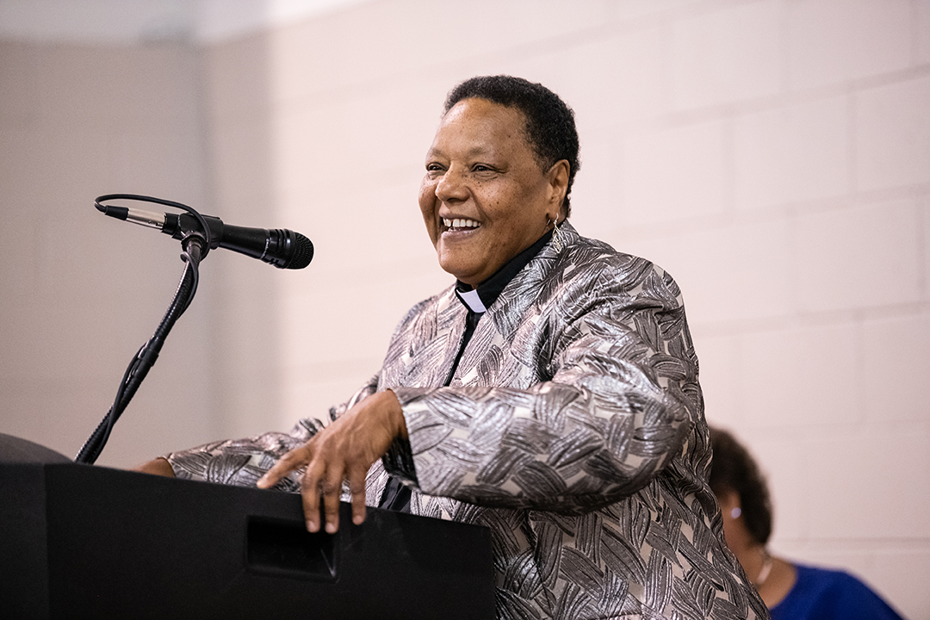
Overview of the section
  Types of Calls
  Size of Congregations Served
  Trends in Types of Calls
Vocational Roles

Slide 16
Types of Calls Where Women Are Relatively Overrepresented
Vocational Roles
Overall, women make up 40% of pastors on the ELCA roster. This includes pastors serving in congregations and in other types of calls.
Several types of calls where women are relatively overrepresented (i.e., they make up more than 40% of pastors serving in that type of call) are:
  In social service agencies (55% of all pastors with calls to social service agencies are women).
  As associate/assistant pastors (54% of all associate/assistant pastors are women).
  As bishops (46% of all bishops are women).
Women
Men

Slide 17
Types of Calls Where Women Are Relatively Under-represented
Vocational Roles
Based on the ELCA roster data, among rostered ministers, women are relatively under-represented (i.e., they make up less than 40% of pastors serving in that type of call) in several types of calls:
  As college, university or seminary professors (34% of all professors are women).
  As solo pastors (38% of all solo pastors are women).
  As senior pastors (22% of all senior pastors are women).*
Women
Men
*Senior pastors are the lead pastors on a multiple-pastor staff; solo pastors refers to pastors who are the only pastor serving that congregation.

Slide 18
Size of Congregations Served
Vocational Roles
Based on ELCA congregational data, women serving as pastors in 2020 are more likely than men to serve in smaller congregations (based on average weekly worship attendance). Twenty-seven percent of all pastors who are women serve in small congregations. This pattern is very similar to the findings from 2015.
While women are nearly as likely as men to serve as pastors in large congregations with more than 500 in average worship attendance, women are most likely to do so as associate or assistant pastors.
Percentages not adding up to 100 are due to rounding. All differences are significant at the .05 level except for congregations worshipping 501-800 or 801 or more.

Slide 19
Trends in Types of Calls: Percentage of Persons in Each Role Who Are Women
Vocational Roles
Role | 2015 | 2020
Senior pastor | 16% (86) | 22% (88)
Bishop | 15% (10) | 46% (30)
Synod or churchwide staff | 40% (77) | 50% (85)
Social service agency | 34% (44) | 55% (47)
Chaplain | 38% (189) | 48% (173)
Based on ELCA roster data from 2015 to 2020, there was an increase in the percentage of senior pastors who are women and of bishops who are women.
There have also been percentage increases in synod or churchwide staff members who are women, women working in social service agencies and chaplains who are women.
We would urge caution about speculating about whether these are positive or negative trends, as a variety of factors determine types of calls. Further research is warranted to better understand women’s experiences of calls and reasons for accepting these calls.

Slide 20
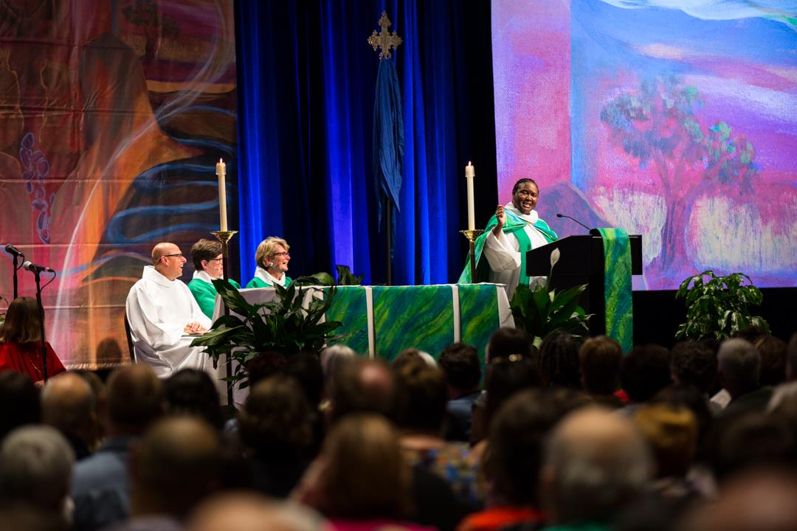
Overview of the section
  Gender Identity of Survey Participants
  3-, 5- and 10-year Retention Rates
  Number of Ordinations by Gender
Composition of the
Word and
Sacrament Roster

Slide 21
Gender Identity of Survey Participants and all Word and Sacrament Ministers on the ELCA Roster
Composition of the Word and Sacrament Roster
Survey participants were asked to indicate their gender identity. Over half of the respondents self-identified as men, with 42% self-identifying as women. Less than 1% of the respondents chose “not listed,” while 0.2% chose “gender non-conforming.” These results are very similar to the gender composition of Word and Sacrament ministers on the ELCA roster, suggesting this is a representative sample.
We also asked survey participants if they publicly identified as LGBTQIA+ in their ministry setting. About 5% answered yes, while 93% answered no and 2% preferred not to answer.
This left us with numbers too small for providing any gender identity or sexuality comparisons beyond the two most frequently reported gender identities (man and woman). We cannot be sure that the sample is large enough for statistical significance tests to be meaningful. We do not know if 5% of the LGBTQIA+ sample is representative of the whole LGBTQIA+ population of rostered ministers.
It is our hope that, over time, as we repeat surveys of this nature, we will see an increase in the proportion of respondents who are comfortable sharing this type of information.

Slide 22
Race and Ethnicity of Survey Participants and All Word and Sacrament Ministers on the ELCA Roster
Composition of the Word and Sacrament Roster
We also examined the race and ethnicity of the survey participants and compared this to the composition of all Word and Sacrament ministers on the ELCA roster.
People from communities minoritized due to race were slightly overrepresented among survey participants (11%) compared to all ministers on the roster (7%).
In contrast, white survey participants were slightly under-represented among survey participants (89%) compared to all ministers on the roster (93%).
We intentionally oversampled people from communities of color to include as many participants as possible in the study. (See Appendix A for more details on sampling.)

Slide 23

Composition of the Word and Sacrament Roster
3-, 5- and 10-year Retention Rates for Ministers of Word and Sacrament
We wanted to see whether men or women were more likely to remain on the roster over time, so we calculated three-year, five-year and ten-year retention rates to find out. We used data from the 2019 ELCA roster database, which was the most recent data we had at the time this analysis was conducted.
Retention rates are calculated as the percentage of rostered ministers active in 2019 who had also been active in a specific year prior to 2019 (in this case, in 2009, 2014 or 2016). For example, three-year retention rates show the percentage of ministers who were active in 2016 and remained active three years later in 2019. Here, the three-year retention rate was 81% for men and 87% for women.
We found that women were more likely to be retained on the roster at each of these intervals.
We also conducted a similar analysis (not shown) starting with a particular ordination date (2009, 2014 and 2016). When we compared how many remained active in 2019, we found no significant gender differences in retention rates.
81%
87%
3-year retention;
active in 2016
(5,926)
70%
79%
5-year retention;
active in 2014
(6,475)
5-year retention;
active in 2014
(3,385)
48%
63%
Men
10-year retention;
active in 2009
(8,016)
10-year retention; active in 2009
(3,272)
Women
19

Slide 24
Number of Ordinations by Gender in the ELCA, 1988-2019
Composition of the Word and Sacrament Roster
Over the life of the ELCA, there has been a steady drop in the total number of ordinations per year. In 2019 the church ordained 32% fewer people than it did in 2015, and the number of people ordained in 2019 is 50% less than the number ordained in 1988.
At the same time, the proportion of those ordained who were women has steadily increased. You can see this by comparing the length of the gold portion of each bar (women) to the length of the blue portion of the bar (men). In 1988 one-third of those ordained were women; in 2019 almost 54% of those ordained were women.
Total 372 374 346 296 313 311 298 339 334 332 351 306 315 310 286 305 273 280 296 296 333 295 299 302 283 238 267 269 209 218 202 183 Ordinations

Slide 25
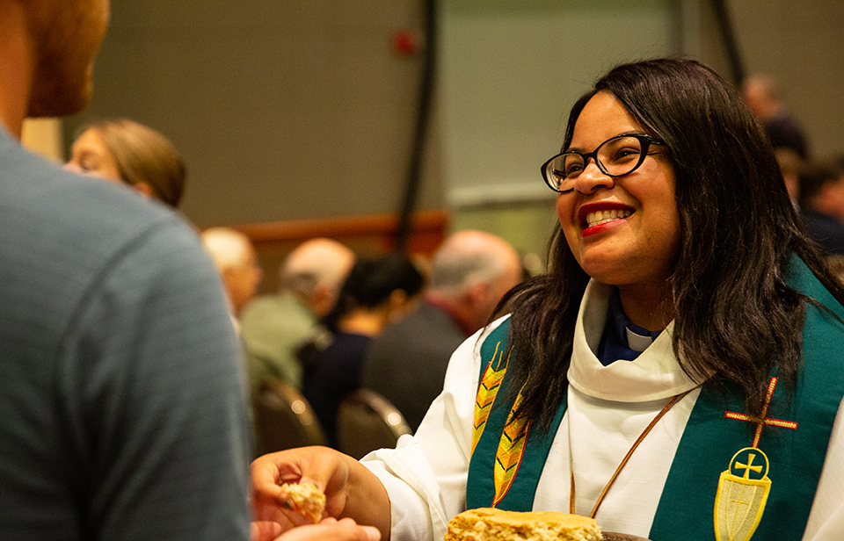
Overview of the section
  Trends in Wait Time
  Differences by Gender and Graduation Year
  Differences by Race and Ethnicity
Wait Time for Most
Recent Call

Slide 26
Trends in Wait Time
Wait Time for Most Recent Call
We compared wait times from previous studies to see how trends have changed compared to five and 15 years ago.
Although more than half (53%) of ministers, on average, still experience a relatively short wait time (four or fewer months) for a call, the proportion of ministers waiting five months or longer has grown in recent years.
Compared to 2005, the combined percentage who waited five months or more for their most recent call has increased from 41% to 48%.
Percentages not adding up to 100 are due to rounding.

Slide 27
Differences in Wait Time by Year of Graduation and Gender
Wait Time for Most Recent Call
We didn’t find significant differences in wait time by gender on its own, so we looked at year of graduation and gender. We thought more recent graduates who were women might have shorter wait times than women who graduated more than 20 years ago.
In the past, most rostered ministers, regardless of gender, received their first call within four months. However, if women did not receive a call within four months, they were more likely to experience more lengthy delays.
We are not seeing any significant gender differences in wait times among the more recent graduates, at least when comparing all men with all women.
Percentages not adding up to 100 are due to rounding.

Slide 28
Differences in Wait Time by Race and Ethnicity
Wait Time for Most Recent Call
After finding no overall gender differences and only slight differences based on graduation period, we next wanted to explore what role race and ethnicity might have on wait time.
We found that women from communities minoritized due to race experience longer wait times for their calls than other groups.
Rostered ministers of color are twice as likely to experience wait times of 24 months or more, compared to white ministers.
White ministers, regardless of gender, are significantly more likely to experience the shortest wait times (four or fewer months).
Percentages not adding up to 100 are due to rounding.

Slide 29
Differences in Number of Restrictions by Race and Ethnicity
Wait Time for Most Recent Call
Rostered ministers in the call process can specify the types of calls they need or prefer. These specifications are known as restrictions.
When we asked rostered ministers about restrictions, we offered three choices of restriction type: geographic (region-specific), familial (driven by the needs of the family) or congregational (based on size or context of the congregation). Rostered ministers could choose as many types of restrictions as applicable.
We wanted to see if differences in wait time by race and ethnicity had anything to do with the number of restrictions rostered ministers placed on their call. This graph shows percentages of the responses given for each of three types of restrictions. These percentages show that ministers who are white placed more restrictions on their calls than did ministers who are people of color, suggesting that the latter were more flexible about the type of call.
Even so, ministers from communities minoritized due to race, as we’ve already shown, are more likely to experience longer wait times. Therefore, the number of restrictions does not explain these longer wait times.

Slide 30
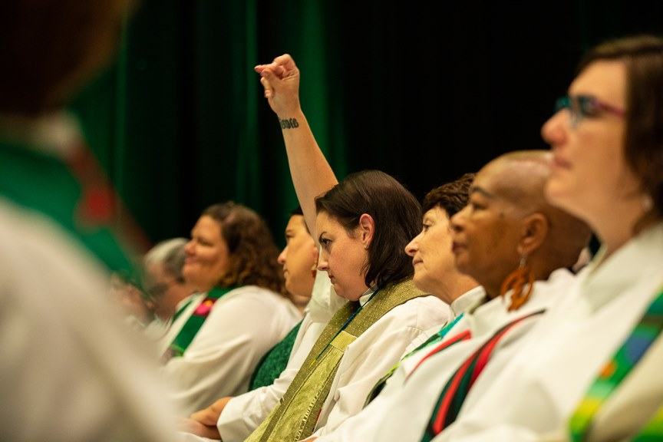
Overview of the section
  Self-description and Rostered Minister Roles
  Pastoral Skills and Ministry Assessment
  Experiences of Discrimination and Sexual Harassment
  Inclusive Language
  Seminary and Educational Debt
Attributes and Experiences

Slide 31
Rostered Minister Role – Prophet
(Percentage Indicating True or Very True)
Attributes and Experiences: Self-Description and Rostered Minister Roles
We also asked ministers to describe their roles as rostered leaders (teacher, priest, prophet, community organizer, nurturer, servant, counselor, administrator, proclaimer and leader), using a five-point scale where 1 = “not true at all” and 5 = “very true.” One of the roles that showed significant changes over time was that of prophet. Numbers on the graph represent the percentages of women and men who saw themselves as prophets in each year.
The role of prophet, while being one of the least identified across all three surveys, seems to have become even less salient over time. For all the Word and Sacrament ministers, there were fewer who consider one of their roles to be that of prophet in 2015 and 2020 compared to 2005 (the percentages in the graph are of those who reported “true” or “very true”).
In all three studies, women were significantly more likely to see themselves as prophets compared to men.

Slide 32
Rostered Minister Role – Administrator and Nurturer (Percentage Indicating True or Very True)
Attributes and Experiences: Self-Description and Rostered Minister Roles
Two additional roles that showed significant differences over the years were administrator and nurturer.
More women in 2015 and 2020 feel they are administrators compared to women in 2005. Percentages represent the number of women who identified with that role in each year.
Fewer men in 2015 and 2020 feel they are nurturers compared to men in 2005. Percentages represent the number of men who identified with that role in each year.

Slide 33
Differences Among Rostered Ministers by Role (Percentage Indicating True or Very True)
Attributes and Experiences: Self-description and Rostered Minister Roles
Majorities of ministers see themselves as servants, priests, nurturers and counselors.
Fewer ministers see themselves as prophets, and the fewest see themselves as community organizers.
Ministers who are people of color are more likely than ministers who are white to see themselves as servants, priests, counselors, prophets and community organizers.
Women, particularly women from communities minoritized due to race, are more likely to see themselves as nurturers than are men.

Slide 34
Gender Differences by Role in 2020
(Percentage Indicating True or Very True)
Attributes and Experiences: Self-Description and Rostered Minister Roles
In 2020, more women serving as rostered ministers feel they are prophets, nurturers and counselors compared to rostered ministers who are men.
In contrast, men identified themselves more strongly as servants than women.
Percentages represent the number of women and men who identified with each role.

Slide 35
Importance of Activities and Concepts in Ministry (Percentage Indicating Important or Very Important)
Attributes and Experiences: Pastoral Skills and Ministry Assessment
We asked ministers to rate how important ten items were in their ministry, where 1 = “not important at all” and 5 = “very important.” (See Appendix B for a full list of frequencies.)
Over 85% in each rostered minister category feel the first five concepts and activities shown here are important or very important.
Seeing steady growth in membership and/or attendance is the least important of these categories for all rostered ministers, especially white women.

Slide 36
Ministry Assessment Differences by Race/Ethnicity (Percentage Indicating Important or Very Important)
Attributes and Experiences: Pastoral Skills and Ministry Assessment
These four areas are more important for ministers from communities of color than for white ministers.
While seeing steady growth is the least important to all groupings of rostered ministers, it is more important to ministers from communities minoritized due to race than to their white counterparts, and significantly less important to white women.

Slide 37
Women Experiencing Gender-based Discrimination
Attributes and Experiences: Experiences by Gender
2015
2020
2015
2020
We asked rostered ministers to indicate if they had experienced gender-based discrimination (different treatment accorded to individuals based on their gender) in any of seven ministry settings, shown on the left as percentages of women who indicated they had.
We found that experiences of gender-based discrimination are common. This was particularly true in congregations or other ministry settings, where in 2020, 65% of women reported experiencing gender-based discrimination.
Additionally, more women in 2020 reported experiencing gender-based discrimination in seminary, in congregational contexts, from other ELCA rostered leaders, during the call process and from ecumenical colleagues compared to 2015.
It is possible that cultural shifts in the last five years allow greater confidence to recognize, name and perhaps report gender-based discrimination.
In seminary
During the call process
During internship
With ecumenical colleagues
In the congregation or ministry setting
By synod and/or churchwide staff
With other ELCA rostered ministers

Slide 38
Experiences in the Congregation or Ministry Setting by Gender (percentages who have had each experience)
Attributes and Experiences: Experiences by Gender
I have received unwelcome comments about my looks and/or attire.
I have experienced gender-based discrimination.
Ministers who are women are more likely than men to indicate they have experienced negative gender-based treatment in their professional church lives in a congregation or ministry setting.
Women are at least twice as likely as men to have had all but one of these experiences.
The difference wasn’t as strong on the final item, “I have thought about how my gender affects how people perceive me,” because a majority of men report having thought about how their gender identity affects how people perceive them.
I have felt as if I represent my gender in what I say or do.
I have experienced sexual harassment.
I have thought about how my gender affects how people perceive me.
Women
Men
Women
Men

Slide 39
Experience of Sexual Harassment by Gender
Attributes and Experiences: Experiences by Gender
Women
Men
Women
Men
Women were much more likely than men to report experiencing sexual harassment (any sexually-related behavior that is unwelcome or offensive, or that fails to respect the rights of others) across all ministry settings.
Nearly half of women (46%) indicated they experienced sexual harassment in their congregation or ministry setting, compared to 13% of men. Also, 63% of men have never experienced sexual harassment, while only 26% of women said they have never experienced it.
In seminary
During the call process
During internship
With ecumenical colleagues
In the congregation or ministry setting
By synod and/or churchwide staff
With other ELCA rostered leaders
Never had this experience

Slide 40
Racial Discrimination by Gender and by Race and Ethnicity
Attributes and Experiences: Experiences by Race and Ethnicity
 | Women of color | Men of color | White women |  |  |  | White men | White men
In the congregation or ministry setting | 49 | 53 | 3 | 7
In seminary | 42 | 39 | 3 |  |  |  |  | 7
By synod and/or churchwide staff | 46 | 35 | 2 |  | 9
Rostered ministers from communities of color are far more likely than their white counterparts to experience racial discrimination (different treatment accorded to individuals based on their race and ethnicity) across all ministry settings.
Both women and men from communities of color were most likely to experience racial discrimination in the congregation or ministry setting, compared to other settings.

Slide 41
Trends in the Use of Inclusive Language From
2015 to 2020
Attitudes and Experiences: Inclusive Language
Respondents to the 2020 survey were more likely to use inclusive language compared to 2015.
White women were most likely to have decreased the use of masculine language and imagery in preaching or other examples.
Women from communities of color were most likely to have increased the use of feminine and gender-neutral language and imagery in preaching or in other examples.

Slide 42
Advocating for the Use of Inclusive Language: Trends From 2005 to 2020
Attitudes and Experiences: Inclusive Language
From 2005 to 2020, rostered ministers have increasingly advocated for the following:
  Use of inclusive language among congregational leaders.
  Scripture translations that use inclusive language.
  Use of inclusive language in congregation/agency publications.
Both women and men are advocating for the use of inclusive language.

Slide 43
How Well Seminary Prepares Candidates for
Their First Call
Attitudes and Experiences: Seminary and Educational Debt
Using a five-point rating scale where 1 = “strongly disagree” and 5 = “strongly agree,” we asked ministers to rate the statement “My experiences in seminary prepared me well for my first call.”
Women of color felt significantly less prepared for their first call than all other groups, with only half agreeing or strongly agreeing with this statement.
White women, white men and men of color had almost identical ratings, with about three-fourths reporting they felt well-prepared for their first call.
We found very similar results in the
2015 study.

Slide 44
Educational Debt at Seminary Graduation
Attitudes and Experiences: Seminary and Educational Debt
In 2015 and in 2020, women were more likely than men to carry substantial educational debt at graduation from seminary.
Overall, the proportion of seminary graduates carrying substantial educational debt at graduation from seminary increased from 2015 to 2020.
While these increases affected both men and women, the increase was greater for men (15% change) than for women (9% change).
Note: The people surveyed in 2015 were not the same people surveyed in 2020, so the changes over five years should be viewed with caution. Factors related to the sample could affect these changes. What’s most relevant here is the fact that debt is increasing for both men and women.

Slide 45
Percentage of Rostered Ministers With No Educational Debt Upon Graduation
Attitudes and Experiences: Seminary and Educational Debt
Survey respondents in 2020 were asked what year they graduated from seminary and whether they had educational debt upon graduation.
The percentage of respondents with no educational debt upon graduation was significantly higher for those who graduated recently (2016-2019), compared to respondents who graduated between 1986 and 2015.

Slide 46
Amount of Educational Debt at Graduation,
1964-2019
Attitudes and Experiences: Seminary and Educational Debt
Survey respondents were also asked to indicate the amount of educational debt they had at graduation from seminary.
Although graduates continue to have significant educational debt loads at graduation, the percentage of graduates with higher debt loads decreased by 12% from those who graduated between 2006-2015 to those who graduated from 2016-2019.
The proportion of seminarians graduating with substantial educational debt has decreased in the past five years.
Note: Percentages not adding up to 100 are due to rounding.

Slide 47
Educational Debt Level for Graduates Since 2000
Attitudes and Experiences: Seminary and Educational Debt
For this analysis, we used 2020 survey data and compared educational debt for ministers who graduated in 2000 or later. We examined both debt at graduation and current debt.
For these more recent graduates, there were no significant differences between women and men either at graduation or for current educational debt in 2020.
This suggests the gender gap for educational debt may be closing.
Percentages not adding up to 100 are due to rounding.

Slide 48
Current Educational Debt Level in 2015 and 2020
Attitudes and Experiences: Seminary and Educational Debt
Among survey respondents, there are significant differences by gender, with women (upper graph) reporting higher levels of current educational debt compared to men (lower graph).
One significant difference is that 42% of women of color who completed the survey in 2015 reported higher levels of educational debt ($15,001 or more) compared to 22% of women of color who completed the survey in 2020.
Women Men

Slide 49
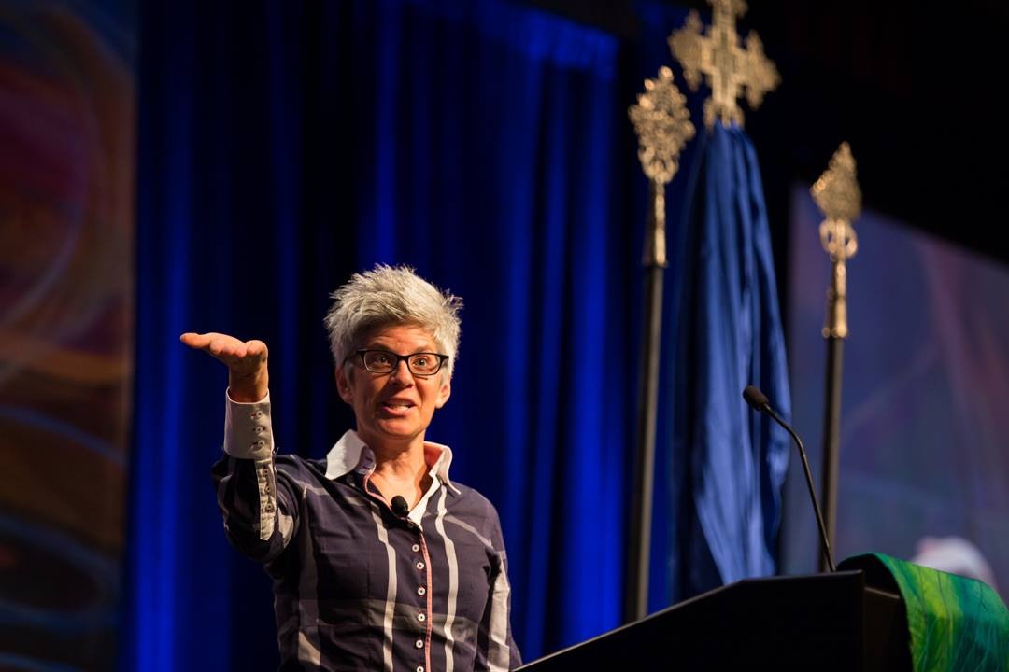
Overview of the section
  Challenges of Rostered Ministry
  Greatest Need to Minister Effectively
  Advice for Women Entering or Serving in Rostered Ministry
  Advice for Bishops, Synod Councils or Churchwide Staff Members
Analyses of Open- ended Questions

Slide 50
Challenges of Rostered Ministry for Women
Qualitative Data
Women of color more often described bias, harassment and discrimination as the greatest challenge.
White women cited the tensions between increasing work and insufficient resources most commonly.
The top three themes among responses from women from communities minoritized due to race were related to:
Racism and sexism in the church (46%).
Vocational challenges (37%).
Time/work/resource tensions (32%).
The top three challenges most common among responses from white women were related to:
Time/work/resource tensions (48%).
Effects on well-being/family (41%).
Racism and sexism in the church (34%).
Open response questions were coded and analyzed for themes as most included multiple examples of different kinds of experiences and challenges. Themes are identified by frequency, that is, how often comments related to these categories occurred in the responses.

Slide 51
Greatest Needs in Ministry for Women
Qualitative Data
When asked to list their greatest needs, rostered women most frequently cited a need for authentic respect and collaboration from congregational members and ELCA colleagues, along with a need for more resources in their ministry settings.
Key themes among responses from women of color included: more action and advocacy from the churchwide organization (32%), more supportive colleagues and colleague networks, and more connections with minoritized colleagues (26%). Safety in the parish and having culturally responsive, safe places to be was also a common theme, along with a desire for proactive, supportive synods (both 24%). White women more commonly identified their greatest needs as support for health and well-being (24%), followed by a need for a proactive, supportive synod (17%).

Slide 52
Core Themes: Advice to Women Entering Ministry
Qualitative Data
When asked what women entering ministry should keep in mind, the top themes in the advice from women of color were: “center your spiritual life,” “create a good support system” and “prioritize your well-being” (each 34%).
More common themes in advice from white women were: “prioritize your well-being” (47%), “set and keep boundaries” (30%) and “trust God, you are not alone” (30%).
A shared theme in the advice mentioned in one in five responses for all participants was that women entering ministry should expect bias and harassment.

Slide 53
Advice for Bishops, Synod Councils or Churchwide Staff Members
Qualitative Data
Responses from women emphasized five major themes: stop discrimination and dismantle patriarchal systems and behaviors, be inclusive, listen to women’s knowledge, and advocate for equity.
Nearly half the responses from women of color emphasized more action to stop allowing discrimination and to dismantle institutional patriarchy, with equal admonition to be more proactive and inclusive.
White women most frequently identified the need for synod and churchwide leaders to advocate for and require equity, with advice to do more to stop discrimination and dismantle patriarchy the second most common theme.

Slide 54
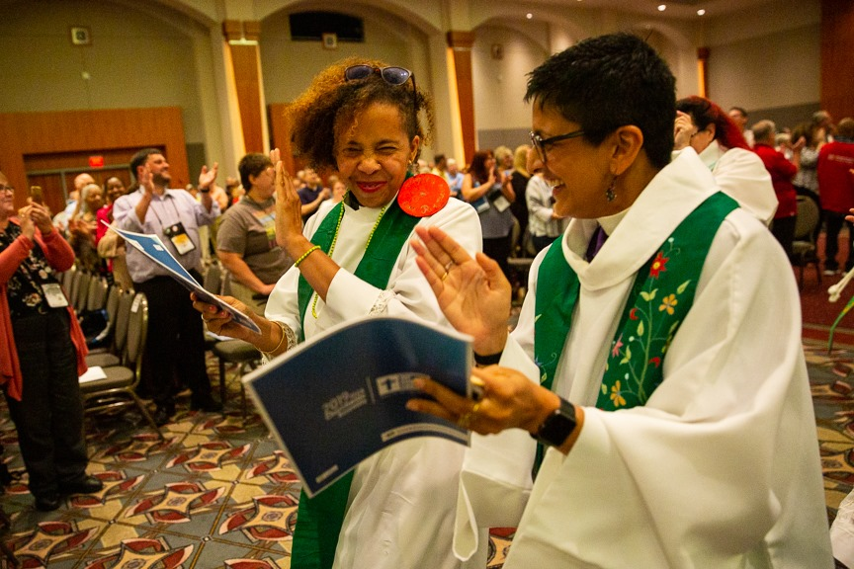
Overview of the section
Recommendations for Future Study and Action, Based on the Key Findings
Recommendations

Slide 55

Recommendations
Recommendation 1:
    Educational debt for rostered ministers continues to rise.
    Women still have significantly more educational debt than do men.
    For 2020 survey participants, we found no significant differences for educational debt comparing ministers of color and white ministers.
      The ELCA and its affiliated seminaries should continue to increase scholarships for seminary students and provide financial wellness education to help them reduce their debt, with a focus on women.
      Additionally, debt reduction strategies should be studied and implemented in all expressions of the ELCA to address the financial needs of existing rostered ministers.

Slide 56
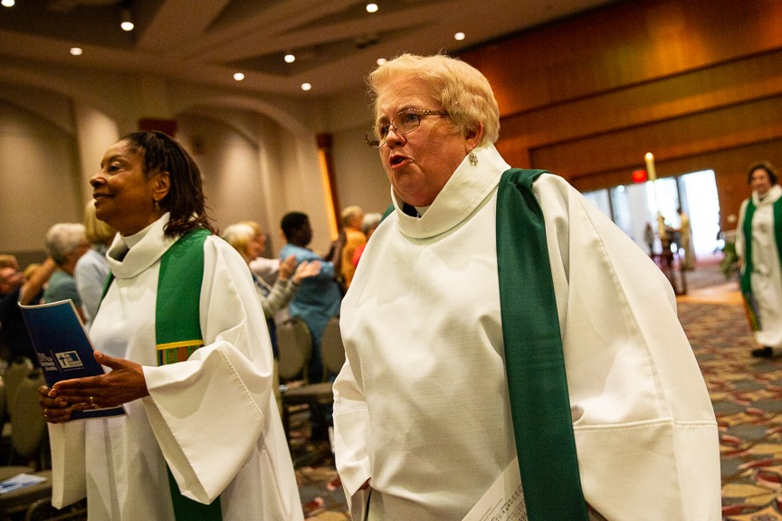
Recommendation 2:
Recommendations
    Women who are rostered ministers are under-represented in the roles of college, university or seminary professors, and as solo and senior pastors.
    While women serving as pastors are nearly as likely as men to serve in large congregations, they are most likely to do so as associate or assistant pastors.
    Women who serve as pastors are more likely than men to be serving in smaller congregations.
      Synods should seek to align with the ELCA’s plan for strategic, authentic diversity, developing and implementing strategies that include education and plans with congregations and their leaders.

Slide 57
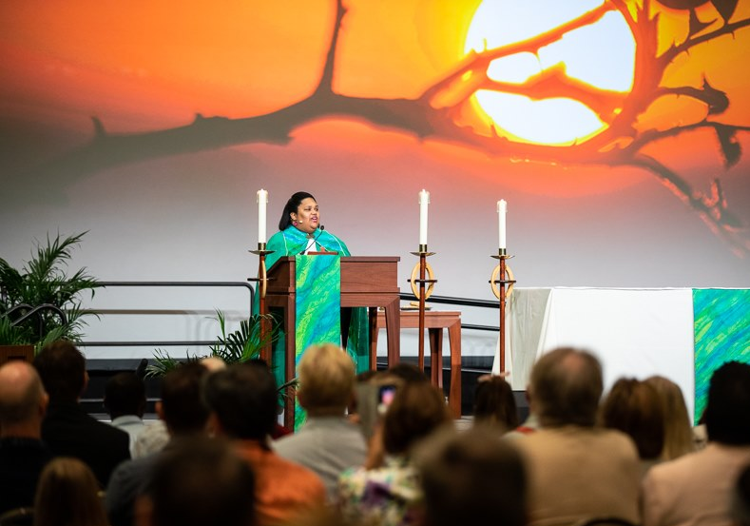
Recommendation 3:
Recommendations
    In the role of pastor, men generally continue to out-earn women, by an average of 9%. This has not improved in the past five years.
    White men are more likely than any other group to be compensated above synod guidelines.
    White women are most likely of the four groups to be paid at synod guidelines, followed closely by women of color.
    Men of color are the group most likely to be compensated below synod guidelines.
    The compensation gap begins at first call and widens over time.
      Synods should continue to advocate for women and people of color to be compensated at or above synod guidelines.

Slide 58
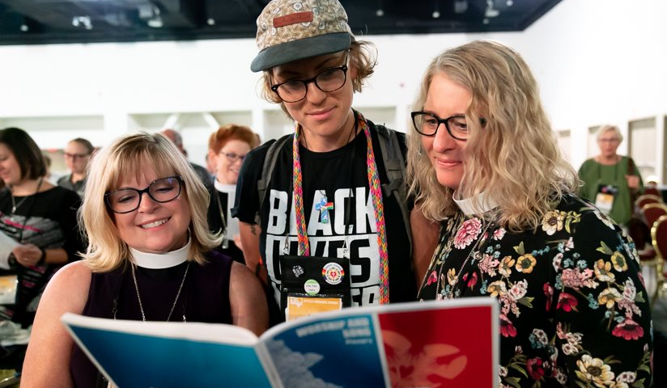
Recommendation 4:
Recommendations
    Women and men of color in the role of rostered minister continue to experience discrimination and sexual harassment. Either reporting of offenses or the number of offenses has increased over time. These are serious problems that must be addressed:
    Sexual harassment.
    Feeling as though they represent their gender in what they say or do.
    Gender-based discrimination.
    Racial discrimination.
    Of significant concern are the reports of discrimination, bias and harassment experienced in seminary, on internship, from bishops and from ELCA ministerial colleagues.
The ELCA churchwide organization, ELCA-affiliated seminaries, and synods should regularly conduct sexual harassment training for all three expressions of the church (congregations, synods and churchwide) and have policies in place that provide accountability measures and safe avenues for reporting offenses.

Slide 59


Appendices
Overview of the section
Appendix A
  Methods
  Sample Design
  Analysis
Appendix B
  Questions Asked and Response Percentages

Slide 60
Methods: How the Study Was Conducted
Appendix A
    Overview
    This survey was patterned after surveys in 1995, 2005 and 2015, which were fielded in support of the 25th, 35th and 45th anniversaries of the ordination of women.
    This is a quantitative study supported with qualitative responses. The survey included mostly closed-ended questions that were assigned numeric response values for statistical analysis, but also included a few open-ended questions to which participants provided answers in their own words.
    See Appendix B for exact question wording and detailed survey responses.
The year 2020 was the 50th anniversary of Lutheran church bodies in the United States deciding to ordain women in ministry.
An extensive survey was conducted to explore the differences and similarities in the ministerial experiences between rostered women and men.

Slide 61
Methods: How the Study Was Conducted
Appendix A
Study Design and Implementation
John Hessian and Deborah Coe, Ph.D., in collaboration with other members of the project team, designed the study and questionnaire. Data were collected by John Hessian. Quantitative and qualitative data analyses were completed by Rebecca Sims, Ph.D., as was the first draft of the final report, which was edited by Deborah Coe and Kendra Rosencrans, Ph.D. Photos were added by Karen Dersnah of the Mission Advancement unit.
The 50th Anniversary of the Ordination of Women Questionnaire was emailed to a sample of ELCA Word and Sacrament ministers on Nov. 8, 2019. A reminder was sent on Dec. 19, 2019, and the survey was closed on Jan. 8, 2020. Although data collection started in 2019, we use the year 2020 throughout the report for ease of reporting and consistency.
The project team consisted of the following ELCA churchwide staff:
John Hessian, Rebecca Sims, Ph.D., and Deborah Coe, Ph.D., Research, Analysis and Data
Mary Streufert, Ph.D., and Heather Dean, Office of the Presiding Bishop
The Rev. Cherlyne Beck, Christian Community and Leadership
The Rev. Brenda Smith, Domestic Mission

Slide 62
Methods: How the Study Was Conducted
Appendix A
Sample Definition
A sample of 2,500 ministers were randomly selected from the total of 7,890 current ELCA Word and Sacrament rostered ministers. To ensure large enough samples from each group for accurate analyses, we over-sampled younger ministers (under 40 years old) and invited 100% of ministers from racialized communities. These changes increased the number of rostered ministers in the sample to 2,707. Table 1, below, shows the sample sizes for each group.
Additional notes:
There are a total of 3,171 women on the roster, which accounts for 40% of rostered ministers. In our sample, there were 1,256 women, representing 46% of the total. Therefore, women were slightly overrepresented in the sample.
There are 2,990 white women on the roster (38%). In our sample, there were 1,075 white women (40%). White women were sampled at nearly the same rate as they are represented on the roster.
There are 4,368 white men on the roster, accounting for 55% of the total. Our sample included 1,100 white men (41%). White men were under-represented in our sample.
Table 1: Samples by group
 | Total on Roster | % of Total on Roster | Random Sample | % of Random Sample | Over/under-sample | % of Final Sample
White women 40+ | 2,434 | 31% | 771 | 31% | 825 | 30%
White men 40+ | 3,729 | 47% | 1,182 | 47% | 850 | 31%
White women under 40 | 556 | 7% | 176 | 7% | 250 | 9%
White men under 40 | 639 | 8% | 202 | 8% | 250 | 9%
Women from racialized communities | 181 | 2% | 57 | 2% | 181 | 7%
Men from racialized communities | 351 | 4% | 111 | 4% | 351 | 13%
Total | 7,890 |  | 2,500 |  | 2,707

Slide 63
Methods: How the Study Was Conducted
Appendix A
Response Rates
Response rates ranged from a high of 46% among white women to a low of 14% among men from racialized communities. These response rates were significantly lower than the surveys fielded in 2015 and 2005, where response rates ranged from 40% to 70% (see Table 2). It is important to note that this survey was closed before the spread of the COVID-19 virus had become an issue in the United States, so the lower response rates cannot be attributed to the pandemic.
It should also be noted that this was not a true longitudinal study; different samples of ministers were selected for each study. Of all the invitations sent for the current study, 64% opened the email, while 38% clicked through and started the survey. Of those who completed the survey, 84% completed the entire survey and 16% partially completed it.
Table 2: Response rates by year
 | 2005 |  |  | 2015 |  |  | 2020
 | Sample | Responses | Response rate | Sample | Responses | Response rate | Sample | Responses | Response rate
Women from racialized communities | 132 | 73 | 55% | 181 | 93 | 51% | 181 | 57 | 31%
Men from racialized communities | 314 | 126 | 40% | 329 | 132 | 40% | 351 | 49 | 14%
White women | 1,334 | 932 | 70% | 775 | 536 | 69% | 1,075 | 499 | 46%
White men | 852 | 494 | 58% | 781 | 482 | 62% | 1,100 | 340 | 31%
Removed | (43)
Total | 2,589 | 1,625 | 63% | 2,066 | 1,243 | 60% | 2,707 | 945 | 35%

Slide 64
Methods: How the Study Was Conducted
Appendix A
Data Analysis
We analyzed survey results by gender, race and ethnicity, and year of graduation from seminary. These analyses help to identify patterns in responses.
To statistically correct for the oversampling of women, people from racialized communities, and younger people, we conducted weighted analyses where appropriate.
In this report, differences between groups were considered statistically significant when they exceeded the p < .05 level. This means that there is a less than 5% chance that we incorrectly detected a difference between groups when they were, indeed, equivalent.
We analyzed qualitative data using content analysis.

Slide 65
Questions Asked and Response Percentages
Appendix B
Number of surveys completed = 943 Note: All responses are shown as percentages.
1. In what year did you enter candidacy? (Various years were entered.)
2. In what year did you graduate from seminary? (Various years were entered.)
3. What is your current/most recent call?
20.8 First call
23.5 Second call
21.3 Third call
15.1 Fourth call
19.3 Fifth or subsequent call
4. Please indicate the approximate number of months you waited for your first call (from the time of assignment until you received your first call).
61.8 One to four months
19.4 Five to eight months
8.4 Nine to 12 months
5.3 13 to 18 months
2.0 19 to 24 months
3.1 25 months or more
5. Please indicate the approximate number of months you waited for your current/most recent call (from the time you began actively seeking a call).
47.6 One to four months
19.3 Five to eight months
11.1 Nine to 12 months
5.0 13 to 18 months
2.9 19 to 24 months
4.0 25 months or more
10.2 This is my first call.
6. Please indicate which, if any, of the following reasons influenced your placement for your current/most recent call. (Please choose all that apply unless you had no restrictions.)
48.8 Geographic
38.7 Familial
30.4 Congregational (i.e., size, staffing)
20.0 No restrictions
7. What is the status of your current/most recent call?
82.5 Full-time
16.6 Part-time

Slide 66
Questions Asked and Response Percentages
Appendix B
8. Why are you in a part-time call? (Choose all that apply.)
7.3 At my request for personal health reasons
5.3 At my request for family health reasons
19.2 At my request to focus on raising my child/children
9.9 At my request to serve jointly with my spouse
58.3 At congregation/agency request because of financial restraints
9. In order to assess exactly how you are doing financially, please let us know your annual defined compensation for 2019. (Various dollar amounts were entered.)
10. For each of the following calls, please indicate whether, for the majority of time during that call period, your compensation was at, above or below your synod’s guidelines.
At Above Below Not sure Not applicable
First call ............................... 53.2 9.5 32.3 3.7 1.3
Second call .......................... 43.9 13.7 27.8 1.9 12.8
Third call.............................. 35.3 14.1 22.3 2.5 25.8
Most recent call .................. 29.2 15.2 17.5 1.7 36.4
(fourth or subsequent call)
11. For each of the following calls, how frequently did you receive pay raises?
Annually or more often | Every 2-5 years | Less than once every 5 years | Never | Not sure | Not applicable
In my first call 57.5 | 18.7 | 4.3 | 12.8 | 3.5 | 3.2
In my second call 47.7 | 21.2 | 3.5 | 11.1 | 1.5 | 15.0
In my third call 40.1 | 15.2 | 5.2 | 9.2 | 1.2 | 29.1
In my most recent 35.6 | 13.5 | 4.8 | 6.4 | 0.3 | 39.4

Slide 67
Questions Asked and Response Percentage
Appendix B
15. If you have ever been on leave from call, what were the reasons? (Please choose all that apply.)
57.9 Never been on leave from call
14.0 Actively seeking/waiting for a call
4.9 Unsure of next vocational steps
6.4 In a graduate study program
8.5 Caring for children/other family
4.3 Caring for own health/medical reasons
2.4 Taking steps for career change out of rostered
ministry
16. In your current call, is paid family leave part of your benefits package?
38.3 Yes
36.3 No
25.4 Don’t know/not sure
17. In your current call, was your ministry’s family leave policy clearly explained?
26.6 Yes
55.9 No
17.4 Don’t remember
18. Have you ever been an internship supervisor?
24.8 Yes
75.2 No
19. How many interns have you supervised throughout your career?
86.0 One to five interns
11.8 Six to 10 interns
2.3 11 or more interns
12. When you moved from your first to second call, how did the amount of your salary and benefits change?
50.4 My salary/benefits package increased.
11.9 My salary/benefits package decreased.
12.5 My salary/benefits package stayed the same.
2.8 Not sure
22.4 Not applicable
13. In your current/most recent call, what is the status of your health care coverage?
66.8 My employer covers the entire health care premium.
9.8 I pay part of my health care premium.
21.3 I have health care coverage through a different
source than my employer.
2.0 I do not have health care coverage.
14. Has your employer reduced your health care coverage during your current/most recent call?
9.9 Yes
90.1 No

Slide 68
Questions Asked and Response Percentages
Appendix B
    20. Please describe how accurately each of the following describes you as a rostered minister.
    21. Please indicate how accurately each of the following describes your role as a rostered minister.
Not true at all 1 | 2 | 3 | 4 | Very true 5 | Not sure | Not applicable | Mean
Personable 0.0 | 0.2 | 3.6 | 33.2 | 62.7 | 0.2 | 0.1 | 4.59
Helpful 0.1 | 0.1 | 5.3 | 42.6 | 51.2 | 0.5 | 0.1 | 4.46
Directive 1.1 | 7.4 | 32.9 | 40.8 | 16.6 | 0.8 | 0.4 | 3.65
Anxious 20.7 | 45.5 | 19.5 | 9.6 | 4.4 | 0.1 | 0.3 | 2.31
Confused 56.9 | 30.6 | 8.0 | 2.6 | 0.4 | 0.5 | 1.0 | 1.57
Goal-oriented 0.6 | 5.9 | 24.2 | 39.4 | 29.4 | 0.2 | 0.3 | 3.92
Not true at all 1 | 2 | 3 | 4 | Very true 5 | Not sure | Not applicable | Mean
Teacher 0.1 | 2.3 | 11.7 | 29.0 | 56.5 | 0.1 | 0.3 | 4.40
Priest 2.1 | 8.2 | 17.4 | 32.3 | 38.1 | 1.3 | 0.7 | 3.98
Prophet 2.2 | 18.2 | 31.8 | 30.7 | 15.1 | 1.4 | 0.6 | 3.39
Community organizer 12.3 | 29.7 | 24.3 | 20.9 | 11.8 | 0.2 | 0.8 | 2.90
Nurturer 0.1 | 9.7 | 22.2 | 34.7 | 32.6 | 0.3 | 0.3 | 3.91
Servant 0.3 | 4.1 | 16.8 | 39.4 | 38.9 | 0.2 | 0.4 | 4.13
Counselor 1.1 | 13.6 | 25.8 | 35.4 | 23.7 | 0.2 | 0.3 | 3.67
Administrator 1.8 | 9.6 | 20.6 | 32.2 | 34.9 | 0.3 | 0.6 | 3.89
Proclaimer 0.5 | 1.3 | 6.6 | 33.6 | 56.9 | 0.6 | 0.4 | 4.47
Leader 0.2 | 0.2 | 6.3 | 36.8 | 55.7 | 0.6 | 0.3 | 4.49

Slide 69
Questions Asked and Response Percentages
Appendix B
    22. In your call as a rostered minister, how important is each of the following to you?
 | 1 – Not important at all | 2 | 3 | 4 | 5 – Very important | Not sure | Not applicable
a. Advocating for justice in parish and community | 0.7 | 8.6 | 20.0 | 36.0 | 33.9 | 0.2 | 0.6
b. Seeing steady growth in membership and/or attendance | 3.2 | 15.4 | 32.1 | 34.3 | 12.2 | 0.3 | 2.5
c. Being faithful in providing ministry | 0.0 | 0.2 | 4.2 | 19.9 | 75.2 | 0.0 | 0.4
d. Developing a vision for mission in the community | 0.1 | 3.8 | 11.1 | 36.0 | 47.2 | 0.5 | 1.4
e. Developing strong relationships of trust | 0.0 | 0.2 | 2.2 | 18.4 | 78.9 | 0.2 | 0.1
f. Being stable and steady in providing ministry | 0.1 | 1.0 | 4.6 | 29.8 | 64.2 | 0.2 | 0.1
g. Preaching and leading worship effectively | 0.0 | 0.7 | 1.9 | 14.3 | 81.6 | 0.2 | 1.3
h. Training strong leaders | 0.2 | 2.6 | 15.6 | 45.3 | 35.4 | 0.4 | 0.5
i. Being an innovative, creative leader in ministry | 0.7 | 4.8 | 19.6 | 34.9 | 39.7 | 0.2 | 0.1
j. Accompanying others as they strive to live their faith in their daily lives | 0.0 | 0.6 | 9.7 | 33.9 | 55.1 | 0.5 | 0.1

Slide 70
Questions Asked and Response Percentages
Appendix B
23. For each of the following experiences, please check each setting where it has occurred. (Please choose all that apply.)
a. I have been asked about my likelihood of having children.
19.9 In seminary
21.7 During internship
33.9 In the congregation or ministry setting
19.2 With ELCA rostered ministers
17.7 During the call process
10.7 With ecumenical colleagues
7.0 By synod and/or churchwide staff
43.1 I have never had this experience.
b. I have been asked about my desire to work with children.
35.1 In seminary
46.5 During internship
60.6 In the congregation or ministry setting
23.4 With ELCA rostered ministers
59.8 During the call process
13.4 With ecumenical colleagues
20.7 By synod and/or churchwide staff
10.0 I have never had this experience.
c. I have received unwelcome comments about my looks and/or attire.
17.1 In seminary
26.4 During internship
44.4 In the congregation or ministry setting
17.6 With ELCA rostered ministers
9.4 During the call process
11.2 With ecumenical colleagues
5.7 By synod and/or churchwide staff
32.9 I have never had this experience.
d. I have felt as if I represent my gender in what I say or do.
30.4 In seminary
31.6 During internship
45.8 In the congregation or ministry setting
36.0 With ELCA rostered ministers
30.7 During the call process
34.0 With ecumenical colleagues
24.1 By synod and/or churchwide staff
31.4 I have never had this experience.

Slide 71
Questions Asked and Response Percentages
Appendix B
23. For each of the following experiences, please check each setting where it has occurred. (Please choose all that apply.)
e. I have thought about how my gender affects how people perceive me.
42.3 In seminary
44.3 During internship
66.7 In the congregation or ministry setting
50.3 With ELCA rostered ministers
48.3 During the call process
45.5 With ecumenical colleagues
39.8 By synod and/or churchwide staff
13.0 I have never had this experience.
f. I have felt as if I represent my race/ethnicity in what I say or do.
20.6 In seminary
17.5 During internship
30.8 In the congregation or ministry setting
24.2 With ELCA rostered ministers
15.9 During the call process
23.2 With ecumenical colleagues
19.2 By synod and/or churchwide staff
44.2 I have never had this experience.
g. I have thought about how my race/ethnicity affects how people perceive me.
31.3 In seminary
27.0 During internship
49.8 In the congregation or ministry setting
35.5 With ELCA rostered ministers
26.2 During the call process
35.3 With ecumenical colleagues
27.8 By synod and/or churchwide staff
22.9 I have never had this experience.
h. I have experienced gender-based discrimination (i.e., different treatment accorded to individuals based on their gender).
19.1 In seminary
18.6 During internship
34.2 In the congregation or ministry setting
25.6 With ELCA rostered ministers
22.2 During the call process
21.7 With ecumenical colleagues
19.4 By synod and/or churchwide staff
37.6 I have never had this experience.

Slide 72
Questions Asked and Response Percentages
Appendix B
23. For each of the following experiences, please check each setting where it has occurred. (Please choose all that apply.)
24. Please describe further any of the experiences above or explain other related experiences.
(Various accounts of experiences were entered and were analyzed using content analysis.)
25. Which of the following actions have you taken and how were they received in your congregation/ministry setting?
a. Expressed strong convictions that using only masculine language about God is inappropriate.
31.9 I have not taken this action.
7.4 I have taken this action, and it was received poorly.
38.4 I have taken this action, and it was received neither
poorly nor well.
22.4 I have taken this action, and it was received quite well.
b. Expressed strong convictions that using feminine language about God is appropriate.
31.6 I have not taken this action.
10.0 I have taken this action, and it was received poorly.
37.6 I have taken this action, and it was received neither
poorly nor well.
20.9 I have taken this action, and it was received quite well.
i. I have experienced racial/ethnic discrimination (i.e., different treatment accorded to individuals based on their race/ethnicity).
8.4 In seminary
5.6 During internship
9.3 In the congregation or ministry setting
8.8 With ELCA rostered ministers
6.6 During the call process
6.4 With ecumenical colleagues
9.0 By synod and/or churchwide staff
67.0 I have never had this experience.
j. I have experienced sexual harassment (i.e., any sexually-related behavior that is unwelcome or offensive, or which fails to respect the rights of others).
11.0 In seminary
12.9 During internship
26.3 In the congregation or ministry setting
11.7 With ELCA rostered ministers
4.6 During the call process
6.8 With ecumenical colleagues
4.4 By synod and/or churchwide staff
48.5 I have never had this experience.

Slide 73
Questions Asked and Response Percentages
Appendix B
25. Which of the following actions have you taken, and how were they received in your congregation/ministry setting?
f. Increased the use of gender-neutral language/imagery in preaching or in other examples.
13.6 I have not taken this action.
1.8 I have taken this action, and it was received poorly.
46.5 I have taken this action, and it was received neither
poorly nor well.
38.1 I have taken this action, and it was received quite well.
g. Advocated for the use of hymns with gender-neutral language/imagery.
52.1 I have not taken this action.
7.5 I have taken this action, and it was received poorly.
24.8 I have taken this action, and it was received neither
poorly nor well.
15.6 I have taken this action and it was received quite well.
h. Advocated for the use of inclusive language about God in congregation/agency publications.
34.4 I have not taken this action.
4.1 I have taken this action, and it was received poorly.
36.8 I have taken this action, and it was received neither
poorly nor well.
24.7 I have taken this action, and it was received quite well.
c. Advocated among congregational leaders/leaders in the ministry setting for the use of inclusive language.
22.4 I have not taken this action.
6.6 I have taken this action, and it was received poorly.
37.6 I have taken this action, and it was received neither
poorly nor well.
33.3 I have taken this action, and it was received quite well.
d. Decreased the use of masculine language/imagery in preaching or in other examples.
7.5 I have not taken this action.
0.8 I have taken this action, and it was received poorly.
46.1 I have taken this action, and it was received neither
poorly nor well.
45.6 I have taken this action, and it was received quite well.
e. Increased the use of feminine language/imagery in preaching or in other examples.
20.7 I have not taken this action.
3.8 I have taken this action, and it was received poorly.
45.0 I have taken this action, and it was received neither
poorly nor well.
30.5 I have taken this action, and it was received quite well.

Slide 74
Questions Asked and Response Percentages (all respondents)
Appendix B
25. Which of the following actions have you taken, and how were they received in your congregation/ministry setting?
i. Advocated for the use of inclusive language about humankind in congregation/agency publications.
28.5 I have not taken this action.
3.1 I have taken this action, and it was received poorly.
37.1 I have taken this action, and it was received neither poorly nor well.
31.4 I have taken this action, and it was received quite well.
j. Advocated for Scripture translations that use inclusive language for God.
39.6 I have not taken this action.
5.6 I have taken this action, and it was received poorly.
29.6 I have taken this action, and it was received neither poorly nor well.
25.2 I have taken this action, and it was received quite well.
k. Advocated for Scripture translations that use inclusive language for humankind.
31.4 I have not taken this action.
3.5 I have taken this action, and it was received poorly.
34.7 I have taken this action, and it was received neither poorly nor well.
30.5 I have taken this action, and it was received quite well.

Slide 75
Questions Asked and Response Percentages
Appendix B
    26. Please agree or disagree with the following statement.
    a. I feel certain that I should have become a rostered minister.
    c. I have considered removing myself from the ELCA roster.
Strongly Disagree | Disagree | Neither agree nor disagree | Agree | Strongly Agree | Not sure | Not applicable | Mean
1.7 | 1.6 | 3.9 | 21.7 | 66.7 | 2.2 | 2.1 | 4.57
b. I feel affirmed in my current call.
Strongly Disagree | Disagree | Neither agree nor disagree | Agree | Strongly Agree | Not sure | Not applicable | Mean
2.1 | 3.9 | 5.5 | 24.0 | 61.8 | 1.0 | 1.9 | 4.43
Strongly Disagree | Disagree | Neither agree nor disagree | Agree | Strongly Agree | Not sure | Not applicable | Mean
47.3 | 18.0 | 6.7 | 18.1 | 6.1 | 1.4 | 2.4 | 2.15
d. My experiences in seminary prepared me well for my first call.
Strongly Disagree | Disagree | Neither agree nor disagree | Agree | Strongly Agree | Not sure | Not applicable | Mean
5.8 | 15.3 | 18.8 | 45.0 | 14.1 | 0.9 | 0.1 | 3.47

Slide 76
Questions Asked and Response Percentages
Appendix B
27. Please explain your response to the above question.
(Various responses were analyzed using content analysis.)
30. In the last six months, in your role as a rostered minister, how many hours per week have you worked on average?
1.3 Fewer than 10
2.2 10 to 19
5.6 20 to 29
8.4 30 to 39
8.8 40
32.9 41 to 49
29.7 50 to 59
11.1 60 or more
31. How much vacation time did you take last year?
3.5 Less than one week
3.9 One week
12.6 Two weeks
21.5 Three weeks
47.0 Four weeks
11.6 Five weeks or more
28. Approximately how much educational debt did you have at seminary graduation?
25.5 I did not have any educational debt.
10.1 $5,000 or less
10.9 $5,001 to $10,000
7.9 $10,000 to $15,000
10.2 $15,001 to $25,000
8.4 $25,001 to $35,000
9.1 $35,001 to $50,000
10.1 $50,001 to $75,000
7.9 More than $75,000
29. Approximately how much seminary debt do you still carry?
73.6 I do not carry any educational debt.
3.4 $5,000 or less
2.2 $5,001 to $10,000
2.3 $10,000 to $15,000
3.4 $15,001 to $25,000
2.9 $25,001 to $35,000
4.1 $35,001 to $50,000
3.5 $50,001 to $75,000
4.6 More than $75,000

Slide 77
Questions Asked and Response Percentages
Appendix B
32. To what extent do you believe the full participation of all women in the life of the ELCA has been achieved?
1 - To a small extent | 2 | 3 | 4 | 5 – To a large extent | Not sure | Mean
2.3 | 8.5 | 35.2 | 35.4 | 15.7 | 2.9 | 3.55
33. To what extent do you believe the full participation specifically of women of color in the ELCA has been achieved?
1 - To a small extent | 2 | 3 | 4 | 5 – To a large extent | Not sure | Mean
34.0 | 32.0 | 19.8 | 5.3 | 3.2 | 5.9 | 2.06
34. What is the most difficult part of rostered ministry for you on a regular basis?
(Various responses were analyzed using content analysis.)
35. What is your greatest need in order to minister more effectively?
(Various responses were analyzed using content analysis.)

Slide 78
Questions Asked and Response Percentages
Appendix B
36. Please provide any advice you have for women entering into or serving in rostered ministry in the ELCA.
(Various responses were analyzed using content analysis.)
37. Please provide any advice you have for bishops, synod councils or churchwide staff related to women in rostered ministry in the ELCA.
(Various responses were analyzed using content analysis.)
38. Gender
41.8 Woman
57.4 Man
0.7 Not listed above (please say more)
0.2 Gender non-conforming
39. Do you publicly identify as LGBTQIA+ in your ministry setting?
5.3 Yes
93.0 No
1.6 Prefer not to answer
40. We may contact certain people to share more about their experiences in rostered ministry. If you agree to be contacted, please indicate “Yes” and provide your email below.
65.8 Yes
34.2 No

