Slide 1


50th Anniversary of the Church’s Decision to Ordain Women
Ministers of Word and Service Survey Report
January 2023
Updated August 2023
Rebecca Sims, Ph.D.
Research, Analysis and Data
Deacon Shannon Johnson
Quality of Call Initiative for Women in Ministry

Slide 2
Table of contents
03
Executive Summary
29
Wait Time for First Call and Current Call
07
Introduction: Research Questions
31
Attributes and Experiences
11
Compensation
54
Analyses of Open-ended Questions
17
Vocational Roles
59
Recommendations
24
Composition of the Word and Service Roster
64
Appendices

Slide 3
Executive Summary
Findings from a 2020 survey of rostered ministers for the 50th anniversary of the church’s decision to ordain women, conducted by ELCA churchwide staff members
  Key Findings
  The results of the Word and Service participants are very similar to both the results of the 2015 study and the results of the Word and Sacrament participants.
      Word and Sacrament ministers are more likely to be compensated at synod guidelines than Word and Service ministers, except in the fourth or subsequent call.
      Word and Service participants were more likely to see themselves as community organizers, nurturers, servants and counselors compared to Word and Sacrament participants.
      There continues to be an upward trend in advocating for the use of inclusive language among deacons over the past 15 years.
      Word and Service participants who are women had less educational debt at seminary graduation than Word and Sacrament participants who are women, while men from both rosters had similar levels of debt.
      A common theme throughout the open-ended responses was that deacons are not as respected as pastors and are often treated as “less than” in all expressions of the church.
  Recommendations
      The churchwide organization, seminaries and synods: Educate all expressions of the church on the role and importance of deacons and the gifts they bring to the ELCA.
      Synods: Continue to advocate for Word and Service ministers to be compensated at or above synod guidelines and to provide full-time calls for deacons.
      The ELCA churchwide organization, ELCA-affiliated seminaries, and synods: Regularly conduct sexual harassment education for all three expressions of the church (congregations, synods and churchwide) and have policies in place that provide accountability measures and safe avenues for reporting offenses.
      The churchwide organization, synods and Portico: Create systems of support for Word and Service ministers, such as continuing education, affinity networks, access to specialized mental health and wellness resources, etc.

Slide 4
Notes on this report
Due to a variety of factors, this report is available much later than anticipated. For this, we who worked on it apologize.
Language matters, and it matters particularly for this report because the survey asked questions about sex, gender, sexuality, and race and ethnicity. Language for these topics is changing and will continue to change. The staff members who worked on this report acknowledge this and hope that the mix of terms employed here reflects justice and integrity, even while we are confident that better and different language will be used in the future.

Slide 5

History and Information About Word and Service Ministry in the ELCA
Word and Service Ministry in the ELCA
    “Ministers of Word and Service provide a ministry exemplifying the life of Christ-like service to all persons and creation: nurturing, healing, leading, advocating for dignity and justice, and equipping the whole people of God for their life of witness and service within and beyond the congregation for the sake of God’s mission in the world.”*
    The ELCA Word and Service roster, now composed of deacons, has changed over time, yet these ministers continue to faithfully answer a call to servant leadership. The three previous rosters were Deaconess, Associate in Ministry, and Diaconal Minister. These rosters were formerly referred to as lay rosters.
Milestones for ELCA Word and Service Ministry
1988 – Formation of the ELCA, with the rosters Deaconess and Associate in Ministry
1996 – Addition of the roster for Diaconal Ministry
2016 – Creation of a new roster of Ministers of Word and Service called “deacons”**
2019 – Ordination approved as the entrance rite for deacons
The ELCA Deacon Cross
(adopted in 2022)
*Definition of Roster of Ministers of Word and Service in the 2023 revision of the ELCA Candidacy Manual, page 26.
**Rostered ministers on the previous lay rosters were grandparented onto the new Word and Service roster on Jan. 1, 2017.

Slide 6
Gender and Word and Service Ministry
Word and Service Ministry in the ELCA
    For much of church history, service ministries were women's only recognized ministry role. Lutheran women called to professional ministry served as deaconesses, teachers, music ministers, parish nurses, or in service-oriented roles. As the church expanded Word and Sacrament to include women, some women in the diaconate did change rosters, but many continued in calls to Word and Service ministry. Men have served in the diaconate throughout church history and within Lutheran church bodies.
    The ELCA Deaconess Community was formerly one of the three lay rosters and is now an intentional community exclusively for women within the Word and Service roster. Members of the ELCA Deaconess Community use the title “sister” and are either rostered as Word and Service Ministers in the ELCA or Diaconal Ministers in the Evangelical Lutheran Church in Canada (ELCIC).*
    For Word and Service ministers that are not part of the ELCA Deaconess Community, the title “deacon” is used and is a non-gender-specific term.
When the ELCA was formed, lay rosters included 860 ministers, with 81% women and 19% men.
These percentages have shifted only slightly in the lifetime of the ELCA. Today the Word and Service roster has an active roster of 79% women, 21% men, and <1% with gender not listed.
*The ELCA Deaconess Community is not part of the Lutheran Diaconal Association (LDA), formerly the Lutheran Deaconess Association. The LDA is a pan-Lutheran organization for women and men in servant leadership that some ELCA rostered ministers are members of.

Slide 7
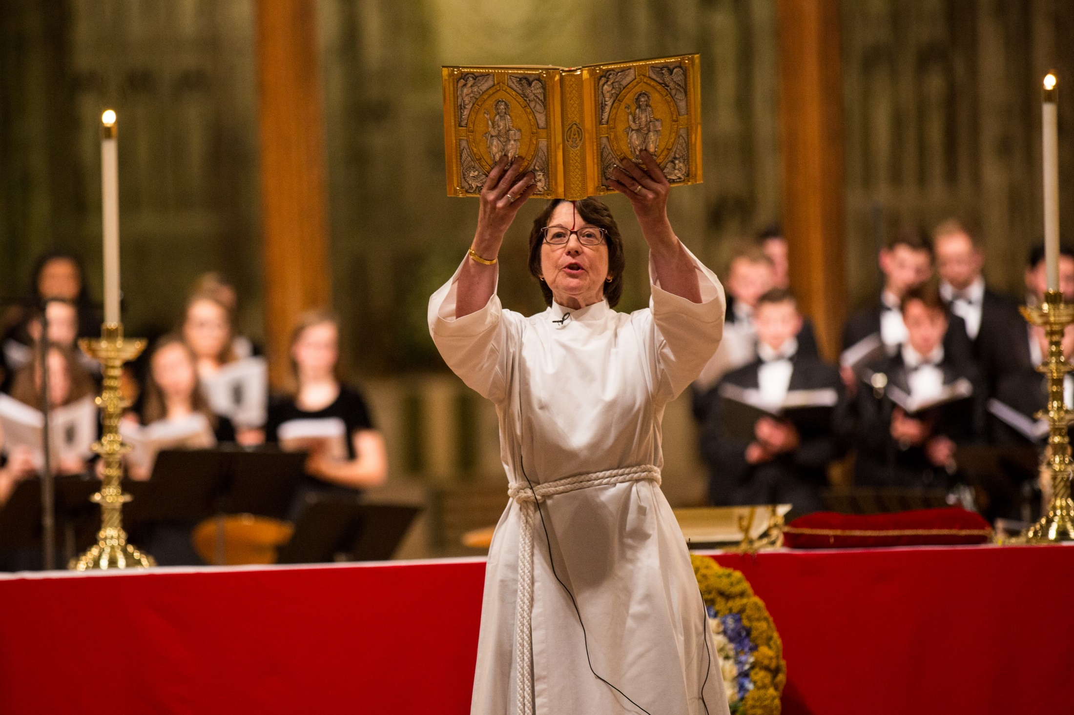
Overview of the Section
  Purpose of the Study
  Research Questions
  How the Study Was Conducted
Introduction:
Research Questions

Slide 8
Purpose of the Study
Introduction
The year 2020 was the 50th anniversary of two Lutheran church bodies in North America deciding to ordain women in Word and Sacrament ministry. In 1970 the American Lutheran Church (ALC) and the Lutheran Church in America (LCA) reformed the church with those historic votes. They later joined the Association of Evangelical Lutheran Churches and became part of the ELCA in 1988. As with previous anniversaries, ELCA Research, Analysis and Data conducted an extensive survey to explore the differences and similarities in ministerial experiences based on gender and race.
We (ELCA Research, Analysis, and Data) patterned this survey on those conducted in 1995, 2005 and 2015, which were fielded in support of the 25th, 35th and 45th anniversaries. Using data from these previous surveys for comparison, we examined trends in ministerial experiences.
We conducted this study to:
Explore differences and similarities in the ministerial experiences of women and men.
Learn how race, ethnicity and gender interact to affect ministerial experiences.
Track any trends over time.
Provide data to help the ELCA in all its expressions make informed decisions to positively affect the ministerial experiences of people of all genders.

Slide 9
Introduction
Research Questions
Are there currently gender, racial and ethnic differences:
  In compensation levels?
  In vocational roles?
  In retention rates?
  In wait time for calls?
  In attributes and experiences?
What are the trends over the past five to ten years?
What are the differences between Word and Service and Word and Sacrament ministers?
    The survey was designed to explore how rostered ministers were experiencing ministry.
    We anticipated that the responses would differ based on gender and on race and ethnicity, as well as at their intersections.
    We compared the responses to the 2020 survey with those of 2015 and 2005 to consider how responses may have changed.
    All reported differences are significant at the .05 level. This means that there is a less than 5% chance that we incorrectly detected a difference between groups when they were, indeed, equivalent.*
* For information about significance testing, see appendix.

Slide 10
How the Study Was Conducted
Introduction
    The 50th Anniversary Questionnaire was emailed to the entire roster of 542 ELCA Word and Service ministers in November 2019. (A sample of ELCA Word and Sacrament ministers was also surveyed; those results are presented in a separate report.) Participants completed the survey between November 2019 and February 2020.
    This sample consisted of:
    428 women.
    114 men.
    531 white people.
    11 people from racialized communities.
    Response rates:
    34% (145) of the women responded.
    22% (25) of the men responded.
    31% (167) of the white people responded.
    27% (3) of the people from racialized communities responded.
    We recognize that the term “rostered ministers” refers to ministers of Word and Service as well as ministers of Word and Sacrament. For brevity, we use “rostered ministers” or “deacons” throughout the report to refer to ministers of Word and Service.
We invited the entire roster of ELCA Word and Service ministers to complete the survey online.
A total of 170 people completed the survey, for a combined response rate of 31%.

Slide 11
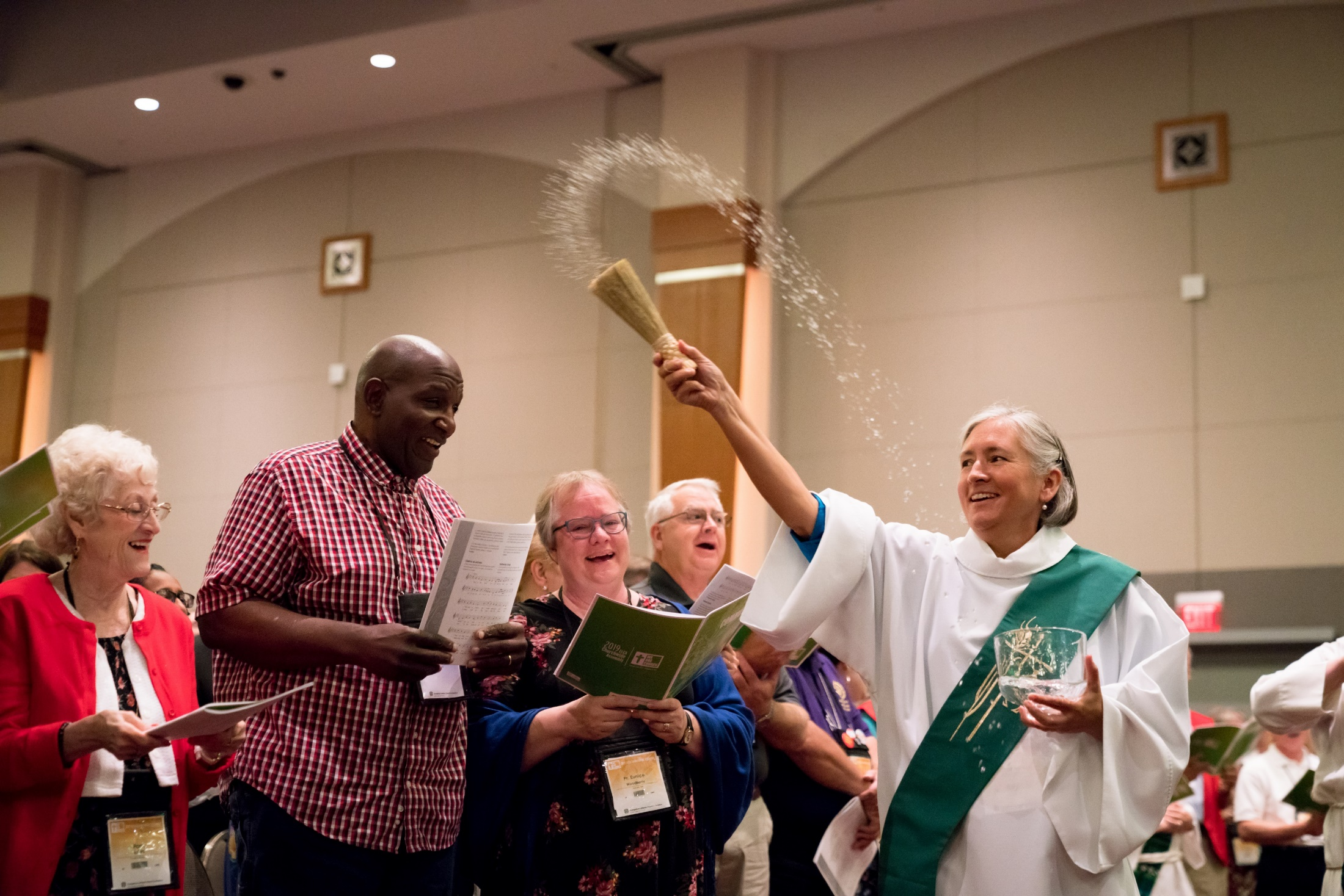
Overview of the Section
  Compensation Levels
  Synod Guidelines
  Pay Raises
Compensation

Slide 12
Compensation for Deacons
Compensation
  Compensation Guidelines for Deacons
Synods have compensation guidelines for ministers of Word and Sacrament. Most, but not all, synods have compensation guidelines for ministers of Word and Service.
Some synods with guidelines for deacons include separate figures for deacons with a bachelor’s degree and deacons with a master’s degree.*
The base salary for pastors and deacons is often similar, but guidelines for pastors can include an additional 30% of their base salary in housing allowance, which is tax-exempt.
Some deacons hold both a theological master’s degree and a master’s or doctoral degree in their specialization and are not compensated for the additional degree.
Data on Compensation and Race for Deacons
This report does not include an analysis of compensation and race for ministers of Word and Service due to limitations with the sample size of data.
*Since the creation of the unified Word and Service Roster (deacons) in 2016, a theological master’s degree has been required. Within the previous rosters, deaconesses and diaconal ministers were required to have a theological master’s degree and associates in ministry were required to have a bachelor’s degree.

Slide 13
Deacons’ Annual Defined Compensation for 2019
Compensation
In the 2020 survey, compensation information was not available from Portico, so participants were asked to self-report their compensation.

Slide 14
Percentage of Word and Service Participants Below, At or Above Synod Guidelines
Compensation
We asked participants whether, for the majority of time during each call period, their compensation was at, above or below their synod’s guidelines.
Word and Service participants were more likely to be at synod guidelines in their fourth or subsequent call compared to earlier calls.

Slide 15
Deacons’ Frequency of Pay Raises
Compensation
In their first call, 46% of participants received pay raises annually or more often, while 28% received raises every two to five years.
A similar pattern was found for subsequent calls, with the largest percentage receiving raises annually or more often, especially in the fourth or subsequent call.

Slide 16
Percentage of Word and Sacrament Participants Below, At, or Above Synod Guidelines
Compensation
This graph shows the results for Word and Sacrament participants. A higher percentage of Word and Sacrament ministers are compensated at synod guidelines than Word and Service ministers, except in the fourth or subsequent call (see previous slide).
However, it is important to note the Word and Service ministers had a very small number of respondents for that call, which may have affected the results.

Slide 17
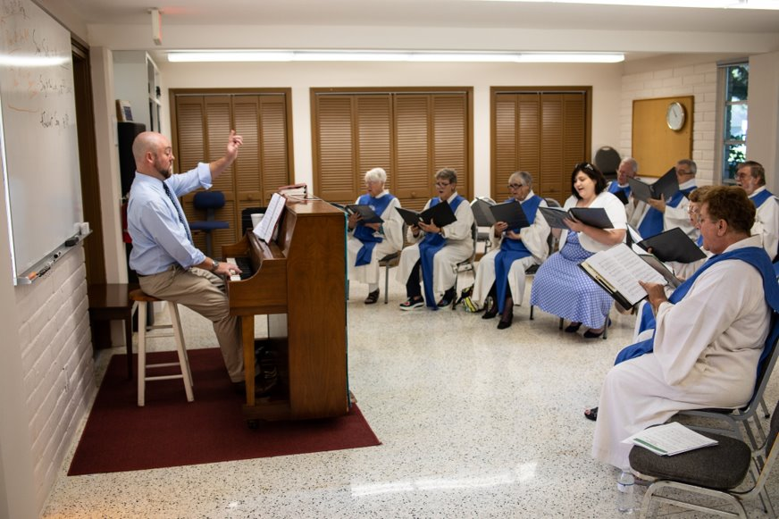
Overview of the Section:
Settings and Specializations of Word and Service Ministers
Gender and Vocation
Vocational Roles

Slide 18
Word and Service Ministers Serving on Behalf of Expressions of the ELCA
Vocational Roles
Each of the three expressions of the ELCA — congregations, synods and the churchwide organization — call deacons to serve. Sometimes this service is carried out in that setting, and other times the ELCA expression extends a letter of call to a deacon to do ministry on behalf of the expression but in the context of a community setting.
Data used from ELCA database call records as of May 2023.

Slide 19
Call Settings of Ministers of Word and Service
Vocational Roles
Deacons are often described as “a bridge between the church and the world.” This chart shows the many ministry settings where deacons serve as that bridge.
*ELCA related organizations includes campus ministry, outdoor ministry, Portico Benefits Services, and 1517 Media.
Data used from ELCA database call records as of May 2023.

Slide 20
Areas of Specialization for Deacons in Congregations
Vocational Roles
Data used from ELCA database call records as of May 2023.

Slide 21
Areas of Specialization for Deacons Serving in Settings Outside of ELCA Expressions
Vocational Roles
Data used from ELCA database call records as of May 2023.

Slide 22
Deacons’ Roles or Settings and Gender Trends
Vocational Roles
This chart shows the roles or settings deacons serve and their gender. The top bar of the chart indicates the gender of all active deacons. The settings in gold have more men than average and the settings in blue have more women serving than the average.
Data used from ELCA database call records as of May 2023.

Slide 23
Gender and Roles Within the Word and Service Roster
Vocational Roles
The following specializations of ministers of Word and Service are served only by women:
Administration in congregations -- nine deacons, 2% of deacons under call.
Counseling and social work -- six deacons, 1% of deacons under call.
Spiritual direction, coaching and wellness -- four deacons, <1% of deacons under call.
Ecumenical and interfaith ministries -- three deacons, <1% of deacons under call.
Data used from ELCA database call records as of May 2023.

Slide 24
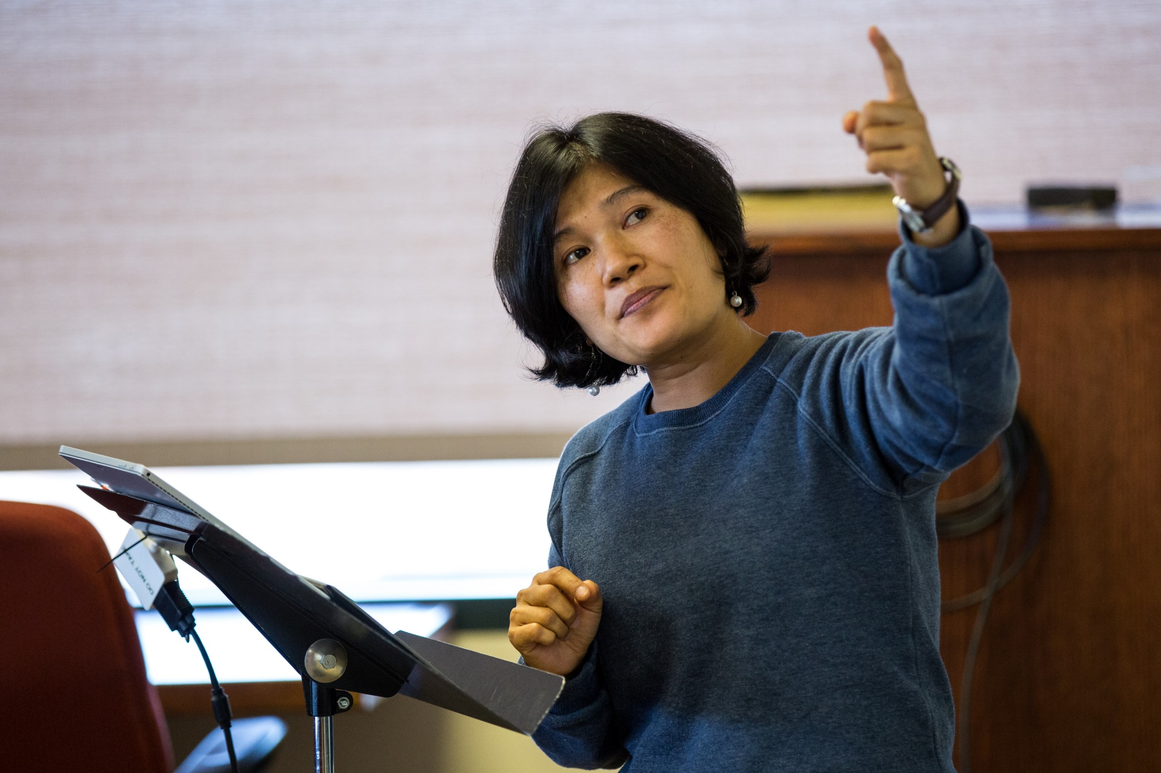
Overview of the Section
  Gender Identity of Survey Participants and Rostered Ministers
  Race and Ethnicity of Survey Participants and Rostered Ministers
Composition of the Word and Service Roster

Slide 25
Gender Identity of Survey Participants and All
Word and Service Ministers on the ELCA Roster
Composition of the Word and Service Roster
Survey participants were asked to indicate their gender identity. The large majority of the participants self-identified as women (88%), with 11% self-identifying as men. Less than 1% of the participants chose “not listed.” Slightly more women participated in the survey compared to the number of women on the Word and Service ELCA roster.
We also asked survey participants if they publicly identified as LGBTQIA+ in their ministry setting. About 5% answered yes, while 95% answered no and 1% preferred not to answer.
This left us with numbers too small for providing any gender identity or sexuality comparisons beyond the two most frequently reported gender identities (man and woman) and left questions of sexuality unanswered. We cannot be sure that the sample is large enough for statistical significance tests to be meaningful. We do not know if 5% of the LGBTQIA+ sample is representative of the whole LGBTQIA+ population of rostered ministers.
It is our hope that, over time, as we repeat surveys of this nature, we will see an increase in the proportion of participants who are comfortable sharing this type of information.

Slide 26
Race and Ethnicity of Survey Participants and All Word and Service Ministers on the ELCA Roster
Composition of the Word and Service Roster
We also examined the race and ethnicity of the survey participants and compared this to the composition of all Word and Service ministers on the ELCA roster.
The proportion of people from communities minoritized due to race were the same for survey participants as the proportion of ministers on the roster (both 2%).
Similarly, the proportion of white survey participants was the same as all ministers on the roster (both 98%).
There were so few participants from communities minoritized due to race that we were unable to make meaningful comparisons between the two groups.

Slide 27
Deacons Actively Serving in ELCA Regions
Composition of the Word and Service Roster
There are deacons serving across the ELCA. There are more deacons serving in Region 3, where there is also a larger ELCA population.
Data used from ELCA database call records as of May 2023.

Slide 28
Number of Ministers of Word and Service Joining the Roster in the ELCA, 1988-2023
Composition of the Word and Service Roster
Data used from ELCA database call records as of May 2023.

Slide 29
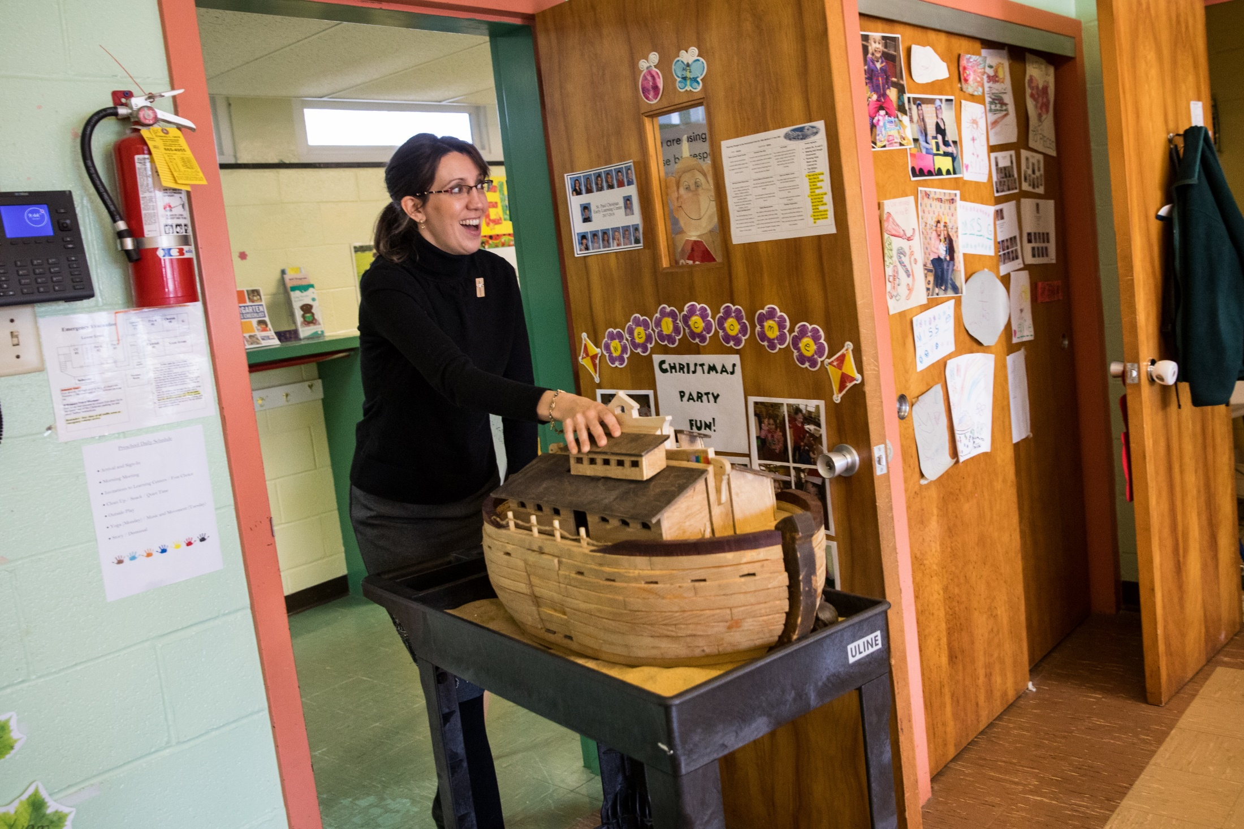
Overview of the Section
  Word and Service Wait Time for First Call and Current Call
Wait Time for First Call and Current Call

Slide 30
Word and Service Participants’ Wait Time for First Call and Current Call
Wait Time for First Call and Current Call
When participants were asked how long they waited for their first call, about two-thirds waited one to four months, while 10% waited five to eight months.
For their current call a similar pattern was found, with 60% of the participants waiting one to four months and 14% waiting five to eight months.
Percentages not adding up to 100 are due to rounding.

Slide 31
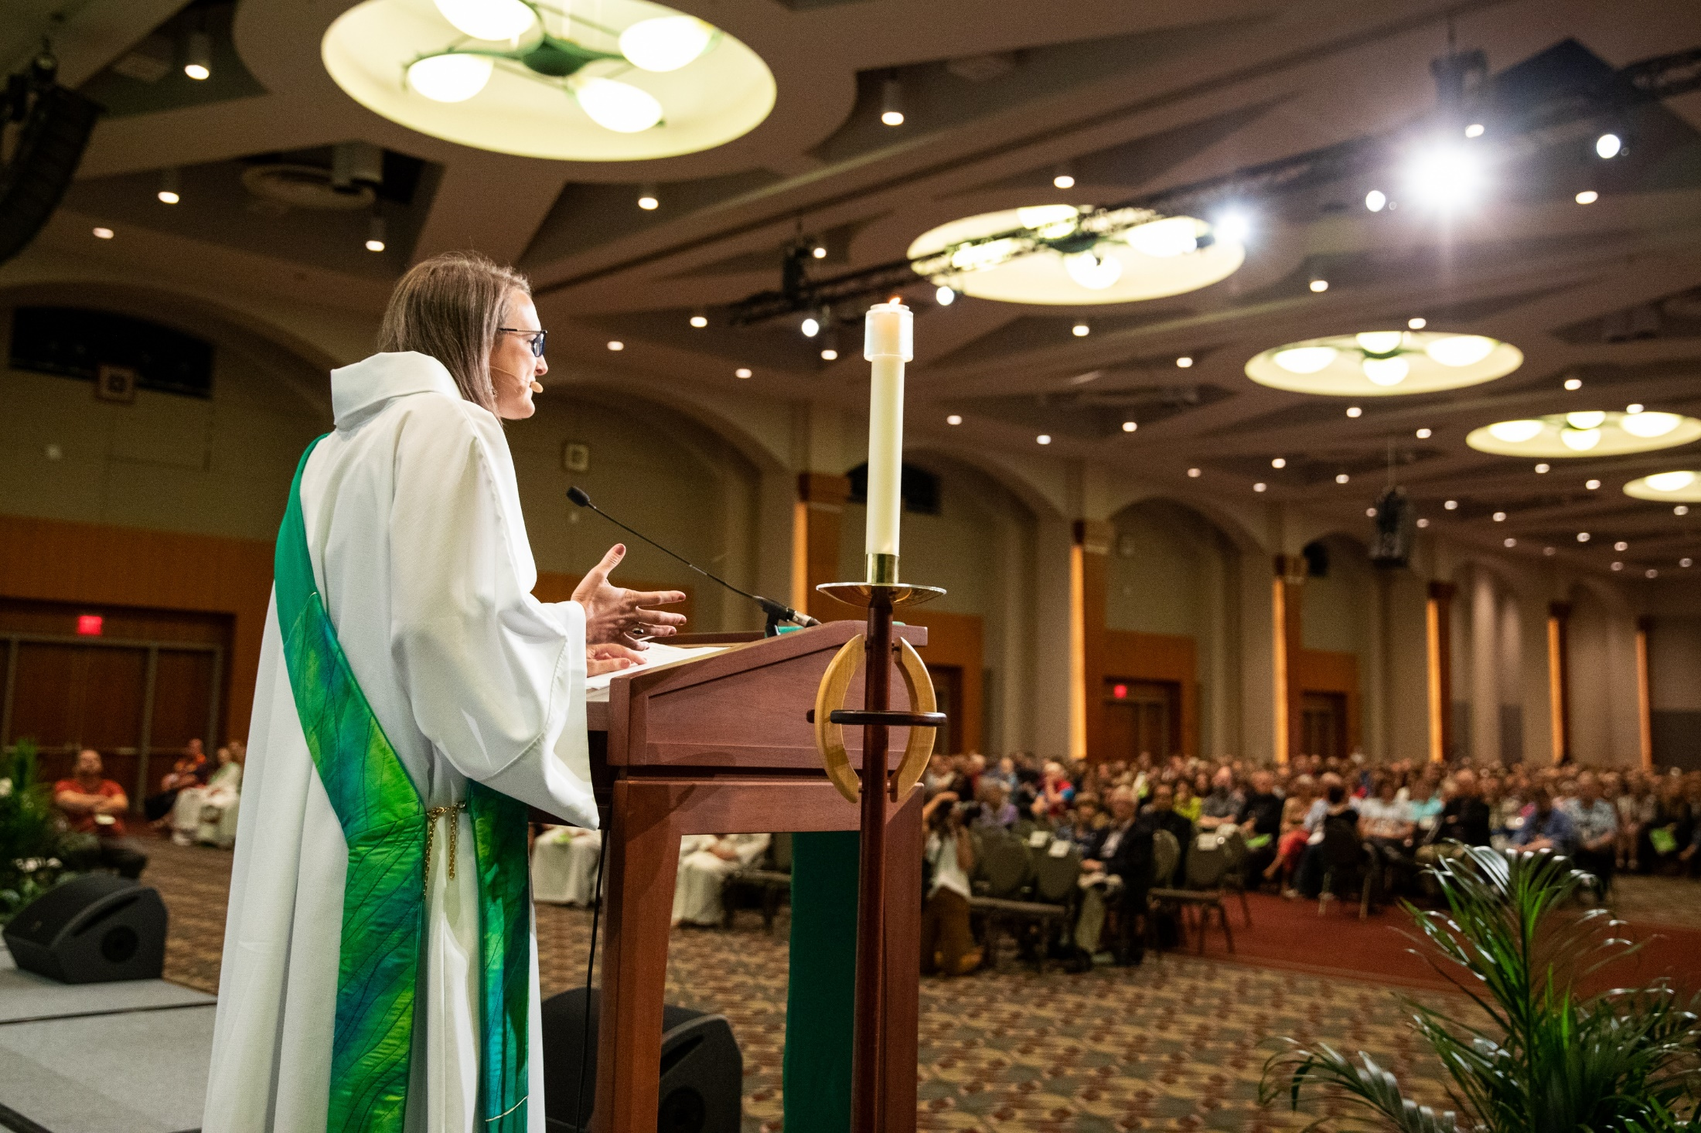
Overview of the Section
  Self-description and Rostered Minister Roles
  Leadership Skills and Ministry Assessment
  Experiences of Discrimination and Sexual Harassment
  Inclusive Language
  Seminary and Educational Debt
Attributes and Experiences

Slide 32
Deacons’ Mean Ratings for Attributes
Attributes and Experiences: Self-description and Rostered Minister Roles
We asked ministers to rate how accurately each of a list of adjectives describes them as a rostered minister, using a five-point scale where 1 = “not true at all” and 5 = “very true.”
The highest ratings were found for “helpful,” followed by “personable” and “goal-oriented.”
Lower ratings were found for “directive,” “anxious” and ”confused.” Since “anxious” and “confused” are negative attributes, we would expect those to have lower ratings.

Slide 33
Self-description as “Goal-oriented” — Word and Service and Word and Sacrament Ministers (Percentage Indicating True or Very True)
Attributes and Experiences: Self-description and Rostered Minister Roles
Word and Service participants were significantly more likely to rate themselves as “goal-oriented” leaders compared to Word and Sacrament participants.
The same pattern was found for the 2015 study.

Slide 34
Self-description Among Word and Service Participants (Percentage Indicating True or Very True)
Attributes and Experiences: Self-description and Rostered Minister Roles
Similar to the results from previous studies, Word and Service participants reported feeling more helpful today than in 2005 as well as less anxious and less confused compared to the 2005 results.
However, ratings of helpfulness have decreased somewhat from 2015 to today, and ratings of anxiety have increased somewhat in the past five years.

Slide 35
Word and Service Participants’ Mean Ratings for Roles
Attributes and Experiences: Self-description and Rostered Minister Roles
Using the same five-point rating scale described above, we asked participants to indicate how accurately a list of roles describes them as a rostered minister.
The highest ratings were found for “servant,” followed by “leader” and “teacher.”
Lower ratings were found for “community organizer,” ”prophet” and “priest.”

Slide 36
Top Three Roles for Word and Service Participants (Percentage Indicating True or Very True)
Attributes and Experiences: Self-description and Rostered Minister Roles
Similar to the findings of the 2015 study, the top three roles endorsed by Word and Service participants were “leader,” “servant” and “teacher.”
Participants to the current study were slightly more likely to choose “servant” compared to five years ago, while they were slightly less likely to choose “leader” or “teacher” compared to 2015.

Slide 37
Roles — Word and Sacrament Participants’ Ratings Compared to Word and Service Participants’
(Percentage Indicating True or Very True)
Attributes and Experiences: Self-description and Rostered Minister Roles
For four roles — ”priest,” “prophet,” “proclaimer” and “leader” — Word and Sacrament participants were significantly more likely than Word and Service participants to feel it represented their roles as rostered ministers.
These findings are very similar to the 2015 study, where Word and Sacrament participants were more likely to describe themselves as “priest,” “prophet” and “proclaimer.”

Slide 38
Roles — Word and Service Participants’ Ratings Compared to Word and Sacrament Participants’
(Percentage Indicating True or Very True)
Attributes and Experiences: Self-description and Rostered Minister Roles
For four additional roles — community organizer, nurturer, servant and counselor — Word and Service participants were significantly more likely than Word and Sacrament participants to feel these represented their roles as rostered ministers.
Again, these findings are similar to the 2015 study, where Word and Service participants were more likely to describe themselves as “servants” and “community organizers.”

Slide 39
Roles — Trends From 2005 to 2020 for Word and Service Participants (Percentage Indicating True or Very True)
Attributes and Experiences: Self-description and Rostered Minister Roles
There have also been changes over the past 15 years in how Word and Service participants describe their roles as rostered ministers.
For the roles of nurturer, administrator, proclaimer, community organizer and priest, percentages dropped from 2005 to 2015, then increased slightly in 2020. However, the percentages are still lower in 2020 compared to 2005.
Therefore, Word and Service participants generally took a broader view of their ministry roles in 2005.

Slide 40
Word and Service Participants’ Mean Ratings for Importance of Activities and Concepts in Ministry
Attributes and Experiences: Leadership Skills and Ministry Assessment
We asked ministers to rate how important ten items were in their ministry, where 1 = “not important at all” and 5 = “very important.” (See Appendix B for a full list of frequencies.)
Developing strong relationships of trust and being faithful in providing ministry were most important to Word and Service participants.
Preaching and leading worship effectively and seeing steady growth in membership and/or attendance were least important to Word and Service ministers.

Slide 41
Importance of Activities and Concepts in Ministry (Percentage Indicating Important or Very Important)
Attributes and Experiences: Leadership Skills and Ministry Assessment
Both Word and Service participants and Word and Sacrament participants rated these top three activities as equally important.
These results are also similar to the 2015 study, where the top three activities were developing strong relationships of trust, being stable and steady in providing ministry, and being faithful in providing ministry.

Slide 42
Importance of Activities and Concepts in Ministry (Percentage Indicating Important or Very Important)
Attributes and Experiences: Leadership Skills and Ministry Assessment
Word and Service participants rated being an innovative, creative leader in ministry as more important compared to Word and Sacrament participants. In contrast, Word and Sacrament participants rated preaching and leading worship effectively as more important.
Seeing steady growth in membership and/or attendance was the least important for both groups; however, it was significantly less important for the Word and Service participants.
Again, a similar pattern was found in the 2015 study. These differences may be due to the typical roles filled by Word and Service ministers, as they are more likely to serve as parish staff or in noncongregational settings.

Slide 43
Word and Service Participants’ Experiences in the Congregation or Ministry Setting
Attributes and Experiences: Experiences in the Congregation or Ministry Setting
The next section of the survey included questions about possible experiences in different church settings. Seven settings were included: in seminary, during internship, in the congregational or ministry setting, with ELCA rostered ministers, during the call process, with ecumenical colleagues, and by synod and/or churchwide organization staff.
For each question, participants reported these experiences occurred most often in the congregation or ministry setting. Over half of the participants have thought about how their gender affects how people perceive them, and almost half have been asked about their desire to work with children.
In addition, almost 40% of participants have experienced gender-based discrimination, and almost one-fourth reported experiencing sexual harassment in the congregation or ministry setting.

Slide 44
Women Experiencing Gender-based Discrimination
Attributes and Experiences: Experiences by Gender
2015
2020
2015
2020
We asked Word and Service ministers to indicate if they had experienced gender-based discrimination (different treatment accorded to individuals based on their gender) in any of seven ministry settings, shown on the left as percentages of women who indicated they had.
We found that experiences of gender-based discrimination are common. This was particularly true in congregations or other ministry settings, where in 2020, 44% of women reported experiencing gender-based discrimination.
Additionally, more women in 2020 reported experiencing gender-based discrimination in all seven ministry settings compared to 2015.
It is possible that cultural shifts in the last five years allow greater confidence to recognize, name and perhaps report gender-based discrimination.
In seminary
During the call process
During internship
With ecumenical colleagues
In the congregation or ministry setting
By synod and/or churchwide organization staff
With other ELCA rostered ministers
44

Slide 45
Experiences in the Congregation or Ministry Setting by Gender (Percentages Who Have Had Each Experience)
Attributes and Experiences: Experiences by Gender
I have received unwelcome comments about my looks and/or attire.
I have experienced gender-based discrimination.
Word and Service ministers who are women are more likely than men to indicate they have experienced negative gender-based treatment in their professional church lives in a congregation or ministry setting.
Women are at least twice as likely as men to have had all but one of these experiences.
The difference wasn’t as strong on the final item, “I have thought about how my gender affects how people perceive me,” because 42% of men report having thought about how their gender identity affects how people perceive them.
I have felt as if I represent my gender in what I say or do.
I have experienced sexual harassment.
I have thought about how my gender affects how people perceive me.
Women
Men
Women
Men
45

Slide 46
Word and Service Participants’ Actions Taken Concerning Inclusive Language That Were Received “Quite Well”
Attitudes and Experiences: Inclusive Language
The next section asked about actions participants had taken concerning inclusive language and how they were received in their congregation or ministry setting.
Four possible outcomes were listed for each action: “I have taken this action”; “I have taken this action and it was received poorly”; “I have taken this action and it was received neither poorly nor well”; “I have taken this action and it was received quite well.”
For those who took each action and it was received quite well, 45% of participants increased the use of gender-neutral language/imagery in preaching or in other examples, while about 43% decreased the use of masculine language/imagery in preaching or in other examples.

Slide 47
Top Three Actions Related to Inclusive Language
Attitudes and Experiences: Inclusive Language
The three most common actions taken related to the use of inclusive language are the following:
  Decreasing the use of masculine language/imagery in preaching or in other examples.
  Increasing the use of feminine language/imagery in preaching or in other examples.
  Increasing the use of gender-neutral language/imagery in preaching or in other examples.
Word and Sacrament participants were significantly more likely to take these actions compared to Word and Service participants.

Slide 48
Top Three Actions Related to Inclusive Language Were Received “Quite Well”
Attitudes and Experiences: Inclusive Language
Next, we compared the responses for participants who took these actions and reported they were received “quite well.”
There were very few differences between Word and Service participants and Word and Sacrament participants in how inclusive or gender-neutral language was received in the congregation or ministry setting.

Slide 49
Trends in the Use of Inclusive Language for Word and Service Participants: 2005-2020
Attitudes and Experiences: Inclusive Language
There continues to be an upward trend in advocating for the use of inclusive language among Word and Service participants over the past 15 years.
This increase is especially evident for advocating for the use of inclusive language among congregational leaders, which has almost doubled since 2005.

Slide 50
Word and Service Participants’ Mean Ratings Call Affirmation
Attitudes and Experiences: Call Affirmation
The next set of questions asked participants to rate their agreement with a set of statements, using a five-point rating scale where 1 = “strongly disagree” and 5 = “strongly agree.”
The highest ratings were found for “I feel certain that I should have become a rostered minister.”
The lowest ratings were found for “I have considered removing myself from the ELCA roster,” where a lower rating is a positive result.

Slide 51
How Well Seminary Prepares Candidates for
Their First Call
Attitudes and Experiences: Seminary Preparation
In 2020 we see a significant decrease for Word and Service participants who agree or strongly agree (77% to 39%) about how well seminary prepared them for their first call.

Slide 52
Educational Debt at Seminary Graduation
Attitudes and Experiences: Seminary and Educational Debt
The next section of the survey focused on participants’ educational debt.
For women, the amount of seminary debt at graduation owed by Word and Service participants was significantly less than debt owed by Word and Sacrament participants.
For men, participants from both rosters had similar levels of debt at seminary graduation.

Slide 53
Educational Debt in 2020
Attitudes and Experiences: Seminary and Educational Debt
The debt load decreased as both groups continued their careers.
Word and Service participants who are women had the lowest amount of current debt, with 87% reporting $15,000 or less in educational debt in 2020.
This difference may be due to the shorter amount of time typically required to earn a Master of Arts in Ministry (two years) versus a Master of Divinity degree (three years plus one year of internship).

Slide 54
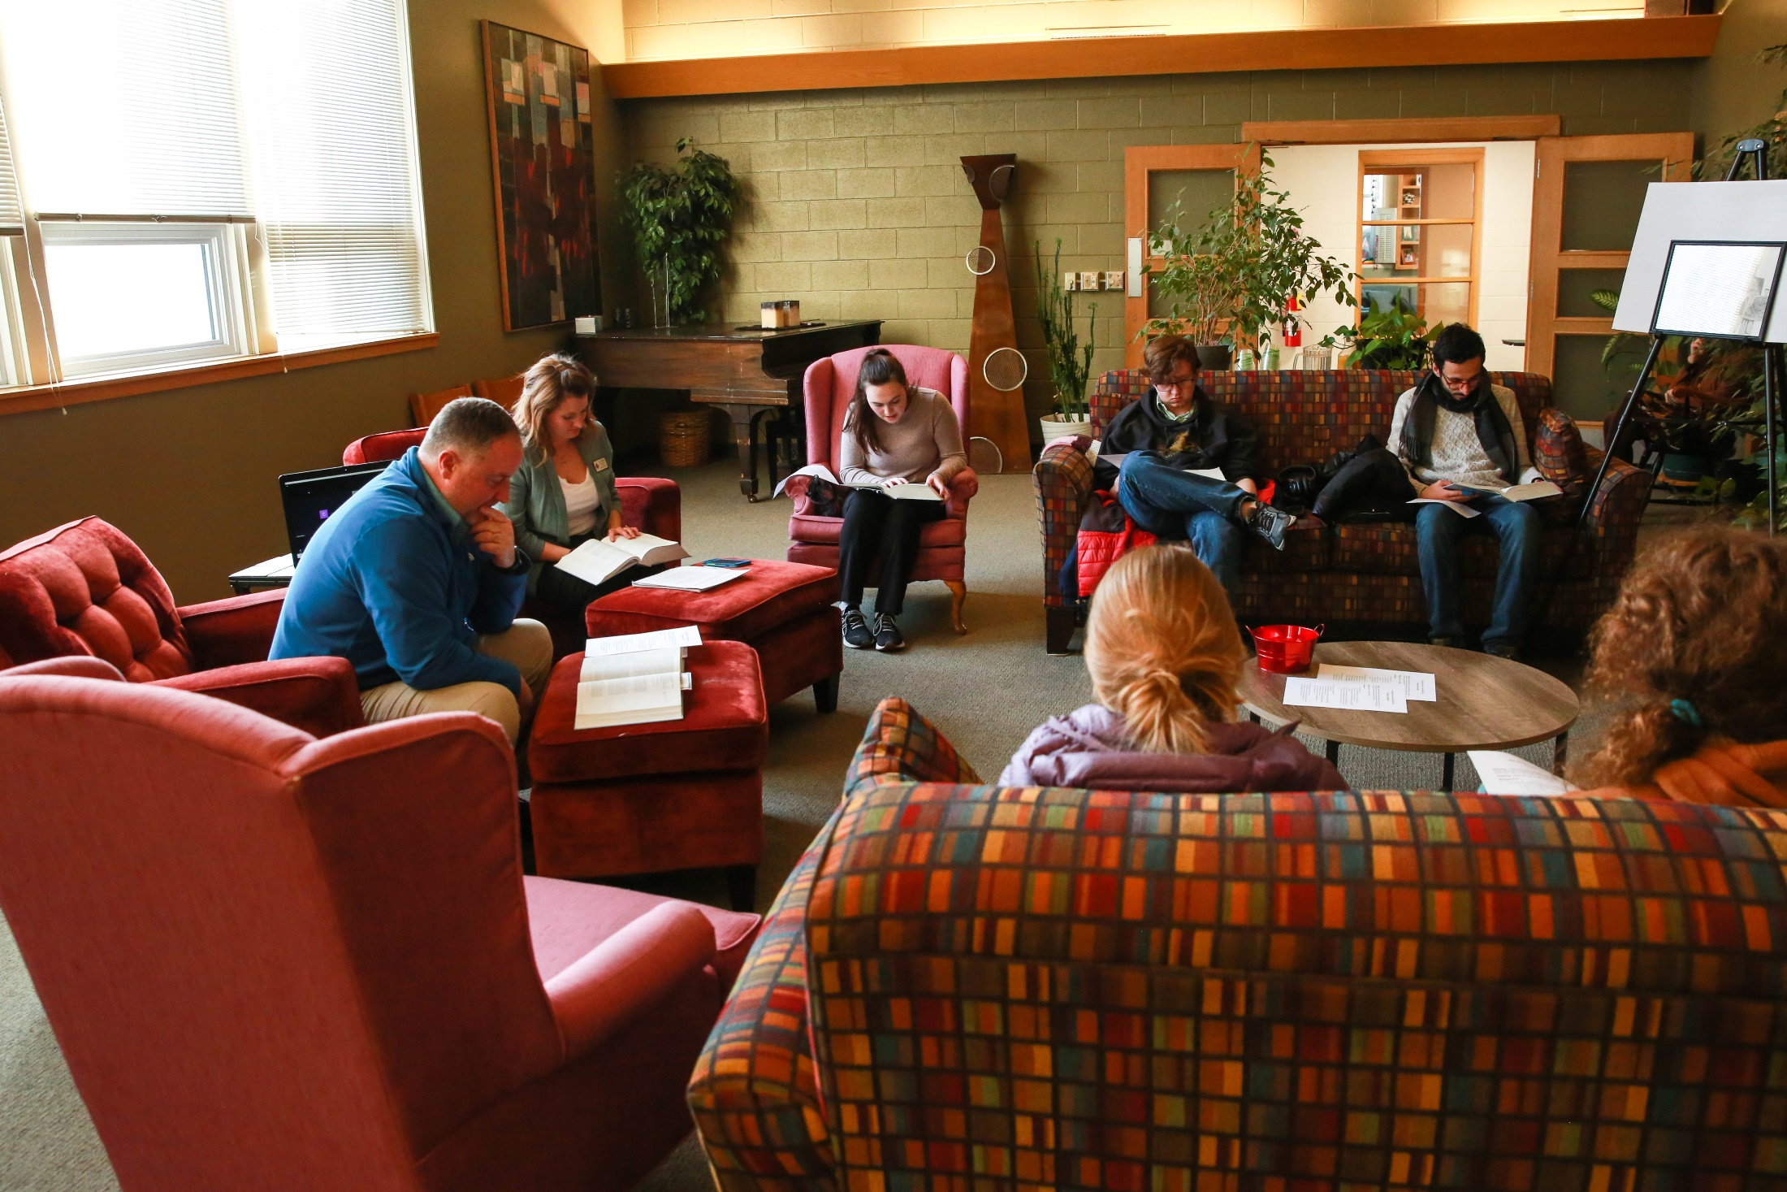
Overview of the Section
  Challenges of Rostered Ministry
  Greatest Need to Minister Effectively
  Advice for Women Entering or Serving in Rostered Ministry
  Advice for Bishops, Synod Councils or Churchwide Organization Staff
Analyses of Open- ended Questions

Slide 55
Challenges of Rostered Ministry
Qualitative Data
The top three challenges most common among responses were related to:
Lack of respect/support for deacons (38%).
Effects on well-being/family (22%).
Sexism in the church (12%).
Open response questions were coded and analyzed for themes as most included multiple examples of different kinds of experiences and challenges. Themes are identified by frequency, that is, how often comments related to these categories occurred in the responses.

Slide 56
Greatest Needs in Ministry
Qualitative Data
When asked to list their greatest needs, deacons most frequently cited a need for authentic respect and collaboration from congregational members and ELCA colleagues, along with a need for more resources in their ministry settings.
Participants also listed support for health and well-being as one of their greatest needs in ministry.

Slide 57
Core Themes: Advice to Women Entering Ministry
Qualitative Data
When asked what women entering ministry should keep in mind, participants offered the following advice:
Create a good support system.
Stand in your strength.
Prioritize your well-being.
Set boundaries.

Slide 58
Advice for Bishops, Synod Councils or Churchwide Organization Staff Members
Qualitative Data
Responses emphasized six major themes: recognize the important work of deacons, stop discrimination and dismantle patriarchal systems and behaviors, listen to women’s knowledge, empower women, advocate for equity, and be proactive and inclusive.
A common theme throughout the open-ended responses was that deacons are not as respected as pastors and are often treated as “less than” in all expressions of the church.

Slide 59
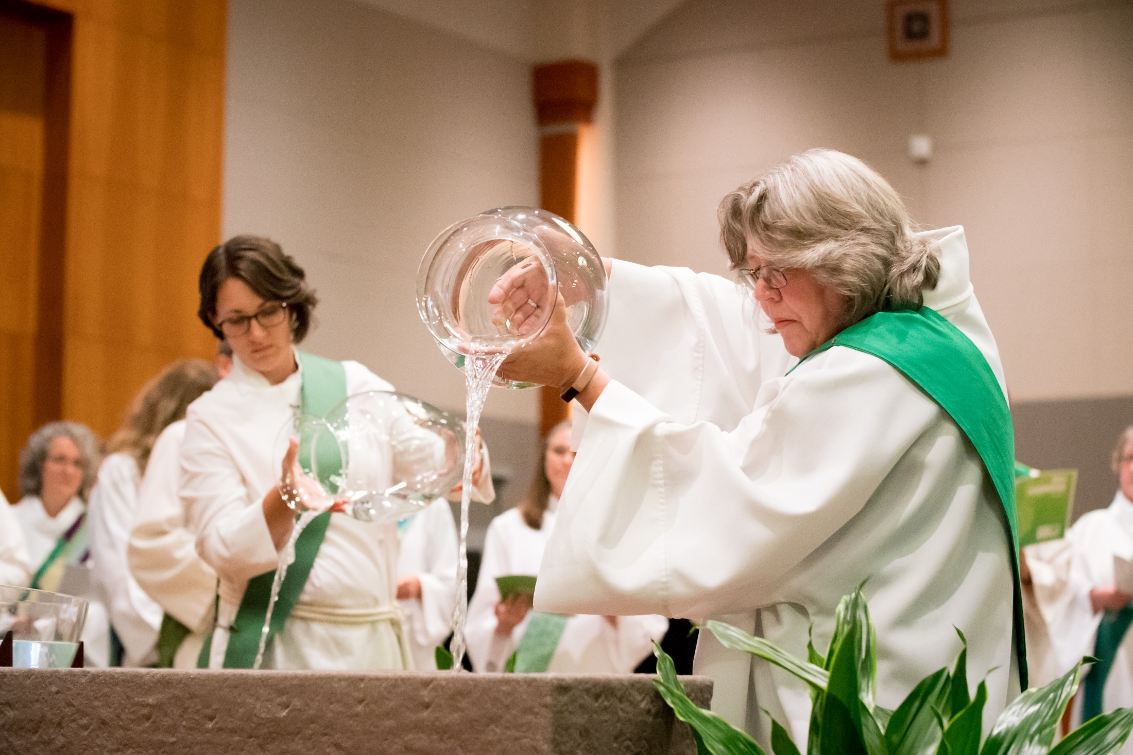
Overview of the Section
Recommendations for Future Study and Action, Based on the Key Findings
Recommendations

Slide 60
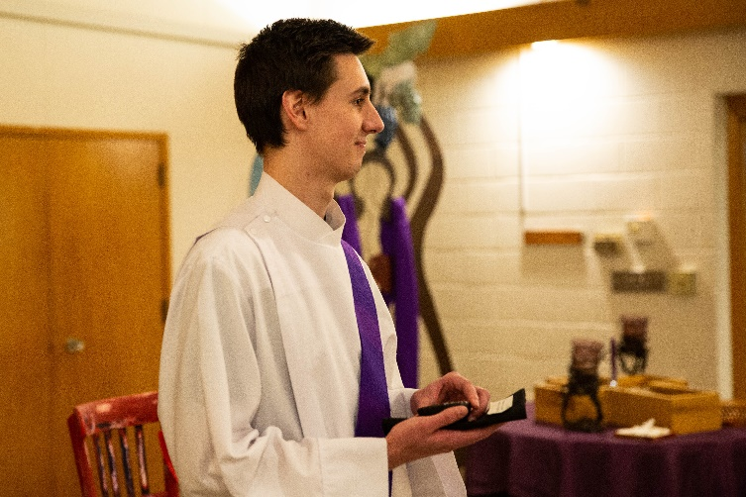
Recommendation 1:
Recommendations
    A common theme throughout the open-ended responses was that deacons are not as respected as pastors and are often treated as “less than” in all expressions of the church.
    Almost one-third of the Word and Service participants cited a need for authentic respect and collaboration from congregational members and ELCA colleagues.
    A survey designed specifically for Word and Service ministers could be conducted in the future, focusing on questions tailored to deacons.
The ELCA churchwide organization, ELCA-affiliated seminaries, and synods should provide education for all three expressions of the church (congregations, synods and churchwide organization) about the role and importance of Word and Service ministers and the gifts they bring to the ELCA.

Slide 61
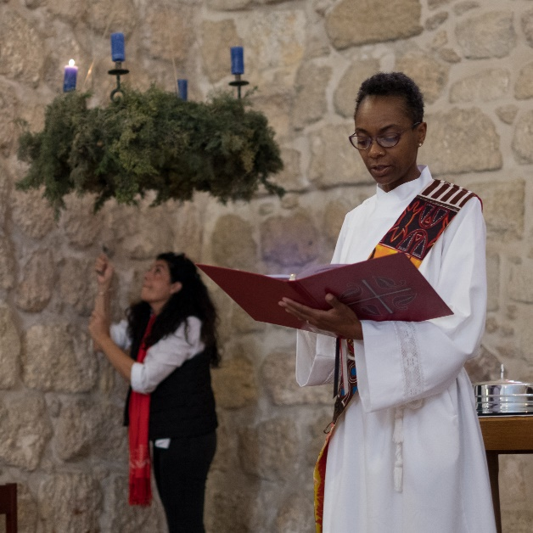
Recommendation 2:
Recommendations
    Word and Service ministers, except in fourth or subsequent calls, are less likely to be compensated at synod guidelines than Word and Sacrament ministers.
    Many Word and Service participants commented on the difficulty of finding a full-time call, and some needed to supplement their calls with other employment.
      Synods should continue to advocate for Word and Service ministers to be compensated at or above synod guidelines and to provide full-time calls for deacons.

Slide 62
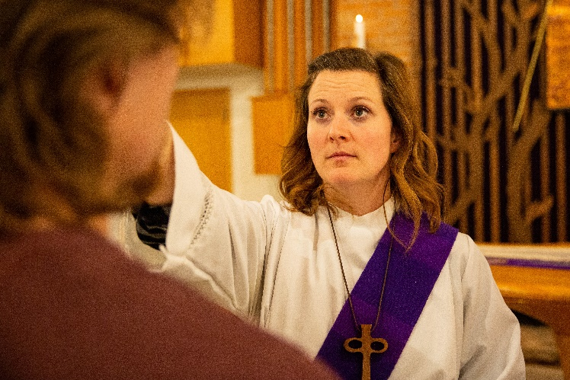
Recommendation 3:
Recommendations
    Women in the role of rostered minister continue to experience discrimination and sexual harassment. Either reporting of offenses or the number of offenses has increased over time. These are serious problems that must be addressed:
      Sexual harassment.
      Feeling as though they represent their gender in what they say or do.
      Gender-based discrimination.
    Discrimination, bias, and harassment are not acceptable. Particularly troubling are the reports of discrimination, bias and harassment experienced in seminary, on internship, from bishops and from ELCA ministerial colleagues.
      The ELCA churchwide organization, ELCA-affiliated seminaries, and synods should regularly conduct sexual harassment education for all three expressions of the church (congregations, synods and churchwide organization) and have policies in place that provide accountability measures and safe avenues for reporting offenses.

Slide 63
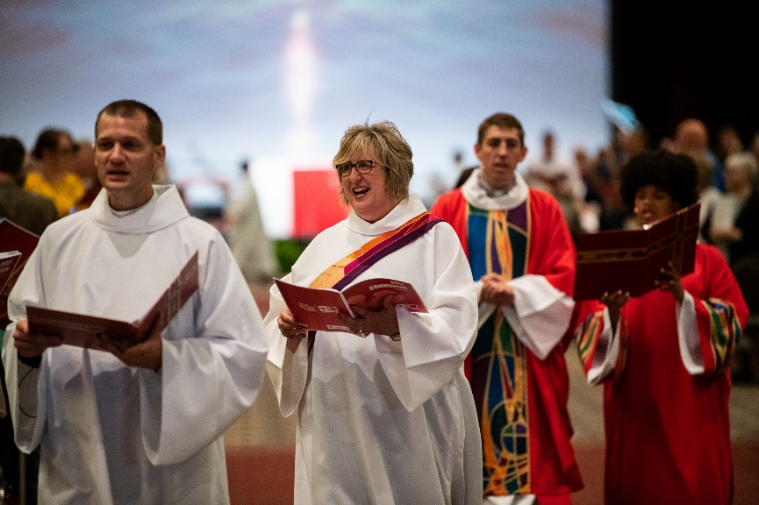
Recommendation 4:
Recommendations
Ministers of Word and Service continually raised the theme of lack of support in the open-ended questions, with support-related responses listed in the challenges in rostered ministry, the greatest needs in ministry, and advice for women entering into ministry.
The setting and specialty of calls for Word and Service ministry vary greatly. Affinity networks would allow ministers to connect across the church with others serving in similar fields for mutual support, idea sharing and building community within these calls.
Similar to ministers of Word and Sacrament, ministers of Word and Service have identified their health and well-being as a concern or needing support as they serve in ministry.
      The ELCA churchwide organization, synods and Portico: Create systems of support for Word and Service ministers, such as continuing education, affinity networks, access to specialized mental health and wellness resources, etc.

Slide 64


Appendices
Overview of the Section
Appendix A
  Methods
  Sample Design
  Analysis
Appendix B
  Questions Asked and Response Percentages

Slide 65
Methods: How the Study Was Conducted
Appendix A
    Overview
    This survey was patterned after surveys in 1995, 2005 and 2015, which were fielded in support of the 25th, 35th and 45th anniversaries of the ordination of women.
    This is a quantitative study supported with qualitative responses. The survey included mostly closed-ended questions that were assigned numeric response values for statistical analysis, but also included a few open-ended questions to which participants provided answers in their own words.
    See Appendix B for exact question wording and detailed survey responses.
The year 2020 was the 50th anniversary of Lutheran church bodies in the United States deciding to ordain women in ministry.
An extensive survey was conducted to explore the differences and similarities in the ministerial experiences between rostered women and men.

Slide 66
Methods: How the Study Was Conducted
Appendix A
Study Design and Implementation
John Hessian and Deborah Coe, Ph.D., in collaboration with other members of the project team, designed the study and questionnaire. Data were collected by John Hessian. Quantitative and qualitative data analyses were completed by Rebecca Sims, Ph.D. Photos were added by Heather Dean and Deacon Shannon Johnson. Deacon Shannon Johnson added information and data about the roster in consultation with Deacon Krista Anderson.
The 50th Anniversary of the Ordination of Women Questionnaire was emailed to all ELCA Word and Service ministers on Nov. 8, 2019. (A sample of ELCA Word and Sacrament ministers was also surveyed; those results are presented in a separate report.) A reminder was sent on Dec. 19, 2019, and the survey was closed on Jan. 8, 2020. Although data collection started in 2019, we use the year 2020 throughout the report for ease of reporting and consistency.
The project team consisted of the following ELCA churchwide organization staff:
John Hessian, Rebecca Sims, Ph.D., and Deborah Coe, Ph.D., Research, Analysis and Data
Mary Streufert, Ph.D., and Heather Dean, Office of the Presiding Bishop
The Rev. Cherlyne Beck, Christian Community and Leadership
The Rev. Brenda Smith, Domestic Mission

Slide 67
Methods: How the Study Was Conducted
Appendix A
Data Analysis
We analyzed survey results by gender, race/ethnicity and roster status. These analyses help to identify patterns in responses.
In this report, differences between groups were considered statistically significant when they exceeded the p < .05 level. This means that there is a less-than-5% chance that we incorrectly detected a difference between groups when they were, indeed, equivalent.
We analyzed qualitative data using content analysis.

Slide 68
Questions Asked and Response Percentages
Appendix B
Number of surveys completed = 170 Note: All responses are shown as percentages. They include respondents of all genders.
1. In what year did you enter candidacy? (Various years were entered.)
2. In what year did you graduate from seminary? (Various years were entered.)
3. What is your current/most recent call?
39.2 First call
31.6 Second call
16.5 Third call
8.2 Fourth call
4.4 Fifth or subsequent call
4. Please indicate the approximate number of months you waited for your first call (from the time of assignment until you received your first call).
67.5 One to four months
9.6 Five to eight months
7.6 Nine to 12 months
3.8 13 to 18 months
1.9 19 to 24 months
9.6 25 months or more
5. Please indicate the approximate number of months you waited for your current/most recent call (from the time you began actively seeking a call).
48.1 One to four months
11.5 Five to eight months
7.7 Nine to 12 months
5.1 13 to 18 months
3.2 19 to 24 months
4.5 25 months or more
19.9 This is my first call.
6. Please indicate which, if any, of the following reasons influenced your placement for your current/most recent call. (Please choose all that apply unless you had no restrictions.)
50.6 Geographic
32.9 Familial
22.4 Congregational (i.e., size, staffing)
17.6 No restrictions
7. What is the status of your current/most recent call?
65.4 Full-time
34.6 Part-time

Slide 69
Questions Asked and Response Percentages
Appendix B
8. Why are you in a part-time call? (Choose all that apply.)
12.7 At my request for personal health reasons
1.8 At my request for family health reasons
14.5 At my request to focus on raising my child/children
5.5 At my request to serve jointly with my spouse
50.9 At congregation/agency request because of financial restraints
9. In order to assess exactly how you are doing financially, please let us know your annual defined compensation for 2019. (Various dollar amounts were entered.)
10. For each of the following calls, please indicate whether, for the majority of time during that call period, your compensation was at, above or below your synod’s guidelines.
At Above Below
First call ............................... 45.6 7.9 46.5
Second call .......................... 46.7 17.3 36.0
Third call............................... 41.7 19.4 38.9
Most recent call .................. 56.0 24.0 20.0
(fourth or subsequent call)
11. For each of the following calls, how frequently did you receive pay raises?
 | Annually or more often | Every 2-5 years | Less than once every 5 years | Never
In my first call................................................................. | 45.6 | 27.9 | 3.7 | 22.8
In my second call…………………………………………………… | 54.1 | 25.7 | 4.1 | 16.2
In my third call………………………………………………………. | 51.4 | 27.0 | 8.1 | 13.5
In my most recent call (fourth or subsequent call)…… | 69.2 | 11.5 | 7.7 | 11.5

Slide 70
Questions Asked and Response Percentages
Appendix B
15. If you have ever been on leave from call, what were the reasons? (Please choose all that apply.)
45.3 Never been on leave from call
18.2 Actively seeking/waiting for a call
7.6 Unsure of next vocational steps
2.4 In a graduate study program
9.4 Caring for children/other family
4.7 Caring for own health/medical reasons
1.2 Taking steps for career change out of rostered
ministry
16. In your current call, is paid family leave part of your benefits package?
40.1 Yes
34.0 No
25.9 Don’t know/not sure
17. In your current call, was your ministry’s family leave policy clearly explained?
29.3 Yes
55.1 No
15.6 Don’t remember
18. Have you ever been an internship supervisor?
8.1 Yes
91.9 No
19. How many interns have you supervised throughout your career?
75.0 One to five interns
8.3 Six to 10 interns
16.7 11 or more interns
12. When you moved from your first to second call, how did the amount of your salary and benefits change?
32.0 My salary/benefits package increased.
11.6 My salary/benefits package decreased.
12.2 My salary/benefits package stayed the same.
2.0 Not sure
42.2 Not applicable
13. In your current/most recent call, what is the status of your health care coverage?
51.4 My employer covers the entire health care premium.
11.5 I pay part of my health care premium.
27.0 I have health care coverage through a different
source than my employer.
10.1 I do not have health care coverage.
14. Has your employer reduced your health care coverage during your current/most recent call?
9.0 Yes
91.0 No

Slide 71
Questions Asked and Response Percentages
Appendix B
    20. Please describe how accurately each of the following describes you as a rostered minister.
    21. Please indicate how accurately each of the following describes your role as a rostered minister.
 | Not true at all 1 | 2 | 3 | 4 | Very true 5 | Not sure | Not applicable | Mean
Personable | 0.0 | 0.0 | 4.4 | 29.4 | 66.2 | 0.0 | 0.0 | 4.62
Helpful | 0.0 | 0.0 | 2.9 | 20.4 | 76.6 | 0.0 | 0.0 | 4.74
Directive | 0.0 | 3.7 | 27.9 | 38.2 | 27.2 | 2.9 | 0.0 | 3.92
Anxious | 12.4 | 48.2 | 24.8 | 9.5 | 3.6 | 1.5 | 0.0 | 2.43
Confused | 63.0 | 30.4 | 4.4 | 0.0 | 1.5 | 0.7 | 0.0 | 1.46
Goal-oriented | 0.0 | 1.5 | 14.6 | 37.2 | 46.0 | 0.7 | 0.0 | 4.29
 | Not true at all 1 | 2 | 3 | 4 | Very true 5 | Not sure | Not applicable | Mean
Teacher | 0.7 | 3.6 | 10.2 | 16.8 | 67.9 | 0.0 | 0.7 | 4.49
Priest | 27.1 | 23.3 | 19.5 | 12.8 | 8.3 | 0.8 | 8.3 | 2.47
Prophet | 10.2 | 19.7 | 28.5 | 24.1 | 14.6 | 0.0 | 2.9 | 3.14
Community organizer | 7.4 | 16.9 | 22.8 | 25.7 | 25.0 | 0.0 | 2.2 | 3.45
Nurturer | 0.7 | 2.2 | 16.9 | 30.1 | 50.0 | 0.0 | 0.0 | 4.26
Servant | 0.7 | 2.2 | 5.1 | 25.7 | 66.2 | 0.0 | 0.0 | 4.54
Counselor | 0.7 | 7.4 | 19.3 | 38.5 | 33.3 | 0.0 | 0.7 | 3.97
Administrator | 3.6 | 4.3 | 15.9 | 29.7 | 42.0 | 0.7 | 3.6 | 4.07
Proclaimer | 0.7 | 14.6 | 21.2 | 33.6 | 27.7 | 0.7 | 1.5 | 3.75
Leader | 0.0 | 1.4 | 13.0 | 20.3 | 64.5 | 0.7 | 0.0 | 4.49

Slide 72
Questions Asked and Response Percentages
Appendix B
    22. In your call as a rostered minister, how important is each of the following to you?
 | 1 – Not important at all | 2 | 3 | 4 | 5 – Very important | Not sure | Not applicable
a. Advocating for justice in parish and community | 2.2 | 3.7 | 16.2 | 29.4 | 46.3 | 0.0 | 2.2
b. Seeing steady growth in membership and/or attendance | 6.6 | 22.8 | 34.6 | 15.4 | 9.6 | 0.0 | 11.0
c. Being faithful in providing ministry | 0.0 | 0.7 | 1.5 | 17.6 | 80.1 | 0.0 | 0.0
d. Developing a vision for mission in the community | 0.0 | 2.9 | 14.0 | 33.8 | 41.9 | 0.0 | 7.4
e. Developing strong relationships of trust | 0.0 | 0.0 | 0.0 | 14.0 | 86.0 | 0.0 | 0.0
f. Being stable and steady in providing ministry | 0.7 | 0.0 | 4.4 | 29.4 | 65.4 | 0.0 | 0.0
g. Preaching and leading worship effectively | 6.6 | 11.8 | 17.6 | 21.3 | 30.9 | 0.0 | 11.8
h. Training strong leaders | 0.7 | 0.7 | 13.2 | 25.7 | 55.9 | 0.0 | 3.7
i. Being an innovative, creative leader in ministry | 0.7 | 0.0 | 7.4 | 31.6 | 59.6 | 0.0 | 0.7
j. Accompanying others as they strive to live their faith in their daily lives | 0.0 | 1.5 | 4.4 | 14.7 | 79.4 | 0.0 | 0.0

Slide 73
Questions Asked and Response Percentages
Appendix B
23. For each of the following experiences, please check each setting where it has occurred. (Please choose all that apply.)
a. I have been asked about my likelihood of having children.
11.2 In seminary
5.3 During internship
21.2 In the congregation or ministry setting
11.8 With ELCA rostered ministers
7.6 During the call process
5.9 With ecumenical colleagues
4.7 By synod and/or churchwide organization staff
52.9 I have never had this experience.
b. I have been asked about my desire to work with children.
27.6 In seminary
21.2 During internship
47.6 In the congregation or ministry setting
25.9 With ELCA rostered ministers
41.2 During the call process
15.3 With ecumenical colleagues
22.9 By synod and/or churchwide organization staff
17.1 I have never had this experience.
c. I have received unwelcome comments about my looks and/or attire.
7.1 In seminary
7.6 During internship
37.6 In the congregation or ministry setting
11.8 With ELCA rostered ministers
2.4 During the call process
5.3 With ecumenical colleagues
2.4 By synod and/or churchwide organization staff
40.0 I have never had this experience.
d. I have felt as if I represent my gender in what I say or do.
24.1 In seminary
18.2 During internship
44.1 In the congregation or ministry setting
38.8 With ELCA rostered ministers
21.8 During the call process
27.6 With ecumenical colleagues
25.9 By synod and/or churchwide organization staff
21.8 I have never had this experience.

Slide 74
Questions Asked and Response Percentages
Appendix B
23. For each of the following experiences, please check each setting where it has occurred. (Please choose all that apply.)
e. I have thought about how my gender affects how people perceive me.
31.8 In seminary
23.5 During internship
55.9 In the congregation or ministry setting
39.4 With ELCA rostered ministers
28.2 During the call process
37.1 With ecumenical colleagues
29.4 By synod and/or churchwide organization staff
15.3 I have never had this experience.
f. I have felt as if I represent my race/ethnicity in what I say or do.
13.5 In seminary
12.4 During internship
26.5 In the congregation or ministry setting
17.1 With ELCA rostered ministers
13.5 During the call process
14.7 With ecumenical colleagues
12.4 By synod and/or churchwide organization staff
46.5 I have never had this experience.
g. I have thought about how my race/ethnicity affects how people perceive me.
18.8 In seminary
15.9 During internship
40.0 In the congregation or ministry setting
23.5 With ELCA rostered ministers
13.5 During the call process
22.9 With ecumenical colleagues
18.2 By synod and/or churchwide organization staff
30.0 I have never had this experience.
h. I have experienced gender-based discrimination (i.e., different treatment accorded to individuals based on their gender).
15.3 In seminary
11.8 During internship
38.8 In the congregation or ministry setting
24.1 With ELCA rostered ministers
10.6 During the call process
18.2 With ecumenical colleagues
14.1 By synod and/or churchwide organization staff
28.8 I have never had this experience.

Slide 75
Questions Asked and Response Percentages
Appendix B
23. For each of the following experiences, please check each setting where it has occurred. (Please choose all that apply.)
24. Please describe further any of the experiences above or explain other related experiences.
(Various accounts of experiences were entered and were analyzed using content analysis.)
25. Which of the following actions have you taken and how were they received in your congregation/ministry setting?
i. I have experienced racial/ethnic discrimination (i.e., different treatment accorded to individuals based on their race/ethnicity).
1.8 In seminary
1.2 During internship
5.3 In the congregation or ministry setting
3.5 With ELCA rostered ministers
2.4 During the call process
2.4 With ecumenical colleagues
2.9 By synod and/or churchwide organization staff
68.2 I have never had this experience.
j. I have experienced sexual harassment (i.e., any sexually related behavior that is unwelcome or offensive or that fails to respect the rights of others).
6.5 In seminary
6.5 During internship
24.1 In the congregation or ministry setting
9.4 With ELCA rostered ministers
2.4 During the call process
5.9 With ecumenical colleagues
1.2 By synod and/or churchwide organization staff
44.7 I have never had this experience.
a. Expressed strong convictions that using only masculine language about God is inappropriate.
40.5 | I have not taken this action.
10.7 | I have taken this action, and it was received poorly.
33.6 | I have taken this action, and it was received neither poorly nor well.
15.3 | I have taken this action, and it was received quite well.
b. Expressed strong convictions that using feminine language about God is appropriate.
39.4 | I have not taken this action.
13.6 | I have taken this action, and it was received poorly.
23.5 | I have taken this action, and it was received neither poorly nor well.
23.5 | I have taken this action, and it was received quite well.

Slide 76
Questions Asked and Response Percentages
Appendix B
25. Which of the following actions have you taken, and how were they received in your congregation/ministry setting?
c. Advocated among congregational leaders/leaders in the ministry setting for the use of inclusive language.
33.8 | I have not taken this action.
9.8 | I have taken this action, and it was received poorly.
27.8 | I have taken this action, and it was received neither poorly nor well.
28.6 | I have taken this action, and it was received quite well.
f. Increased the use of gender-neutral language/imagery in preaching or in other examples.
22.9 | I have not taken this action.
2.3 | I have taken this action, and it was received poorly.
29.8 | I have taken this action, and it was received neither poorly nor well.
45.0 | I have taken this action, and it was received quite well.
d. Decreased the use of masculine language/imagery in preaching or in other examples.
16.8 | I have not taken this action.
2.3 | I have taken this action, and it was received poorly.
38.2 | I have taken this action, and it was received neither poorly nor well.
42.7 | I have taken this action, and it was received quite well.
g. Advocated for the use of hymns with gender-neutral language/imagery.
65.9 | I have not taken this action.
4.7 | I have taken this action, and it was received poorly.
16.3 | I have taken this action, and it was received neither poorly nor well.
13.2 | I have taken this action, and it was received quite well.
e. Increased the use of feminine language/imagery in preaching or in other examples.
28.2 | I have not taken this action.
4.6 | I have taken this action, and it was received poorly.
30.5 | I have taken this action, and it was received neither poorly nor well.
36.6 | I have taken this action, and it was received quite well.
h. Advocated for the use of inclusive language about God in congregation/agency publications.
47.3 | I have not taken this action.
3.8 | I have taken this action, and it was received poorly.
20.6 | I have taken this action, and it was received neither poorly nor well.
28.2 | I have taken this action, and it was received quite well.

Slide 77
Questions Asked and Response Percentages
Appendix B
25. Which of the following actions have you taken, and how were they received in your congregation/ministry setting?
i. Advocated for the use of inclusive language about humankind in congregation/agency publications.
39.2 I have not taken this action.
1.5 I have taken this action, and it was received poorly.
25.4 I have taken this action, and it was received neither poorly nor well.
33.8 I have taken this action, and it was received quite well.
j. Advocated for Scripture translations that use inclusive language for God.
50.8 I have not taken this action.
6.9 I have taken this action, and it was received poorly.
20.0 I have taken this action, and it was received neither poorly nor well.
22.3 I have taken this action, and it was received quite well.
k. Advocated for Scripture translations that use inclusive language for humankind.
48.4 I have not taken this action.
3.9 I have taken this action, and it was received poorly.
24.2 I have taken this action, and it was received neither poorly nor well.
23.4 I have taken this action, and it was received quite well.

Slide 78
Questions Asked and Response Percentages
Appendix B
    26. Please agree or disagree with the following statement.
    a. I feel certain that I should have become a rostered minister.
    c. I have considered removing myself from the ELCA roster.
Strongly disagree | Disagree | Neither agree nor disagree | Agree | Strongly agree | Not sure | Not applicable | Mean
0.0 | 1.5 | 5.1 | 18.4 | 72.8 | 2.2 | 0.0 | 4.66
b. I feel affirmed in my current call.
Strongly disagree | Disagree | Neither agree nor disagree | Agree | Strongly agree | Not sure | Not applicable | Mean
2.9 | 6.6 | 10.3 | 24.3 | 52.2 | 0.0 | 3.7 | 4.21
Strongly disagree | Disagree | Neither agree nor disagree | Agree | Strongly agree | Not sure | Not applicable | Mean
47.1 | 16.2 | 8.1 | 16.2 | 5.9 | 1.5 | 5.1 | 2.12
d. My experiences in seminary prepared me well for my first call.
Strongly disagree | Disagree | Neither agree nor disagree | Agree | Strongly agree | Not sure | Not applicable | Mean
4.4 | 16.2 | 25.0 | 29.4 | 9.6 | 2.2 | 13.2 | 3.28

Slide 79
Questions Asked and Response Percentages
Appendix B
27. Please explain your response to the above question.
(Various responses were analyzed using content analysis.)
30. In the last six months, in your role as a rostered minister, how many hours per week have you worked on average?
6.0 Fewer than 10
7.5 10 to 19
14.3 20 to 29
11.3 30 to 39
12.0 40
27.1 41 to 49
13.5 50 to 59
8.3 60 or more
31. How much vacation time did you take last year?
6.9 Less than one week
3.8 One week
26.9 Two weeks
27.7 Three weeks
27.7 Four weeks
6.9 Five weeks or more
28. Approximately how much educational debt did you have at seminary graduation?
47.7 I did not have any educational debt.
7.6 $5,000 or less
5.3 $5,001 to $10,000
5.3 $10,001 to $15,000
9.1 $15,001 to $25,000
10.6 $25,001 to $35,000
3.8 $35,001 to $50,000
6.8 $50,001 to $75,000
3.8 More than $75,000
29. Approximately how much seminary debt do you still carry?
79.5 I do not carry any educational debt.
1.5 $5,000 or less
2.3 $5,001 to $10,000
1.5 $10,001 to $15,000
3.8 $15,001 to $25,000
5.3 $25,001 to $35,000
2.3 $35,001 to $50,000
0.8 $50,001 to $75,000
3.0 More than $75,000

Slide 80
Questions Asked and Response Percentages
Appendix B
32. To what extent do you believe the full participation of all women in the life of the ELCA has been achieved?
1 - To a small extent | 2 | 3 | 4 | 5 – To a large extent | Not sure | Mean
4.5 | 11.2 | 30.6 | 33.6 | 17.2 | 3.0 | 3.49
33. To what extent do you believe the full participation specifically of women of color in the ELCA has been achieved?
1 - To a small extent | 2 | 3 | 4 | 5 – To a large extent | Not sure | Mean
29.9 | 31.3 | 23.1 | 3.7 | 3.0 | 9.0 | 2.11
34. What is the most difficult part of rostered ministry for you on a regular basis?
(Various responses were analyzed using content analysis.)
35. What is your greatest need in order to minister more effectively?
(Various responses were analyzed using content analysis.)

Slide 81
Questions Asked and Response Percentages
Appendix B
36. Please provide any advice you have for women entering into or serving in rostered ministry in the ELCA.
(Various responses were analyzed using content analysis.)
37. Please provide any advice you have for bishops, synod councils or churchwide organization staff related to women in rostered ministry in the ELCA.
(Various responses were analyzed using content analysis.)
38. Gender
88.0 Woman
11.3 Man
0.8 Not listed above (please say more)
0.0 Gender-nonconforming
39. Do you publicly identify as LGBTQIA+ in your ministry setting?
4.5 Yes
94.7 No
0.8 Prefer not to answer
40. We may contact certain people to share more about their experiences in rostered ministry. If you agree to be contacted, please indicate “Yes” and provide your email below.
62.9 Yes
37.1 No

